Slide 1

Selected Highlights from ECTRIMS 2018
October 10-12, 2018 | Berlin, Germany
Copyright 2018 Lind Publishing Inc. All rights reserved.

Slide 2
Scientific Review
Dr. Daniel Selchen
Senior Consultant, Division of Neurology
St. Michael’s Hospital
Toronto, Ontario

Slide 3
Highlights from ECTRIMS 2018
Diagnostics: McDonald 2017 criteria
Biomarkers: NfL, central vein sign
MRI: Spinal cord imaging, MCMS
Gut microbiome
Environmental risk factors: vitamin D, obesity
Treatment studies: RRMS, PPMS, novel therapies
Safety – Pregnancy, Ocrelizumab
Treatment strategies: Initiation, Switching, Stopping
Clinical tips & Observations

Slide 4
Diagnostics
Revised McDonald 2017 criteria
Clinical attacks | Number of lesions with objective clinical evidence | Additional data needed for MS diagnosis
>2 clinical attacks | > 2 | None
>2 clinical attacks | 1 (and clear-cut historical evidence of a previous attack involving a lesion in a distinct anatomical location) | None
>2 clinical attacks | 1 | DIS (additional clinical attack implicating a different CNS site OR by MRI)
1 clinical attack | > 2 | DIT (additional clinical attack OR by MRI OR CSF-specific OCBs
1 clinical attack | 1 | DIS (additional clinical attack implicating a different CNS site OR by MRI AND DIT (additional clinical attack OR by MRI OR CSF-specific OCBs
Key changes from 2010 McDonald criteria:
OCBs can be used in CIS patients to meet DIT criteria
Symptomatic and asymptomatic lesions can be used to demonstrate DIS or DIT (related to Gd+ lesions)
Cortical lesions can be used to demonstrate DIS
Thompson et al. Lancet Neurol 2018;17:162-173
Notes:
The International Panel on Diagnosis of Multiple Sclerosis reviewed the 2010 McDonald criteria and recommended revisions. The 2017 McDonald criteria continue to apply primarily to patients experiencing a typical clinically isolated syndrome, define what is needed to fulfil dissemination in time and space of lesions in the CNS, and stress the need for no better explanation for the presentation.
The following changes were made:
In patients with a typical CIS and clinical or MRI demonstration of dissemination in space, the presence of CSF-specific oligoclonal bands allows a diagnosis of MS
Symptomatic lesions can be used to demonstrate dissemination in space (DIS) or time (DIT) in patients with supratentorial, infratentorial, or spinal cord syndrome
Cortical lesions can be used to demonstrate DIS

Slide 5
Applying the McDonald 2017 criteria
Barcelona cohort (n=566)¹
DIS criteria: 58.8% (2017) vs. 54.5% (2010)
DIT criteria: 32.5% (2017 and 2010)
OCB+: 59.4%; DIS + OCB+: 46.5%
MS diagnosis: 51.4% (2017) vs. 28.1% (2010)
At 6.9 years: 51.5% meeting 2017 criteria had a second attack and 73.5% fulfilled 2010 criteria
EDMUS cohort (n=100)²
OCB+ allowed for earlier MS diagnosis in 12 patients
Presence of cortical lesions and symptomatic lesions did not shorten the time to MS diagnosis
Netherlands cohort (n=229)³
Sensitivity: 68% (2017) vs. 36% (2010)
Specificity: 61% (2017) vs. 85% (2010)
MS diagnosis at baseline: 54% (2017) vs. 26% (2010)
Proportion without a second attack at 5 years: 33% (2017) vs. 23% (2010)
UK neurologist survey (n=60)⁴
51% would offer CIS patients an LP to obtain an MS diagnosis
Only 29% would contact OCB+ CIS patients to tell them they now have MS
70% said applying the criteria retrospectively would have a socioeconomic impact on patients
32% said retrospective application of 2017 guidelines could have medicolegal implications
1. Arrambide et al. ECTRIMS 2018; abstract 139. 2. Gassama et al. ECTRIMS 2018; abstract P339. 3. van der Vuurst de Vries et al. ECTRIMS 2018; abstract 140. 4. Giovannoni G. ECTRIMS 2018; abstract P653.
Notes:
Abstract: 139 – Arrambide et al. Application of the 2017 revisions to the McDonald criteria in the clinical practice: comparison with the 2010 diagnostic criteria at the time of the CIS
Background: The 2017 revisions to the McDonald criteria allow the use of symptomatic lesions to demonstrate dissemination in space (DIS) or time (DIT), of cortical lesions to demonstrate DIS or DIT, and the presence of IgG oligoclonal bands (OB) together with clinical or radiological DIS to diagnose multiple sclerosis (MS) (Brain 2018, Lancet Neurol 2018).
Objectives: To compare the proportion of patients diagnosed with MS at the time of the clinically isolated syndrome (CIS) using the 2010 and 2017 McDonald criteria, and to assess the proportion of patients fulfilling exclusively the 2017 criteria at baseline who present a second attack or fulfil 2010 McDonald on follow-up.
Methods: Study based on an ongoing CIS cohort. MRIs were obtained 3-5 months after the CIS, at one year and every five years. OB were determined by isoelectric focusing combined with immunoblotting. From this cohort, we selected 566 patients with OB determination and sufficient data on baseline brain MRI to assess DIS and DIT. We calculated the proportion of patients fulfilling each component of the 2010 and 2017 McDonald criteria at baseline (DIS, DIT, presence of OB) separately and in combination as appropriate. After selecting the patients who fulfilled exclusively the 2017 criteria at baseline, we assessed the proportion presenting a second attack or fulfilling the 2010 criteria on follow-up.
Results: The baseline characteristics were in line with those previously described in our cohort. 2010 DIS was fulfilled by 308 (54.5%) patients compared to 333 (58.8%) fulfilling 2017 DIS. DIT was fulfilled by 184 (32.5%) patients in both the 2010 and 2017 criteria. OB were positive in 336 (59.4%) cases. The proportion of patients fulfilling 2010 DIS plus DIT (n=159, 28.1%) and 2017 DIS plus DIT (n=168, 29.7%) at baseline was similar. Nevertheless, the DIS plus positive OB criterion was met by 263 (46.5%) patients, and when taking into consideration the 2017 DIS plus DIT or DIS plus positive OB complete criteria, 291 (51.4%) patients were diagnosed with MS. At baseline, 132 (23.3%) patients met exclusively the 2017 criteria. After a median (percentiles 25-75) follow-up of 6.9 (2.7-10.6) years during which 86 (65.2%) patients initiated disease-modifying treatments, 68 (51.5%) had a second attack and 97 (73.5%) fulfilled 2010 McDonald over time.
Conclusions: The 2017 revisions to the McDonald criteria increase the proportion of patients diagnosed with MS by nearly 25% at the time of the CIS.
Abstract: P339 – Gassama et al. A comparative analysis of diagnosis delays when applying the 2017 McDonald criteria to patients with recurring-remitting multiple sclerosis
Background: Multiple Sclerosis (MS) diagnosis remains a challenge because of the heterogeneity of the clinical presentation and the interindividual evolution among patients. Throughout the years, scientific and technological progress in multiple fields such as imaging, biology and pathology contributed to better define MS diagnosis. In 2017, new elements were added to the previous MS definition, the 2017 McDonald criteria.
Objective: To evaluate the impact of the 2017 McDonald criteria on MS diagnosis delay and on direct medical costs by studying a hundred recurrent-remitting MS patients.
Methods: We analysed the last hundred patients included in the European Database for Multiple Sclerosis (EDMUS) cohort by our Neurology department at the University Hospital of Rouen (France). Demographic (sex, age), clinical (Expanded Disability Status Scale - EDSS), imaging (lesion load on brain Magnetic Resonance Imaging - MRI), biology (oligoclonal bands in the Cerebrospinal Fluid - CSF) and economical variables were evaluated.
Results: Application of the 2017 McDonald criteria were associated with a mean decrease of MS diagnosis delay of 28.58 weeks eg. about 7 months (p=0,0002 ; CI 95%=[16,1 ; 40,3 weeks]) among 12 patients. All of these patients had received a lumbar puncture and had positive oligoclonal bands in the CSF. 2 of them had symptomatic lesions and 2 had cortical lesions on the MRI. The mean EDSS score was 1,38 [0 ; 5] . In comparison, among the patients whom MS diagnosis was not shortened by the 2017 McDonald criteria, 30 patients had a lumbar puncture, among which 16 (53%) had positive oligoclonal bands. 23 of these patients had symptomatic lesions and 2 had cortical lesions on the MRI. The mean direct medical costs during the delayed diagnosis period is under calculation. Further data will be presented at the ECTRIMS.
Conclusion: Applying the 2017 McDonald criteria can reduce diagnosis delay when oligoclonal bands are positive in the CSF and can contribute in treating MS patients earlier than with the previous Revised 2010 criteria.
Abstract: 140 – van der Vuurst de Vries et al. Application of the 2017 revised McDonald criteria for multiple sclerosis to patients with a typical clinically isolated syndrome
Background and objective: Recently, the International Panel on Diagnosis of Multiple Sclerosis revised the McDonald 2010 criteria for the diagnosis of multiple sclerosis (MS). The new criteria are easier to apply and could lead to more and earlier diagnoses. It is important to validate these criteria globally for their accuracy in clinical practice.
Our aim was to evaluate the diagnostic accuracy of the McDonald 2017 criteria versus the 2010 criteria to predict clinically definite MS (CDMS) in patients with a typical clinically isolated syndrome (CIS).
Methods: We included 229 patients between March 2006 and August 2016 in this prospective CIS cohort. Patients underwent a baseline MRI scan within three months after onset of symptoms and, if clinically required, a lumbar puncture was performed. CDMS was used as the gold standard for MS diagnosis. Sensitivity, specificity, accuracy, positive and negative predictive value were calculated after 1, 3 and 5 years for the 2017 versus the 2010 criteria.
Results: Among the 229 CIS patients, 167 were female (73%). The mean (SD) age was 33.5 (8.2) years. Hundred and thirteen patients (49%) were diagnosed with CDMS during a mean (SD) follow-up time of 65.3 (30.9) months. Sensitivity for the 2017 criteria was higher than for the 2010 criteria (68% vs 36%; p< 0.001), but specificity was lower (61% vs 85%; p< 0.001). Using the 2017 criteria more MS diagnoses could be made at baseline (97 (54%) vs 46 (26%); p< 0.001). In the group with at least 5 years of follow-up, 33% of patients who were diagnosed with MS using the 2017 criteria did not experience a second attack during follow-up versus 23% when using the 2010 criteria.
Conclusion: The 2017 revised McDonald criteria are more sensitive but less specific for a second attack than the previous 2010 criteria. The trade-off is that it leads to a higher number of MS diagnoses in patients with a less active disease course.
Abstract: P653 – Giovannoni G. What are the implications of retrospectively applying the 2017 McDonald MS diagnostic criteria to patients with CIS?
Background: The 2017 McDonald criteria for the diagnosis of multiple sclerosis (MS) allows intrathecally synthesised oligoclonal IgG bands (OCBs) to substitute for dissemination in time. This has implications for clinical practice in terms of the routine use of lumbar puncture (LPs) as part of the diagnostic work-up for suspected MS and for the retrospective diagnosis of MS in patients previously diagnosed as having a clinically isolated syndrome compatible with demyelination (CIS).
Objectives: To explore the potential implications of applying the 2017 McDonald Diagnostic criteria in routine neurological practice in the UK amongst neurologists with a specialist interest in MS (MSologists).
Methods: 118 UK MSologists were contacted by email and asked to complete a short online questionnaire in relation to the implementation of the new 2017 McDonald MS Diagnostic Criteria in clinical practice.
Results: The response rate to the online questionnaire was 51% (60/118). MSologists were more likely to perform diagnostic lumbar punctures in subjects presenting with focal signs other than optic neuritis. 57% of respondents reported using atraumatic needles for performing lumbar punctures in their centres. The majority of centres (87%) did not use ultrasound guided LPs. 51% of respondents would offer patients diagnosed as CIS in the past the option of having a lumbar puncture and CSF analysis to potentially change the diagnosis of CIS to that of MS. However, only 29% of respondents would recall patients previously diagnosed as having CIS, with a positive CSF analysis, to tell them that they now had MS (retrospective diagnosis). Only 40% of respondents felt ethically obliged to apply the new McDonald criteria retrospectively and 32% acknowledged that the retrospective application of the criteria had potential medicolegal implications. In comparison, 70% of respondents felt the retrospective application of the new diagnostic criteria had socioeconomic implications for subjects previously diagnosed with CIS who would now have MS.
Conclusions: The routine application of CSF analysis in the diagnosis of MS not only has practical implications for routine neurological practice, but has ethical, legal and potential socioeconomic implications for people previously diagnosed as having CIS, but who now have, or potentially have, MS using the new McDonald diagnostic criteria. Wider discussion and international guidance is needed to address these controversial issues.

Slide 6
Is MS overdiagnosed?
The McDonald criteria were developed to identify patients with MS or a high likelihood of MS
  They were not designed to differentiate CIS/MS from MS mimics
Estimates of MS misdiagnosis typically in the range of 10-15%^{1,2}
A U.S. survey found that in 33% of cases, the duration of MS misdiagnosis was >10 years and 70% were currently being treated with a DMD³
Analysis of MS cases diagnosed at two MS centres in Los Angeles in 2016-2017 (n=236)⁴
Rate of misdiagnosis was 18%
Factors associated with misdiagnosis: atypical clinical syndrome, atypical MRI findings and misapplication of McDonald criteria
Misdiagnosed patients received 44 patient-years of unnecessary DMDs
1. Herndon & Brooks. Semin Neurol 1985;5:94-8. 2. Murray & Murray. CMAJ 1984;131:336-7. 3. Solomon et al. Neurology 2016;87:1393-9. 4. Kaisey et al. ECTRIMS 2018; abstract P656.
Notes:
P656 – Kaisey et al. Misdiagnosis of multiple sclerosis: prevalence and characteristics of misdiagnosed patients referred to two academic MS centers
Introduction: Multiple Sclerosis (MS) specialists routinely evaluate misdiagnosed patients, or patients incorrectly assigned a diagnosis of MS. Cohorts of such patients have been described, yet the contemporary prevalence of MS misdiagnosis is unknown. Such data would confirm the impact of MS misdiagnosis, and further characterization of misdiagnosed patients would inform strategies for its prevention.
Objectives: Determine the prevalence of MS misdiagnosis in new patients referred for evaluation at two academic MS referral centers, the most common alternate diagnoses identified, and factors associated with misdiagnosis.
Methods: Electronic medical record documentation and MRIs from all new patient evaluations at the Cedars-Sinai Medical Center and the University of California, Los Angeles MS clinics performed from July 2016 to June 2017 were retrospectively reviewed. Predefined criteria identified patients with an established diagnosis of MS prior to referral: patients referred for any question regarding diagnosis of MS were excluded from analysis. Predefined criteria determined if a misdiagnosis of MS was identified during these evaluations and excluded patients with clinically isolated syndrome. Demographic data, comorbidities, neurological examination findings, radiologic and laboratory findings, and final diagnosis based on fulfillment of 2010 and 2017 McDonald Criteria were collected and analyzed using multivariable logistic regression.
Results: A total of 366 new patients were evaluated at the two centers, 236 of whom had a previously established MS diagnosis. 19/112 (17%) at Cedars-Sinai and 24/124 (19%) at UCLA were determined to have been misdiagnosed. Presentation with an atypical clinical syndrome (p< 0.0001) and atypical imaging (p< 0.0001) were the only factors significantly associated with MS misdiagnosis. The most common alternate diagnosis was migraine (14%). The misdiagnosed group received a total of 44 patient-years of unnecessary MS disease modifying therapy.
Conclusion: Misdiagnosis is common in patients with an established diagnosis of MS; in our combined referral cohort, 18% of patients who carried a pre-existing diagnosis of MS did not fulfill MS diagnostic criteria and had a more likely alternate diagnosis. Misapplication of McDonald Criteria appears to contribute to MS misdiagnosis. This high rate of misdiagnosis has significant implications for patient morbidity, healthcare costs, and MS research integrity.

Slide 7
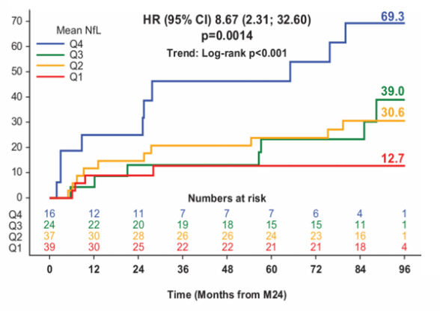
Biomarkers
Neurofilament light chain – Disability
NfL is a cytoskeleton protein released into CSF and blood following axonal damage
Post-hoc analysis of NfL levels over 1-2 years¹
A single NfL assessment was not predictive of
6-month confirmed disability progression
Predictive value was stronger with serial assessments over 1-2 years
Highest NfL quartile was 8-fold more likely to progress to EDSS >4.0 vs. lowest quartile
In progressive MS, baseline NfL levels shown to be higher in SPMS vs. PPMS patients (32.1 vs 22.0 pg/mL)²
Cumulative probability of EDSS >4 by NfL quartile over 24 months (2-5 values)
1. Kuhle et al. ECTRIMS 2018; abstract P1227. 2. Kuhle et al. ECTRIMS 2018; abstract 286.
Notes:
Abstract: P1227 – Kuhle et al. An integral measure of serial neurofilament light chain assessments in blood is a predictor of long-term disability progression in relapsing-remitting multiple sclerosis
Background: Neurofilament light (NfL) chain is a cytoskeletal protein that is released into the cerebrospinal fluid and eventually in blood following neuroaxonal injury. In relapsing-remitting multiple sclerosis (RRMS), single measurements of elevated NfL concentrations (e.g. at baseline) are correlated with disease activity and are predictive of mid-term lesions and brain atrophy. We hypothesise that an integral measure of several NfL assessments over time may predict long-term disability outcomes in RRMS.
Objective: To assess the predictive value of serial NfL assessments collected over 1 or 2 years in reaching time to 6-month confirmed disability progression (6mCDP) and time to Expanded Disability Status Scale score of 4 or more (EDSS≥4).
Methods: This post hoc analysis included data from the Phase 3 FREEDOMS trial in patients with RRMS who were randomised to fingolimod 0.5 mg, and continued on the same dose when transitioned into the LONGTERMS extension. The NfL assessments were collected at baseline, and Months 6, 12, 18 and 24 in a subset of patients (N=146). The predictive value of NfL was analysed using a log-rank test and a Cox proportional hazards model with adjustments for sex, age, baseline EDSS, number of relapses in the 2 years prior to study, and quartiles of the geometric mean NfL over 1 or 2 years. The response variable was 6mCDP or time to EDSS≥4 starting after 1 or 2 years. Results are provided with a global log-rank test across all NfL categories, and with a hazard ratio (HR; 95% confidence interval) between the lowest and highest NfL category.
Results: Patients with the highest quartile of NfL were twice as likely to have a 6mCDP compared to the lowest quartile when using the geometric mean NfL over 1 year (log-rank test, p=0.0712; Cox: HR=2.0 [0.81; 5.00], p=0.133) and 2.3-times as likely when using the mean NfL over 2 years (p=0.0221; Cox: HR=2.3 [0.77; 6.81], p=0.137). Patients with the highest quartile of NfL were 3.69-times as likely to reach EDSS≥4 compared to the lowest quartile when using the mean NfL over 1 year (p=0.0034; Cox: HR=2.0 [1.31; 10.4], p=0.014) and 8.7-times as likely when using the mean NfL over 2 years (p=0.0007; Cox: HR=2.3 [2.31; 32.6], p=0.0014).
Conclusion: NfL in blood fulfils a critical requirement as a prognostic biomarker in MS. It predicts long-term physical disability progression in patients with RRMS when taking the mean of several NfL assessments within a period of at least 12 months.
Abstract: 286 – Kuhle et al. Neurofilament light levels in the blood of patients with secondary progressive MS are higher than in primary progressive MS and may predict brain atrophy in both MS subtypes
Background: Neurofilament light chain (NfL) is considered a blood biomarker for monitoring neuronal damage, disease activity and treatment response in multiple sclerosis (MS). While the vast majority of studies on blood NfL concentrated on patients with relapsing-remitting MS (RRMS), little is known about blood NfL levels in patients with progressive MS.
Objective: To compare blood NfL baseline levels and to assess the prognostic potential of NfL for brain atrophy in patients with primary progressive MS (PPMS) and secondary progressive MS (SPMS) in placebo-controlled Phase 3 trials of fingolimod (INFORMS) and siponimod (EXPAND), respectively.
Method: Blood NfL levels in patients with SPMS (n=1452; mean age: 48.2 years; EDSS: 5.4) and patients with PPMS (n=378; mean age: 48.7 years; EDSS: 4.6) were retrospectively analysed. The NfL levels at baseline were quantified using Single Molecule Array technology and grouped into 3 categories (low: < 30, medium 30-60, high: > 60). High and low baseline NfL categories were compared using Chi-square and Wilcoxon rank sum tests. The association of baseline NfL levels with MRI parameters was done by Spearman rank correlation (Gd+ lesion count, T2 lesion volume) and the Jonckheere Terpstra test (brain volume change).
Results: NfL levels (Geometric mean, pg/mL) at baseline were higher in SPMS patients than in PPMS patients (32.1 vs 22.0, p< 0.001). A similar trend was observed when patients of the same age were compared: SPMS patients had higher NfL levels than those with PPMS. Similarly, patients with no Gd+ lesions at baseline had NfL levels of 29.2 and 21.0 in SPMS and PPMS, respectively, while patients with Gd+ lesions had NfL levels of 45.0 in SPMS and 34.0 in PPMS. The Gd+ lesion count (SPMS: r=0.33; PPMS: r=0.26) and T2 lesion volume (SPMS: r= 0.29; PPMS: r=0.32) at baseline correlated best with baseline NfL (p< 0.0001, all). In both SPMS and PPMS patients, high NfL at baseline was associated with higher percentage of brain volume loss at Month 12 (high NfL vs low NfL: −0.8% vs −0.2% in SPMS, p< 0.0001 and −0.8% vs −0.4% in PPMS, p=0.0044) and at Month 24 (−1.5% vs −0.5% in SPMS and −1.9% vs −0.8% in PPMS; both p< 0.0001).
Conclusion: Patients with SPMS showed evidence for more ongoing neuronal loss than PPMS patients of comparable age, both in the presence and in absence of Gd+ lesions. In both SPMS and PPMS patients, NfL may serve as a prognostic marker of brain atrophy.

Slide 8
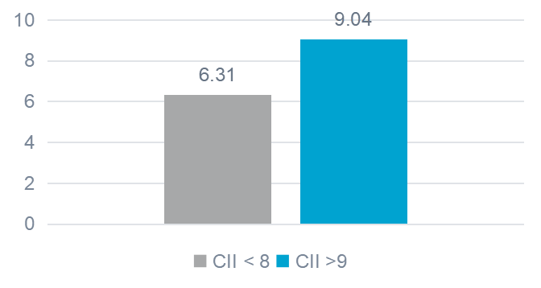
Biomarkers
NfL – Cognition
Serum NfL in MS patients according to Cognitive Impairment Index (CII)
Serum NfL levels were significantly higher in MS cases vs. age-matched controls (mean age 45 years)
  Serum NfL correlated with age
Positive correlation of serum NfL level and Cognitive Impairment Index (CII)*
Figure: Mean NfL was significantly higher in patients with more severe cognitive impairment (CII >9) vs. less severe cognitive impairment (CII < 8)
NfL was also correlated with measures of brain atrophy**
Serum NfL (pg/mL)
p=0.003
*CII calculated by summing z-scores for cognitive tests of memory and executive function
** Grey-matter density in right parahippocampus
Mattioli et al. ECTRIMS 2018; abstract P458.
Notes:
Abstract: P458 – Mattioli et al. Serum Neurofilament light chain concentration correlates with cognitive impairment and brain atrophy in relapsing remitting MS
Background: Neurofilaments are structural proteins of neurons, axons and dendrites and increased levels of neurofilament light chain (NfL) have been reported in serum of Multiple Sclerosis patients, correlating with CSF levels, disease severity, worse clinical outcome and MRI lesions. Current NfL observations do not include correlations with cognitive deficits and brain atrophy, which mostly have axonal loss as pathological substrate.
Objective: to evaluate in a sample of homogeneous MS patients with relapsing remitting course and same therapy, the correlation between serum NfL levels and cognitive impairment as well as brain atrophy.
Methods: 18 right handed relapsing remitting MS patients (mean age 45 years, mean EDSS 2), prescribed with interferon beta 1a from no more than a semester, were submitted to neuropsychological evaluation with Brief Repeatable Battery (BRB) and Delis Kaplan Executive Function Sorting (DKEFS) tests, MRI to assess gray matter volume and density and NfL serum concentration by using SR-X immunoassay analyzed, Simoa TM, which runs ultrasensitive paramagnetic bead-based enzyme-linked immunosorbent assays (Quanterix Corp, Boston, MA).
Results: a significantly increased serum NfL level was found in MS cases compared to age matched controls (p=.03). Serum NfL correlated with age (Pearson r=.58; p=.001). A positive correlation was found between serum NfL and Cognitive Impairment Index (CII, calculated by summing -z scores in each cognitive test, Spearman p=.04), memory (Selective reminding test, Spearman p< .05) and executive function (DKEFS Sorting test description p=.03) tests. More severely impaired patients in cognition (CII>8) had significantly higher serum NfL (9.04 pg/ml) than less severely impaired ones (6,31 pg/ml; Mann Whitney p=.003). A significant correlation was found between NfL and GM density in the right parahippocampus and between CII and GM density in the right prefrontal region.
Conclusions: serum NfL values are related to cognitive deficits and to measures of brain atrophy. These data, though obtained in a small sample, support the future use of serum NfL as a surrogate marker of disability in MS patients, with particular regard to axonal injury.

Slide 9
Biomarkers
NfL – Treatment effect
Assessment of serum NfL in DMD-treated patients in Swiss MS Cohort Study
Blood samples obtained from patients on continuous treatment with natalizumab, fingolimod, IFNβ and glatiramer acetate for 3-24 months
Results
NfL increased with aging (2.1%/year), EDSS (5.7%/step), and recent (<120 days) relapse (19.4%)
NfL decreased with time on DMD (-3.2%/year)
  Steeper decreases in NfL levels seen with natalizumab (-12.8%) and fingolimod (-6.8%) compared to IFNβ and GA
Baseline NfL level was predictive of relapse rate over the next 2 years in fingolimod-treated patients (80th percentile, IRR 2.3; 90th percentile, IRR 3.1)
A 10 pg/mL higher NfL level at baseline was associated with a 29% increase in relapse rate over the next two years (IRR 1.29)
Results support obtaining serial NfL levels for monitoring treatment response
Yaldizli et al. ECTRIMS 2018; abstract 262.
Notes:
Abstract: 262 – Yaldizli et al. Value of serum neurofilament light chain levels as a biomarker of suboptimal treatment response in MS clinical practice
Introduction: Serum neurofilament light chain levels (sNfL) reflect neuroaxonal damage and disease activity in MS and may qualify as a biomarker of suboptimal response to disease modifying therapies (DMT).
Objective: To investigate the predictive value of sNfL in relapsing remitting (RR)MS patients with established DMT on future MS disease activity in the Swiss MS Cohort Study.
Methods: All patients were on continuous DMT between 3-24 months prior to baseline (BL) serum sampling and the entire follow-up (median 2.0 [IQR 1.1;3.0] years). BL and yearly follow-up sNfL were measured by Single Molecule Array (Simoa) assay in 569, 79 and 88 serum samples from 182, 27 and 28 patients on fingolimod, natalizumab or interferon beta or glatiramer acetate (IFN/GLAT), respectively. We used generalized estimating equation models (without and with a [drug*treatment duration] interaction term) to investigate the associations between clinical and treatment parameters and log sNfL. BL sNfL was dichotomized according to age-corrected percentile categories derived from 254 healthy controls (Disanto et al., 2017). Negative binominal regression models were used to compare relapse rates in the following two years and calculate incidence rate ratios (IRR).
Results: sNfL independently increased with age (2.1%/year [95%CI:1.4;2.7], p< 0.001), EDSS (5.7%/step,[1.6;9.9], p=0.006) and recent (< 120 days) relapse (19.4% [0.1;42.5], p=0.05), whereas sNfL decreased with time on DMT (-3.2%/year [-0.9;-5.5],p=0.006). This decrease was -12.8% [-4.7;-20.3] steeper in patients on natalizumab (p=0.003) and -6.8% [-1.8;-11.7] steeper in fingolimod patients (p=0.009) compared with patients on IFN/GLAT. Patients on fingolimod with BL sNfL levels above vs below [n above/below] the respective percentiles had increasingly higher relapse rates within the following two years (80th percentile [43/139], IRR: 2.3 [1.1;4.9],p=0.036; 90th [28/154]: 3.1 [1.4; 6.9],p=0.005; 95th [19/163]: 4.1 [1.8; 9.5], p=0.001; 97.5th [14/168]: 5.9 [2.6; 13.2],p< 0.001; 99th [10/172]: 8.5 [4.0;18.3],p< 0.001), whereas there was no difference in the relapse rate one year before treatment start over all percentile cut-offs. A 10 pg/ml higher BL sNfL level (corrected for age, EDSS, previous on-treatment relapses) was associated with a 29% increase in relapse rate in the following two years (IRR:1.29 [1.16;1.43], p< 0.001).
Conclusion: Our data support the value of sNfL levels for treatment monitoring in MS clinical practice.

Slide 10
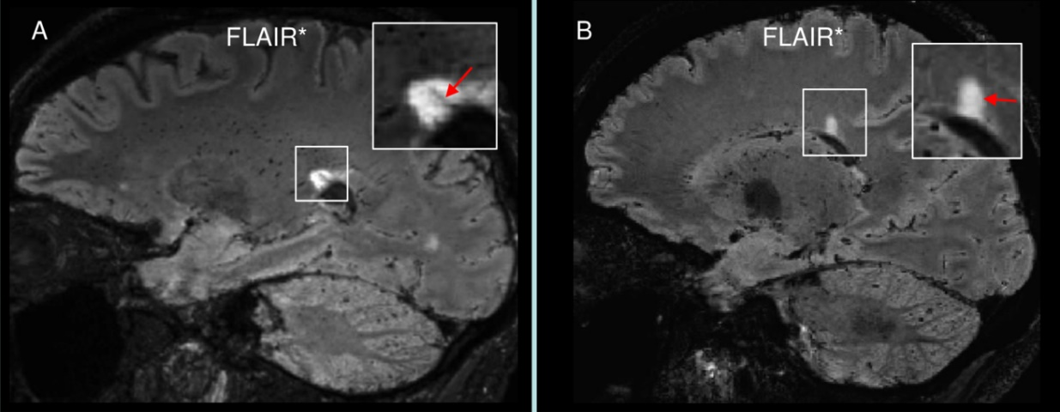
Biomarkers
Central vein sign
“Central vein sign” may help in the differential diagnosis of MS with atypical features but prospective studies have been lacking
Right: Prospective study confirmed MS in 12 of 17 patients using 3T FLAIR imaging¹
Percentage of perivenular lesions was >50% in all patients with a final diagnosis of MS, and < 50% in all patients with an alternative diagnosis*
STAR MS study (n=38)²
The proportion of WM lesions with CVS was 0.76 for MS and 0.26 for non-MS
MAGNIMS study group (n=606)³
3 positive CVS lesions on 3T2*w MRI differentiated CIS/MS from non-MS
STAR MS: Single Test to Arrive at MS diagnosis
Perivenular lesion with CVS later diagnosed with RRMS
B. Lesion without CVS later diagnosed with Sjogren
*Alternative diagnoses: Sjogren, lupus, spondyloarthritis,
SPG4-spastic-paraparesis and migraine
STAR MS, Single Test to ARrive at MS diagnosis
1. Maggi et al. ECTRIMS 2018; abstract P815. 2. Clarke et al. ECTRIMS 2018; abstract P650. 3. Sinnecker et al. ECTRIMS 2018; abstract 138.
Notes:
Abstract: P815 – Maggi et al. The “central vein sign” in patients with diagnostic “red flags“ for multiple sclerosis: a prospective multicenter 3T study
Introduction: MS misdiagnosis is a frequent problem, especially when clinical, imaging, or laboratory features are not typical for MS. The central vein sign (CVS) has been shown to help in the differential diagnosis, but most prior studies are retrospective. Prospective, multicenter studies starting from the time of initial work-up are needed to assess the true diagnostic value of the CVS, especially in difficult cases.
Objective: To prospectively assess the diagnostic predictive value of the CVS on 3T FLAIR* images in diagnostically difficult cases.
Methods: Patients with suspected MS who had clinical, imaging, or laboratory “red flags” (i.e., features atypical for MS5) underwent a single-standardized 3T MRI protocol in Milan, Italy; Brussels, Belgium; or Lausanne, Switzerland.3 FLAIR* images were generated and blindly analyzed by two independent observers for the presence of the CVS.2 All patients received an extensive work-up, and expert clinicians, blinded to the results of the CVS assessment, came to a final diagnosis. The value of the percentage of CVS-positive lesions to prospectively predict MS diagnosis was assessed.
Results: All patients (n=17) had at least one clinical (n=8), imaging (n=1), or laboratory (n=8) red flag at initial presentation. After an extensive work-up, MS was confirmed in a total of 12 patients, 4 of whom were diagnosed as having MS and a concomitant systemic inflammatory disorder. Five patients received an alternative diagnosis (neuro-Sjögren, neuro-lupus, spondyloarthritis, SPG4-spastic-paraparesis, and migraine). The percentage of perivenular lesions was >50% in all patients with final diagnosis of MS but < 50% in non-MS patients (n=5). Agreement between raters was 94% (16/17 cases).
Conclusions: Our data provide preliminary evidence that the CVS detected on 3T FLAIR* images can accurately predict MS diagnosis in patients suspected to have MS, but with atypical clinical, laboratory, and imaging features.
Abstract: P650 – Clarke et al. STAR MS: Single Test to ARrive at MS diagnosis; a prospective, investigator blinded pilot study assessing the accuracy of the ´Central Vein Sign´ using a single 3T MRI scan in diagnosing MS in cases of diagnostic uncertainty (NCT02485223)
Introduction: There is no single test for multiple sclerosis (MS). While current diagnostic criteria work well in patients with a typical presentation, atypical white matter lesions (WMLs) on MRI or unusual clinical presentations can cause diagnostic uncertainty in MS clinics. The 'central vein sign' (CVS) has been proposed as an MRI marker that could help differentiate between MS and other WM pathologies. Here we present the first prospective, investigator blinded study to evaluate the diagnostic value of the CVS as compared to the eventual clinical diagnoses in patients with diagnostic uncertainty at presentation.
Aims: To test the usefulness of the CVS in diagnosing MS using a single 3T T2* scan.
Objectives: To calculate the proportion of WMLs with CVs for each patient and classify them as MS if more than 40% of lesions have CVs. To calculate the sensitivity, specificity and positive and negative predictive values (PPV and NPV) of the CVS in diagnosing MS in patients with atypical presentation.
Methods: Patients with possible MS, brain WMLs, and discrepant neuroradiological reports were recruited from the Nottingham MS Clinic and had 3D T2* with high EPI MRI. Two blinded raters estimated the proportion of WMLs with CVs and proposed a diagnosis of MS or non-MS. Results were then compared to the diagnoses given by the patients' neurologist after clinical follow-up and further tests including oligoclonal bands (OBs).
Results: 38 patients were recruited, 24 of whom had already been given a clinical diagnosis. Raters 1&2 identified 765 & 711 WMLs, respectively. The proportion of WMLs with CVs was 0.76 for MS and 0.26 for non-MS as calculated by Rater1 and 0.84 for MS and 0.26 for non-MS for Rater2. Rater 1's agreement with the clinical diagnoses was 83.2% with 100% sensitivity, 73.3% specificity, PPV=69.2% and NPV=100%. Rater2 achieved 79.2% agreement, with 88.9% sensitivity, 73.3% specificity, PPV= 66.7% and NPV=91.7%.
Conclusions: This prospective study demonstrates that the CVS, assessed using a single 3T scan, is diagnostically useful in patients with diagnostic uncertainty and complements previous studies in established MS. In this diagnostically challenging group the CVS appears to be broadly as useful as OBs with similar sensitivity and specificity values to those of OBs cited in literature. Since a diagnosis of MS often leads to demanding disease modifying therapies, it is vital that neurologists use all the information available to ensure a correct diagnosis.
Abstract: 138 – Sinnecker et al. The central vein sign on cerebral 3T MRI in multiple sclerosis - a multi-center investigation under the auspices of the MAGNIMS study group
Background: The central vein sign (CVS) has been proposed as a imaging biomarker to differentiate multiple sclerosis (MS) from non-MS patients at advanced MRI. The diagnostic value of the CVS in clinical routine MRI at 3T, however, remains unknown.
Objective: To evaluate the sensitivity and specificity of various CVS-based criteria in differentiating MS from non-MS on clinical 3T MRI in a multi-center study.
Methods: 606 subjects with clinically isolated syndromes suggestive of MS (CIS, n=117), relapsing-remitting MS (RRMS, n=236; 108 with disease duration < 5 years), aquaporine-4 antibody positive NMOSD (n=32), systemic lupus erythematosus (n=25), migraine (n=29), cluster headache (n=5), diabetes mellitus (n=20), or other types of cerebral small vessel disease (n=142) were analysed.
The CVS was examined on parcellated 3T T2*weighted (T2*w) or susceptibility weighted imaging (SWI). The brain parcellation enabled blinding of the raters by avoiding inference on disease type based on the lesion distribution pattern. Sensitivity and specificity values were calculated for different MR sequences and various CVS-based criteria.
Results: 4447 lesions were analysed. The median proportion of a positive CVS was 50% (75% percentile: 67%, range 0-100%) in CIS/RRMS, and 0% (75% percentile: 25%, range 0-100%) in non-MS. A 35% threshold was the best CVS-proportion-based cut-off with a specificity and sensitivity of 82.9%, and 68.1% respectively. In addition, a two-CVS-positive-lesion threshold had a specificity and sensitivity in differentiating between RRMS/CIS and non-MS of 79.3%, and 76.2%, respectively. The specificity and sensitivity of a three-CVS-positive-lesions threshold was 89.0%, and 61.9%, respectively.
We observed comparable findings across all studied disease subgroups, and in patients with CIS or early RRMS as well.
The sensitivity was higher when applying an optimized T2*w sequence (35%-CVS-proportion threshold on T2*w: sensitivity 100%, specificity 86.7%). SWI data still yielded a sufficient differentiation between disease groups (35%-CVS-proportion threshold: sensitivity 66.6%, specificity 82.6%).
Conclusion: The CVS as evaluated on clinical 3T MRI has a high specificity in differentiating MS from non-MS and may thus be used to support the diagnosis of MS. The sensitivity is moderate on SWI and increases when using optimized T2*w imaging. A 35%-proportion-based and a three-positive-CVS-lesions threshold best differentiated between MS and non-MS.

Slide 11
MRI
Myelocortical MS (MCMS)
Myelocortical MS: subtype of MS with demyelination of spinal cord/cerebral cortex with no WM lesions¹
  Autopsy study found 12% of confirmed MS cases had no WM demyelination²
  Spinal cord demyelination area greater in typical MS vs. MCMS (13.8% vs. 3.8%)
Cortical neuronal density significantly decreased in MCMS despite the lack of WM demyelination
  More extensive neuronal loss in MCMS vs. typical MS
  Swollen myelinated axons a pathological correlate of WM regions with MRI abnormalities
Challenges the paradigm that WM demyelination is a prerequisite for neurodegeneration
1. Trapp et al. ECTRIMS 2018; abstract 1. 2. Trapp et al. Lancet Neurol 2018;17:870-884.
Notes:
Abstract: 1 – Trapp et al. Myelocortical multiple sclerosis: cortical neuronal loss in the absence of cerebral white matter demyelination
Background: Demyelination of cerebral white matter is thought to drive neuronal degeneration and permanent neurological disability in individuals with multiple sclerosis (MS). Brain magnetic resonance imaging (MRI) studies, however, support the possibility that demyelination and neuronal degeneration can occur independently. The purpose of this study was to investigate whether post-mortem MS brains show pathological evidence of cortical neuronal loss that is independent of cerebral white-matter demyelination.
Methods: Visual examination of centimeter-thick slices from 97 post-mortem MS brains identified 12 without evidence of cerebral white-matter demyelination. Demyelination was quantified histologically in cerebral white matter, cerebral cortex, and spinal cord and compared with demyelination in 12 cases of MS with cerebral white-matter lesions. Atrophy, MRI metrics, cortical neuronal densities, and pathological correlates of MRI abnormalities were compared.
Results: Cases without cerebral macroscopic lesions had demyelination in spinal cord and cortex, but a paucity of histologic cerebral white-matter demyelination. Despite the lack of cerebral white-matter demyelination, cortical neuronal loss, cortical thinning, and cerebral white-matter MRI abnormalities were significantly increased compared to brains from healthy controls and were similar to those in MS brains with cerebral white-matter demyelination. In the 12 brains without cerebral white-matter demyelination, swollen myelinated axons were the pathological correlate of white-matter regions with MRI abnormalities.
Conclusions: A subtype of MS, which we call myelocortical multiple sclerosis (MCMS), is characterized by demyelination of spinal cord and cerebral cortex, but not of cerebral white matter. Cortical neuronal loss is not accompanied by cerebral white-matter demyelination and is therefore an independent pathological event in MCMS.

Slide 12
MRI
Role of spinal cord imaging – 3T MRI
Spinal cord atrophy and SPMS¹
Accelerated SC atrophy rate (-2.28 mm²/year) prior to conversion to SPMS compared to matched RRMS patients (-0.74 mm²/year)
Change in SC atrophy rate detectable 4 years prior to SPMS onset
More rapid SC atrophy rate in males
Mild disability may be associated with significant spinal cord atrophy²
Early SC atrophy (-5.1%) in males with EDSS < 2.5
SC atrophy was -5.6% in patients with EDSS 3.0–3.5
SC atrophy up to -16.0% in patients with EDSS 4.0–4.5 and >5.0
1. Bischof et al. ECTRIMS 2018; abstract P1745. 2. Vaneckova et al. ECTRIMS 2018; abstract P794.
Notes:
Abstract: P1745 – Bischof et al. Accelerated cord atrophy precedes conversion to secondary progressive disease in relapsing multiple sclerosis
Background: A major challenge in multiple sclerosis (MS) research is the understanding of progressive disease. Magnetic resonance imaging (MRI) measures might provide useful surrogates of disease progression and disability. Among all radiographic measures, spinal cord area shows the strongest correlations with MS disability and discriminates progressive from relapsing-remitting (RR) disease subtypes. Here, a novel method to accurately capture upper cervical cord area from legacy brain MRI scans was utilised to longitudinally evaluate the utility of spinal cord atrophy as a surrogate marker for impending conversion to secondary progressive MS (SPMS).
Methods: In a single centre observational study, 57 of 507 RRMS subjects converted to SPMS during the 12-year observation period. We matched them, using demographic and clinical criteria, to 57 RRMS subjects who remained RRMS during the observation period. From brain MRI, we analysed brain measures and spinal cord area at C1 level over 12 years to evaluate their potential to discriminate between the two matched subgroups during the pre-conversion period.
Results: Subjects who developed SPMS showed accelerated spinal cord atrophy rates (-2·28 mm2/year, standard error (SE) 0·21) before conversion to a SP course compared to their RRMS matches (-0·74 mm2/year, SE 0·21, p< 0·0001), with men demonstrating a more rapid decline. Our data suggest that this difference exists at least four years before conversion to SPMS. Measures of brain atrophy and white matter lesions did not discriminate between the groups.
Conclusion: Upper cervical cord atrophy, as obtained from routine brain MRI, is a strong indicator of impending conversion to SPMS. As cervical atrophy likely reflects a generalised neurodegenerative process, it could be used to study the role of genetic, epidemiologic and immune variables on MS, and to measure the long-term impact of treatment in clinical trials.
Abstract: P794 – Vaneckova et al. Cerebellar and spinal cord volume reduction is prominent even in patients with mild disability in multiple sclerosis
Background: Accelerated regional brain (BVL) and spinal cord volume (SCV) loss are well described in MS patients. However, large sample studies investigating timing of volume loss onset and its relation to disability in multiple sclerosis (MS) patients are lacking.
Objective: To compare regional brain (BV) and spinal cord volume (SCV) in different disability groups.
Methods: We examined 1197 MS patients on a 3T MRI scanner (MAGNETOM Skyra, Siemens Healthcare, Erlangen, Germany). The MRI protocol comprised 3D-T2WI-Fat-Sat in transversal plane for SCV and 3D-MPRAGE for total brain volume (TBV). Regional BV and TBV were estimated by the fully automated FreeSurfer program. SCV was measured semi-automatically in 21 1mm slices centered at the C3/C4 intervertebral disc. Disability status was measured using the Expanded Disability Status Scale (EDSS). Patients were divided into 5 disability groups: Group 1 (EDSS 1.5), Group 2 (EDSS 2.0 to 2.5), Group 3 (EDSS 3.0 to 3.5), Group 4 (EDSS 4.0 to 4.5), and Group 5 (EDSS ≥5). Regional BV and SCV in groups 1-5 were compared with a reference group consisting of patients with minimal disability (EDSS 0-1.0). Subjects in each group were matched with a reference subgroup according to age, sex and disease duration. Comparison of total and regional BV and SCV between Groups 1-5 and reference subgroups were performed using paired t-tests, done separately for male and female.
Results: Significant volume loss (p< 0.05; given in % for female/male) was found in the cerebellum as early as Group 2 (-2.7/-4.3), and also in the male spinal cord (-5.1%); in Group 3 volume loss was found in the spinal cord (-5.6/-6.4), brainstem (-4.6/-5.2), putamen (-3.4/-6.0), pallidum (-4.7/-6.9), hippocampi (-3.2/-4.6), and cortex (-3.9/-3.1). In Groups 4 and 5, highly significant reductions up to 16% were observed for the vast majority of structures (male patients in Group 5 were not assessed due to small sample size).
Conclusions: Significant reductions of regional brain and spinal cord volumes are detectable even in patients with low clinical disability (i.e. cerebellum and spinal cord) and increase dramatically with EDSS progression. Finding an appropriate volumetric marker for each stage of multiple sclerosis has potential to improve radiological monitoring of disease burden in individual MS patients.

Slide 13
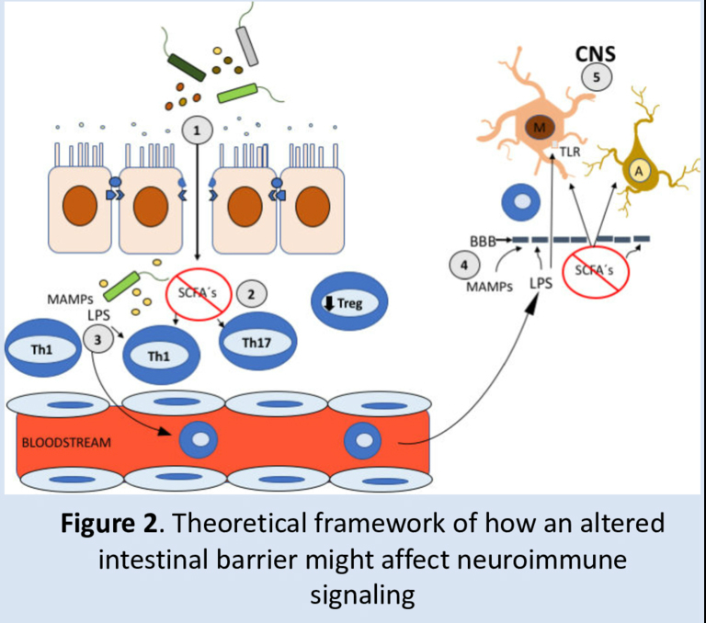
Gut microbiome and MS – Emerging concepts
Increased intestinal permeability reported in MS patients
Disruption of the intestinal barrier in GI disorders is associated with CNS demyelination
Intestinal microbiome contents entering into the circulation may affect the function of CNS microglia¹
Study of 29 CIS patients in the Minocycline-CIS trial matched to healthy controls and IBD patients²
Measured serum levels of Intestinal Fatty-Acid Binding Protein (IFABP), a marker of intestinal barrier integrity
Results
Higher IFABP levels in CIS/early MS vs. controls
IFABP correlated with EDSS, number of active MRI lesions and inflammatory mediators (e.g. TNFα)
An altered intestinal barrier was associated with higher concentrations of MMP-1
  MMP-1 alters tight junctions in the intestinal barrier as well as in the blood-brain barrier
1. Camara-Lemarroy et al. Brain 2018;141:1900-16. 2. Camara et al. ECTRIMS 2018; abstract P854.
Notes:
Abstract: P854 – Camara et al. Patients with early MS and an altered intestinal barrier have a distinct immunologic phenotype
Introduction: Patients with Multiple Sclerosis (MS) have increased intestinal permeability. An altered intestinal barrier could lead to the translocation of gut commensals and associated molecules into the circulation that alter immunologic responses.
Objectives and Aims: Our aim was to measure the serum levels of Intestinal Fatty-Acid Binding Protein (IFABP), a marker of intestinal barrier integrity, in patients with early MS/Clinically Isolated Syndrome (CIS). Inflammatory mediators including multiple cytokines, chemokines, growth factors and matrix metalloproteases were also quantified.
Methods: We included Calgary site patients from the Minocycline-CIS trial (Metz et al., New Engl J Med 376:2122, 2017), who experienced a first clinical demyelinating event (29 patients with a mean age of 32.2 ± 9.1 years, where 62% were female). We used 10 age and sex matched healthy individuals as controls and 5 patients with Inflammatory Bowel Disease (IBD) as positive controls (for IFABP levels only). Pre-treatment blood-samples were used to measure IFABP by ELISA and cytokine levels by Luminex® Assay. Clinical (EDSS), demographic and outcome measures (conversion to Definite MS) were analyzed.
Results: Patients with early MS/CIS have higher concentrations of IFABP than controls, indicating an altered intestinal barrier. IFABP levels were not associated with age or sex, but they were significantly correlated with EDSS. When comparing patients with an altered intestinal barrier to those with an intact barrier, we found differences in the concentrations of several immune mediators. Notably, patients with an altered intestinal barrier had higher concentrations of TNF-alpha, MMP-1, and MMP-1/TIMP-1 ratio, while patients with an intact barrier had higher concentrations of GCSF, GMCSF, IP10, MCP-3 and IL-18.
Conclusions: Some patients with early MS/CIS have an altered intestinal barrier. This subgroup also has a distinct immunologic phenotype. The clinical relevance of these differences remains to be elucidated.

Slide 14
Environmental risk factors
Vitamin D and smoking – BENEFIT 11-year data
Prospective evaluation of BENEFIT dataset of CIS patients
N=278 followed for 11 years
Assessments: 25(OH)D, cotinine (nicotine metabolite), EBNA-1 IgG, PASAT-3, NfL
Results
25(OH)D predicted better long-term cognitive outcomes
  A 50-nmol/L increment in first 2 years associated with:
    65% lower risk of a worse PASAT score in year 11
    20% lower NfL level
Smoking predicted worse cognitive outcomes
  NfL levels were 29% higher in smokers vs. non-smokers
EBNA-1 not associated with cognitive function or NfL
Cortese et al. ECTRIMS 2018; abstract 321.
EBNA-1, Epstein–Barr virus nuclear antigen 1
Notes:
Abstract: 321 – Cortese et al. Vitamin D, smoking, EBV and long-term cognitive performance among CIS patients: 11-year follow-up of BENEFIT
Background: Cognitive impairment is a disabling problem in multiple sclerosis (MS). Whether known MS risk factors, especially modifiable ones, predict long-term cognitive status in patients is unknown.
Objective: To evaluate whether vitamin D, smoking, and Epstein-Barr virus (EBV) predict long-term cognitive status in clinically isolated syndrome (CIS) patients.
Methods: We prospectively assessed serum 25-hydroxyvitamin D (25(OH)D) (vitamin D biomarker), cotinine (tobacco use biomarker), and EBV nuclear-antigen 1 (EBNA-1) immunoglobulin G levels at several times (baseline, months 6, 12, 24; vitamin D: also years 5, 11) among the 468 CIS patients participating in BENEFIT (Betaferon/Betaseron in Newly Emerging Multiple Sclerosis for Initial Treatment). We followed 278 patients for 11 years to assess cognitive function by Paced Auditory Serial Addition Test (PASAT-3); further we measured serum neurofilament light chain (NfL), a marker of neuro-axonal injury. The estimates and 95% confidence intervals (CI) from linear and logistic regression models were adjusted for age, sex, initial treatment allocation, steroid treatment, multifocal symptoms, T2-lesions, and body mass index.
Results: Higher 25(OH)D levels predicted better, and smoking predicted worse long-term cognitive function. A 50nmol/l increment in mean vitamin D within the first 2 years was related to 65% lower odds of scoring worse on the PASAT (below median) at year 11 (OR=0.35; 95% CI: 0.14-0.89, p=0.027). Standardized PASAT scores (mean=0, SD=1) were lower in smokers (cotinine >25ng/ml in all measurements: ß=-0.26, 95% CI: -0.69, 0.17) and heavy smokers (cotinine >189ng/ml, median in smokers, in all measurements: ß=-0.81, 95% CI: -1.60, -0.02) than non-smokers (p-trend=0.036). EBNA-1 levels after clinical onset did not predict cognitive function (p-trend across quartiles= 0.73). Associations with NfL concentrations at year 11 corroborated the main findings. A 50nmol/l increase in mean 25(OH)D the first 2 years was associated with 20% lower NfL (95% CI: 0.64-0.99, p=0.05), and smokers had 29% higher NfL levels as non-smokers (95% CI: 1.08-1.54, p=0.006), while EBNA-1 was not associated with NfL.
Conclusions: Vitamin D elevation and smoking cessation after clinical onset might protect cognitive function and neuronal integrity long-term in CIS patients.

Slide 15
Environmental risk factors
Abdominal obesity and MS
Childhood/adolescent obesity associated with increased risk of developing MS¹ (female > male)
Higher BMI during MS not associated with a more severe clinical course (except in obese smokers)^{2,3}
NARCOMS survey examined possible association of abdominal obesity and disability⁴ (n=6231)
Waist circumference was associated with an increased risk of severe vs. mild disability (odds ratio 1.61)
  Waist circumference: Females >89 cm, Males >102 cm
  A 5-cm increase in waist circumference was associated with a 24% increased risk of severe vs. mild disability
1. Liu et al. Neuroepidemiology 2016;47:103-108. 2. Bove et al. Mult Scler Relat Disord 2016;8:136-40. 3. Manouchehrinia et al. Front Neurol 2018;9:232. 4. Fitzgerald et al. ECTRIMS 2018; abstract P409.
Notes:
Abstract: P409 – Fitzgerald et al. Abdominal obesity is associated with more severe disability in a large population of people with multiple sclerosis
Background: Metabolic syndrome and related vascular disorders such as diabetes and hyperlipidemia are overrepresented in people with multiple sclerosis (MS) and are associated with adverse MS outcomes. Excess visceral adiposity, approximated using waist circumference (WC),is a strong risk factor for metabolic comorbidity in the general population and is associated with poorer outcomes in other neurologic diseases. Whether abdominal obesity is associated with disability and symptom severity in people with MS is unknown.
Objective: To evaluate the association between abdominal obesity as measured by WC and disease characteristics in a large population of people with MS.
Methods: As a part of the Fall 2017 semi-annual survey, North American Research Committee on MS (NARCOMS) registry participants reported height and weight (used to calculate body mass index [BMI] as kg/m2) and were mailed a tape measure with detailed instructions on how to measure WC. We considered WC as a continuous variable and used WC cut-points derived from the abdominal obesity criteria for the metabolic syndrome (men: WC≥102 cm; women: WC≥89 cm). We assessed the association between WC and disability status, as measured using Patient-determined Disease Steps (PDDS), and symptom severity (using Performance Scales© and NARCOMS depression and pain scales) using multinomial models (comparing moderate vs. mild and severe vs. mild disability or symptom severity), adjusting for age, sex, income, smoking status, disease-modifying therapy, and symptom duration.
Results: Of the 6231 responders with MS, 4309 (69%) reported WC in addition to BMI. Of these, 52% meet criteria for the abdominal obesity component of metabolic syndrome (men: WC≥102 cm; women: WC≥89 cm). In multivariable models adjusting for BMI, WC meeting this criterion was independently associated with a 61% increased odds of severe vs. mild disability (OR: 1.61; 95% CI: 1.30-2.01). In stratified models among normal weight individuals (BMI: 18.5-25), a 5 cm increase in WC was associated with 24% increased odds of severe vs. mild disability (OR: 1.24; 95%CI: 1.15-1.35). WC was not independently associated with depression, fatigue or pain severity in models adjusted for BMI.
Conclusions: Increased WC is associated with more prevalent severe disability, even after adjusting for overall obesity level. Longitudinal studies should evaluate whether excess abdominal obesity is a predictor of future changes in disability and symptom severity.

Slide 16
Treatment studies
RRMS
  Long-term studies – Dimethyl fumarate, Ocrelizumab, Alemtuzumab, Natalizumab
  Subgroup analyses – Oral cladribine
Progressive MS
  Ocrelizumab, MD1003
Novel therapies – Bruton’s tyrosine kinase (Btk) inhibitors
Safety
  Pregnancy outcomes
  Ocrelizumab

Slide 17
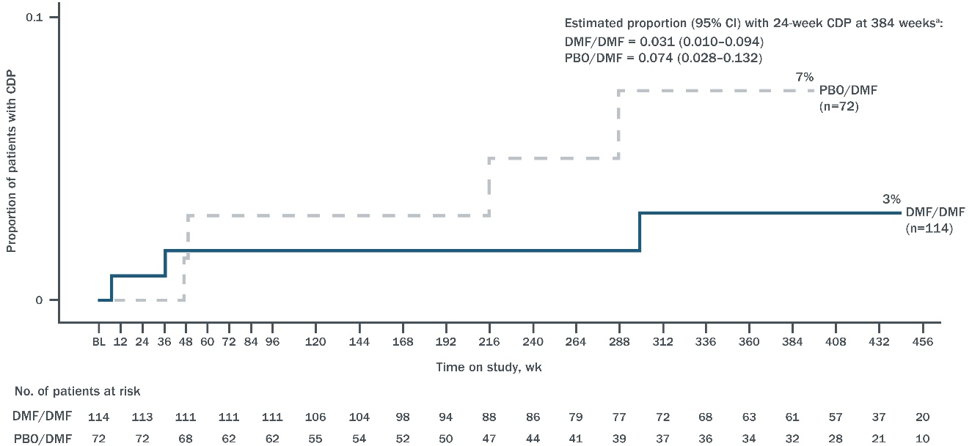
Long-term data
ENDORSE – Dimethyl fumarate
Proportion of newly-diagnosed patients with
6-month CDP to EDSS score ≥4 over 7.4 years weeks
Subgroup analysis of newly-diagnosed RRMS patients* who completed DEFINE and CONFIRM trials and enrolled in ENDORSE long-term follow-up (n=229)
At ~9 years, 50% of DMF/DMF and 45% of PBO/DMF patients were still on treatment
ARR remained low: 0.14 (DMF/DMF) and 0.15 (PBO/DMF)
EDSS < 4.0 in 93% of both groups at year 9
83% of DMF/DMF group and 77% of PBO/DMF group had no 6-month CDP
~50% remained free of clinical disease activity
*Defined as diagnosed ≤1 year before DEFINE/CONFIRM entry and either treatment-naive or previously treated with corticosteroids alone
CDP, confirmed disability progression
Gold et al. ECTRIMS 2018; abstract P920.
Notes:
P920 – Gold et al. Delayed-release dimethyl fumarate demonstrates sustained efficacy over nine years in newly diagnosed patients with relapsing-remitting multiple sclerosis
Introduction: Long-term follow-up data are useful to characterise the efficacy and safety of disease-modifying therapies when initiating treatment in newly diagnosed patients with relapsing-remitting multiple sclerosis (RRMS). Delayed-release dimethyl fumarate (DMF) demonstrated strong efficacy and a favourable benefit-risk profile in RRMS patients in Phase 3 studies (DEFINE/CONFIRM), which is sustained in the ongoing extension study, ENDORSE (NCT00835770).
Objectives: To evaluate efficacy in newly diagnosed patients with RRMS treated with DMF for ~9 years.
Methods: “Newly diagnosed” patients were diagnosed with MS ≤1 year before DEFINE and CONFIRM study entry and were either treatment-naïve or previously treated with corticosteroids alone. An integrated analysis of newly diagnosed patients who continued after 2 years onto the ENDORSE study assessed annualised relapse rate (ARR) and expanded disability status scale (EDSS) score. Results are reported for patients treated with DMF 240 mg BID: placebo (PBO)/DMF (PBO for Years 0-2 /DMF for Years 3-9) or continuous (DMF/DMF) treatment.
Results: As of September 2017, all newly diagnosed patients have total follow-up (including DEFINE/CONFIRM) ~9 years (median 8.6 years, range 2.1-10.8, 1 year=48 weeks); among whom 50% (72/144) DMF/DMF and 45% (38/85) PBO/DMF remained on treatment. The primary reason for discontinuation was 'other' for DMF/DMF (17/61: 'want/become pregnant´ n=7; ´moving to a different city/country´ n=3; ´site closure´ n=2; other reasons n=5) and 'adverse event' for PBO/DMF (14/43). 7/61 and 3/43 patients in the DMF/DMF and PBO/DMF groups, respectively, discontinued the study specifically due to MS. Over 9 years, adjusted ARR (95% CI) was 0.14 (0.10-0.18) for DMF/DMF and 0.15 (0.10-0.23) for PBO/DMF. For PBO/DMF, adjusted ARR (95% CI) was 0.25 (0.18-0.37) for Years 0-2 (PBO) and 0.09 (0.06-0.14) for Years 3-9 (DMF); the rate ratio (95% CI) was 0.36 (0.23-0.55; P< 0.0001), representing a 64% decrease in ARR after initiating DMF. The observed proportion of patients with EDSS ≤3.5 was 129/139 (93%) and 65/72 (90%) at Year 2, and 50/54 (93%) and 26/28 (93%) at Year 9 for DMF/DMF and PBO/DMF, respectively.
Conclusions: The majority of patients remaining on study maintained walking abilities (EDSS ≤3.5) over 9 years. ARR decreased significantly in PBO/DMF patients after initiating DMF, and remained low for newly diagnosed patients after 9 years.

Slide 18
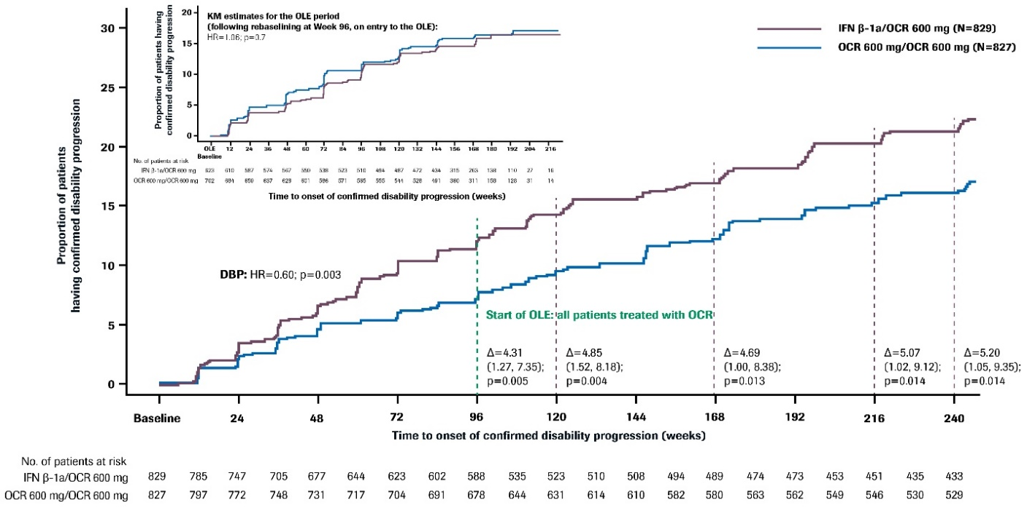
Long-term data
OPERA I/II – Ocrelizumab – 5-year data
3-year follow-up of OPERA I/II trials
ARR remained low in continuous OCR group (0.065 in Year 5)
In the IFNβ/OCR group, ARR decreased from 0.20 at time of switch to 0.07 in Year 5
Proportion with 6M CDP was lower in OCR/OCR vs. IFNβ/OCR group:
  Year 2: 7.7% vs. 12.0%
  Year 3: 10.1% vs. 15.6%
  Year 4: 13.9% vs. 18.1%
  Year 5: 16.1% vs. 21.3%
The proportion of patients with 6M confirmed disability improvement with continuous OCR was 25.8% in Year 5
6M CDP, 6-month confirmed disability progression
Hauser et al. ECTRIMS 2018; abstract P590.
Notes:
Note: Safety data are shown on slide 25
P590 – Hauser et al. Long-term reduction of relapse rate and confirmed disability progression after 5 years of ocrelizumab treatment in patients with relapsing multiple sclerosis
Background: The efficacy and safety of ocrelizumab (OCR) in relapsing multiple sclerosis (RMS) were demonstrated in the 96-week double-blind control period of OPERA I and OPERA II (NCT01247324; NCT01412333), and results for the 2-year follow-up of the pooled OPERA I and OPERA II open-label extension (OLE) period have previously been reported (Hauser SL, et al. AAN 2018; Abstract P1.366).
Objective: To assess the efficacy of switching to or maintaining OCR therapy on clinical measures of disease activity and progression after 3 years of follow-up in the OLE period of the OPERA I and OPERA II Phase III trials in RMS.
Methods: At the start of the OLE period, patients continued OCR (OCR-OCR) or were switched from interferon (IFN) β-1a to OCR (IFN-OCR). Adjusted annualised relapse rate (ARR), time to onset of 24-week confirmed disability progression (CDP24) and change in adjusted mean Expanded Disability Status Scale (EDSS) score from baseline were analysed.
Results: Overall, 88.6% of patients who entered the OLE completed OLE Year 3. Among IFN-OCR patients, ARR decreased from 0.20 in the year pre-switch to 0.10, 0.08 and 0.07 at Years 1, 2 and 3 post-switch (p< 0.001, Year 1 vs pre-switch; p=0.31, Year 1 vs Year 2; p=0.56, Year 2 vs Year 3). OCR-OCR continuers maintained the low ARR through the year pre-OLE and the 3 years of the OLE period (0.13, 0.11, 0.08 and 0.07). OCR-OCR continuers versus IFN-OCR switchers had lower proportions of patients with CDP24 in the year pre-switch and Years 1, 2 and 3 of the OLE period (7.7%/12.0%, 10.1%/15.6%, 13.9%/18.1% and 16.1%/21.3%; p< 0.05, all difference comparisons). Changes in mean EDSS scores from baseline in OCR-OCR continuers versus IFN-OCR switchers will also be presented.
Conclusions: Switching from IFN to ocrelizumab after 2 years at the start of the OLE period was associated with a rapid reduction in ARR. Both OCR-OCR as well as IFN-OCR patients maintained their robust reduction in ARR through the 3-year follow-up of the OLE period. After 5 years of follow-up, the proportion of patients with disability progression was lower in patients who initiated ocrelizumab treatment earlier (OCR-OCR), compared to patients who received initial IFN treatment (IFN-OCR switchers), showing that patients who initiated ocrelizumab 2 years earlier accrued significant and sustained reductions in disability progression compared to patients switching from IFN.

Slide 19
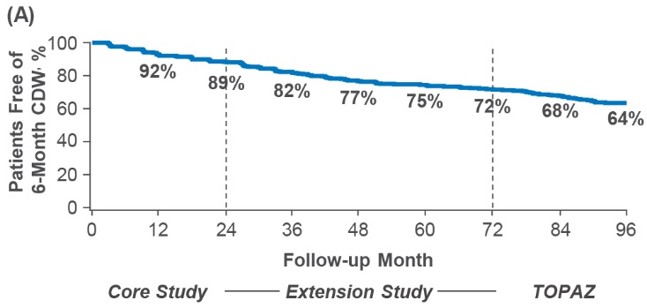
Long-term data
CARE-MS II – Alemtuzumab – 8-year data
6-year follow-up of the CARE-MS II trial
44% received no additional courses
ARR in Years 3-8 was 0.19
48% were relapse-free in Years 3-8
EDSS was stable/improved in 70%
Mean change in EDSS from core study baseline was 0.17
64% were free from 6M CDP in Year 8
47% had 6M confirmed disability improvement
Sustained NEDA for Years 3-8 was 15%
Proportion free of 6-month confirmed disability progression over 8 years
6M CDP, 6-month confirmed disability progression
NEDA, no evidence of disease activity
Singer et al. ECTRIMS 2018; abstract P590.
Notes:
P913 – Singer et al. Alemtuzumab improves clinical and MRI disease activity outcomes, including slowing of brain volume loss, in RRMS patients over 8 years: CARE-MS II follow-up (TOPAZ study)
Introduction: Over 2 years (y) in the CARE-MS II phase 3 trials (NCT00548405), 2 courses of alemtuzumab (12 mg/day; baseline: 5 consecutive days; 12 months later: 3 consecutive days) significantly improved clinical and MRI outcomes versus SC IFNB-1a in RRMS patients with inadequate response to prior therapy at baseline. In a 4-y extension (NCT00930553), patients could receive additional courses of alemtuzumab (12 mg/day on 3 consecutive days; ≥12 months apart) as needed for disease activity or receive other disease-modifying therapy (DMT) per investigator discretion; efficacy on clinical/MRI outcomes was maintained in the extension, with 50% receiving no additional alemtuzumab or other DMTs over 6 y after the initial 2 courses. Following the initial 4-y extension, patients could continue in TOPAZ (NCT02255656), an additional 5-y extension study, for further evaluation.
Aims: To evaluate the efficacy and safety of alemtuzumab over 8 y in CARE-MS II patients.
Methods: At the investigator's discretion, patients in TOPAZ can receive additional as-needed alemtuzumab (≥12 months apart; no criteria) or receive other DMT (at any time).
Results: Of the 435 patients who received alemtuzumab in CARE-MS II, 300 (69%) completed Y2 of TOPAZ (Y8 after initiating alemtuzumab). 44% received neither additional courses of alemtuzumab nor another DMT through Y8. Annualized relapse rate at Y8 was 0.18; 85% were relapse-free in Y8. 70% of patients had stable/improved EDSS scores from core study baseline through Y8; mean change in EDSS score from core study baseline to Y8 was 0.17. Through Y8, 64% of patients were free from 6-month confirmed disability worsening, and 47% achieved 6-month confirmed disability improvement. In Y8, 58% of patients achieved no evidence of disease activity, 70% were free of MRI disease activity, 89% were free of new Gd-enhancing lesions, and 70% were free of new/enlarging T2 hyperintense lesions. Median percent cumulative brain volume loss (BVL) from baseline through Y8 was -1.06%; reduction in BVL was 0.19% or less annually in Y3-8. The safety profile in Y8 was consistent with the previous years. The incidence of AEs, infections, and thyroid AEs continued to decline through Y8; no new cases of immune thrombocytopenia or nephropathy were seen.
Conclusion: Efficacy of alemtuzumab on clinical, MRI, and BVL outcomes was maintained over 8 y in the absence of continuous treatment in CARE-MS II patients, with a consistent and manageable safety profile.

Slide 20
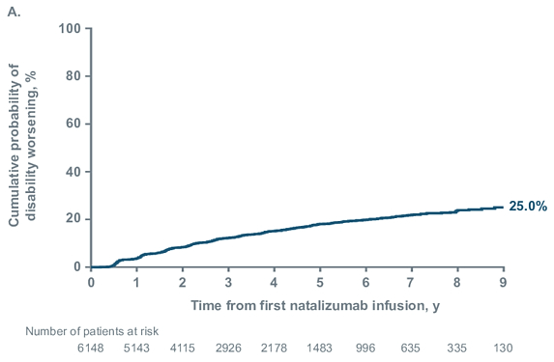
Long-term data
Natalizumab – 10-year observational data
Tysabri Observational Program (TOP) analysis of long-term natalizumab use (n=6149)¹
Median duration: 63 months
Median NTZ exposure: 38 doses
52.2% stopped NTZ, most commonly due to JCV Ab+ serostatus
ARR reduced 92.5% during treatment (1.99 to 0.15)
Cumulative probability of 6M CDP was 25.0% over 9 years
Probability of 6M disability improvement was 32.3% over 9 years
Overall prevalence of PML was 0.8%
  Extended-interval dosing (every 5-8 weeks) has been proposed to reduce PML risk²
6M CDP, 6-month confirmed disability progression
1. Kappos et al. ECTRIMS 2018; abstract P908. 2. Zhovtis Ryerson et al. ACTRIMS Forum 2018; abstract LB250.
Notes:
Abstract: P908 – Kappos et al. Real-world data from over 10 years in the TYSABRI® Observational Program: long-term safety and effectiveness of natalizumab in relapsing-remitting multiple sclerosis patients
Introduction: The TYSABRI Observational Program (TOP) began >10 years ago to inform on long-term safety and effectiveness of natalizumab (NTZ) in relapsing-remitting multiple sclerosis (RRMS) patients in clinical practice. TOP is the largest ongoing, real-world study of NTZ-treated patients.
Objectives: Report an interim analysis of safety and effectiveness in patients with up to 10 years of NTZ treatment in TOP, an open-label, multinational, prospective, observational study.
Methods: Annualised relapse rates (ARRs) for the year prior to starting NTZ and on NTZ (and ≤84 days post discontinuation) were compared using a repeated Poisson model. Confirmed Expanded Disability Status Scale (EDSS) worsening, an increase of ≥1.5 from a baseline (BL) of 0, ≥1.0 from a BL of 1.0-5.5, or ≥0.5 from a BL ≥6.0, and improvement, a decrease of ≥1.0 from a BL ≥2.0, while on NTZ were estimated by Kaplan-Meier analysis; confirmation could occur ≤84 days post discontinuation. Serious adverse events (SAEs) were assessed at clinical visits.
Results: As of November 2017, TOP included 6149 patients. At BL, mean EDSS score was 3.5; 90.6% had prior disease-modifying therapy (DMT) use. A total of 3210 patients (52.2%) discontinued NTZ; 2118 (34.4%) withdrew from TOP. Median exposure was 38 (range, 1-135) doses; median follow-up time was 63 (range, 1-131) months. ARR while on NTZ was reduced by 89.4% (from 1.99 pre-NTZ to 0.21 on NTZ; P< .001). Similarly, for those with BL EDSS scores < 3.0 or ≥3.0, ARR decreased by 91.0% (P< .001) and 87.9% (P< .001), respectively. For those with 0, 1, or ≥2 prior DMTs, ARRs were reduced by 92.7% (P< .001), 91.0% (P< .001), and 86.7% (P< .001), respectively. At 10 years, cumulative probabilities of 24-week-confirmed EDSS worsening and improvement were 32.9% and 35.5%, respectively. Overall, 828 of 6149 patients (13.5%) experienced ≥1 SAE (most commonly reported by system organ class: infections and infestations, 253 patients [4.1%]).
Conclusions: Since the TOP 5-year interim analysis (December 2012), cohort size (N=4821), median exposure (22 doses), and median follow-up time (26 months) have grown, and this analysis reinforces the consistent effectiveness particularly when used earlier in the disease and treatment course and the unchanged, established safety profile of NTZ, now assessed over 10 years. The planned continued follow-up for up to 15 years in TOP will provide the longest evaluation of real-world outcomes in NTZ-treated patients.

Slide 21
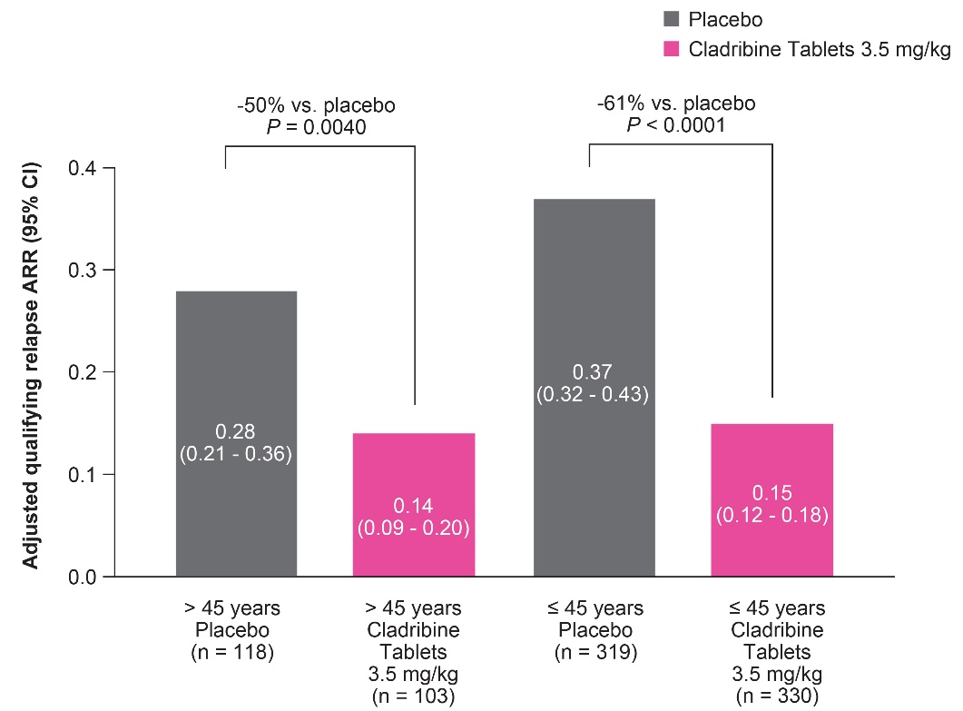
Oral cladribine – Effect by age group
ARR* in patients treated with oral cladribine 3.5 mg/kg stratified by age
CLARITY post-hoc analysis of treatment effect by age (< 45 years vs. >45 years) at 96 weeks
ARR: Oral cladribine 3.5 mg/kg showed comparable efficacy in both subgroups
Number of new Gd+ lesions/scan: >90% reduction from baseline with cladribine in both age groups
6M CDP: 14.6% for >45 years (vs. PBO 19.2%) and 8.2% for < 45 years (vs. PBO 17.5%)
NEDA: 55.6% vs. 28.2% of older patients and 39.6% vs. 9.5% of younger patients achieved NEDA with cladribine vs. placebo, respectively
Odds ratio for achieving NEDA with cladribine vs. PBO: 3.19 (>45 years) and 6.23 (≤ 45 years)
*Qualifying relapses. Results were similar for All relapses
6M CDP, disability progression confirmed at 6 months
Giovannoni et al. ECTRIMS 2018; abstract P1204.
Notes:
P1204 – Giovannoni et al. An exploratory analysis of the efficacy of cladribine tablets 3.5mg/kg in patients with relapsing multiple sclerosis stratified according to age above and below 45 years in the CLARITY study
Introduction: In the CLARITY study, treatment with Cladribine Tablets 3.5 mg/kg (CT3.5) showed strong efficacy vs placebo (PBO) over 2 years in a large cohort of patients with relapsing multiple sclerosis (RMS). Age-related variability in response to disease modifying treatments has been observed in patients with MS .
Objectives: In post hoc analyses, the effect of CT3.5mg/kg treatment was evaluated in patients with RMS above and below the age of 45 years.
Methods: The intention-to-treat population for the CT3.5 and PBO treatment groups of CLARITY was stratified according to age (≤45 and >45 years). Efficacy analyses were conducted for endpoints of qualifying relapse, all relapses, mean and cumulative numbers of new T1 gadolinium-enhancing (Gd+), active T2 and combined unique (CU) lesions.
Results: 649 patients were ≤45 years (CT3.5 N=330; median age of 34.5 years) and 221 were >45 years (CT3.5 N=103; median age of 51 years). There was a higher proportion of females in the older group (CT3.5 77.7%) than in the younger group (CT3.5 66.1%). Annualised qualifying relapse rate comparison at Week 96 showed that CT3.5 was associated with significant relative risk reduction vs PBO in both age groups (≤45 years: relative risk [RR] 0.39 [95% confidence interval (CI) 0.31,0.51], p< 0.0001; >45 years: RR 0.5 [95%CI 0.31,0.80] p=0.004). 'All relapse' data were comparable for the same age groups, respectively: 0.4 [95%CI 0.34, 0.49], p< 0.0001 and 0.52 [95%CI 0.37, 0.72], p< 0.0001. The number of cumulative new T1 Gd+ lesions at Week 96 was reduced with CT3.5 compared to PBO in both age groups. The mean number of active T2 lesions per patient per scan at Week 96 was also significantly reduced with CT3.5 versus PBO in both age groups (≤45 years: -0.667 [95%CI -0.67, -0.50], p< 0.0001; >45 years: -0.167 [95%CI -0.33, 0.00], p< 0.0001), as were mean number of CU lesions per patient per scan (≤45 years: -0.667 [95%CI -1.00, -0.67] p< 0.0001; >45 years; -0.333 [95%CI -0.33, 0.00] p< 0.0001).
Conclusions: CT3.5 treatment was efficacious in patients both above and below 45 years of age with respect to reduction of relapse frequency and number of MRI lesions, consistent with previous similar analyses.

Slide 22
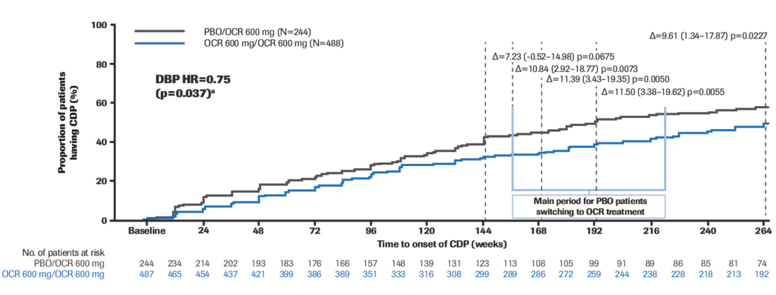
Progressive MS
Ocrelizumab – ORATORIO extension
Open-label extension of ORATORIO trial in PPMS
Total study duration was up to 5.5 years (264 weeks)
During the double-blind phase, the proportion with 6M CDP was 29.6% with OCR vs. 35.7% with placebo (HR 0.75)
At 5 years, the proportion with 6M CDP was 48.1% with OCR/OCR and 57.7% with PBO/OCR
The rate of progression on the composite endpoint* was 69.3% with OCR/OCR and 78.3% with PBO/OCR at 5 years
*Composite endpoint: Increase in EDSS, 20% increase in 9HPT or 20% increase in T25FW
6M CDP, disability progression confirmed at 6 months
Wolinsky et al. ECTRIMS 2018; abstract P910.
Notes:
Note: Safety data are shown on slide 25
Abstract: P910 – Wolinsky et al. Sustained reduction in confirmed disability progression in patients with primary progressive multiple sclerosis treated with ocrelizumab in the open-label extension period of the Phase III ORATORIO trial
Background: The efficacy and safety of ocrelizumab (OCR) in primary progressive multiple sclerosis (PPMS) were demonstrated versus placebo (PBO) in the Phase III ORATORIO study (NCT01194570).
Objective: To assess the efficacy of switching to or maintaining OCR therapy on disability progression, confirmed at 24 weeks, in the open-label extension (OLE) phase of ORATORIO.
Methods: For the double-blind period (DBP) of ORATORIO, patients (N=732) were randomised (2:1) to OCR or PBO and followed for ≥120 weeks until a prespecified number of confirmed disability progression (CDP) events occurred. At the end of the DBP, patients remained on blinded treatment as randomised until the outcome of the trial was ascertained (extended controlled period). At the start of the OLE period, patients continued (OCR-OCR) or were switched from PBO to OCR (PBO-OCR). By Week 240, the last patient had entered the OLE. Time to onset of 12- (primary endpoint) and 24-week-CDP (increase from baseline [BL] Expanded Disability Status Scale [CDP-EDSS] score of ≥1 point if BL EDSS ≤5.5 or ≥0.5 points if BL EDSS >5.5) and time to 24-week CDP on the 9-Hole Peg Test (CDP-9HPT, ≥20% increase from BL in the timed 9HPT from BL) were analysed up to Week 264 (all patients had ~2 years of OLE follow-up).
Results: Overall, 72% (527/732) patients entered the OLE. In the DBP, and compared with PBO, OCR reduced the risk of 24-week CDP by 25% (p=0.037) and 24-week CDP-9HPT by 45% (p< 0.001). At Week 168 (12 weeks after the first patients entered the OLE), the proportion of patients with 24-week CDP-EDSS in the PBO-OCR and OCR-OCR groups was 44.7% vs 33.3% (Δ=11.4%; p=0.005), respectively. At Weeks 192 and 264, the corresponding proportions were 49.3% vs 37.8% (Δ=11.5%; p=0.006) and 57.7% vs 48.1% (Δ=9.6%; p=0.023). At Week 168, the proportion of patients with 24-week CDP-9HPT in the PBO-OCR and OCR-OCR groups was 29.7% vs 17.9%, respectively (Δ=11.8%; p=0.001). At Weeks 192 and 264, the corresponding proportions were 32.5% vs 21.6% (Δ=10.9; p=0.005) and 39.5% vs 26.1% (Δ=13.4%; p=0.001).
Conclusions: After 5.5 years (264 weeks) follow-up, the proportion of patients with disability progression in EDSS and 9HPT was lower in patients who initiated OCR treatment earlier (OCR-OCR) compared to patients initially receiving PBO (PBO-OCR), showing that patients initiating OCR between 3-5 years (144-240 weeks) earlier accrued significant and sustained reductions in disability progression compared to patients switching from PBO.

Slide 23
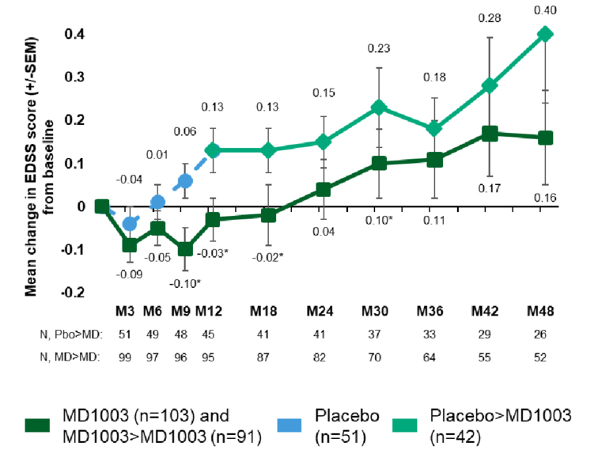
Progressive MS
MD1003 (Biotin) – 48-month follow-up
Open-label extension of the MS-SPI trial¹ of MD1003 in progressive MS*
At the end of the 1-year double-blind phase, the proportion with improvement in EDSS and/or T25FW was 12.6% with MD1003 vs. 0% with placebo
During the extension phase, the mean change from baseline in EDSS score remained numerically lower in the MD1003/MD1003 group vs. PBO/MD1003 group²
Differences were not significant at month 48
The discontinuation rate was 58% at month 48
*SPMS or PPMS, not clinically active and with evidence of spastic paraparesis
1. Tourbah et al. Mult Scler 2016;22:1719-31. 2. De Seze et al. ECTRIMS 2018; abstract P592.
Notes:
Abstract: P592 – De Seze et al. Effect of MD1003 (high dose pharmaceutical grade biotin) for the treatment of progressive MS: 48-month follow-up data
Background: MS-SPI was a 12-month (M) double-blind study where 154 patients (pts) with nonactive progressive multiple sclerosis (PMS) were randomised to MD1003 (n=103) or placebo (n=51). As reported previously, expanded disability status scale (EDSS) or timed 25-foot walk (TW25) improvement, mean EDSS (mEDSS) score, and clinical global impression (CGI) score were all significantly (P< 0.05) in favour of MD1003 relative to placebo (Tourbah et al. 2016). In the open-label extension phase, all pts received MD1003 after M12. Here, we present the 48M results (shown as MD1003>MD1003 [MM] vs placebo>MD1003 [PM]).
Objective: To evaluate the effects of MD1003 in pts with PMS during the open-label extension phase of the pivotal MS-SPI study.
Methods: A total of 133 pts (MM: 91; PM: 42) entered the extension phase. At M18, M24, M30, M36, M42 and M48 we assessed EDSS or TW25 improvement, mEDSS change from baseline, CGI, and adverse events (AEs).
Results: In the extension phase, where both groups received MD1003, EDSS or TW25 improvement remained higher for MM vs PM pts at M18 (13% vs 7%), M24 (8% vs 5%), M30 (10% vs 2%), M36 (13% vs 0%), and M42 (13% vs 3%) (each confirmed after 6M). The difference in mEDSS score between the MM and PM groups was significant at M30 (0.10 vs 0.23, P=0.041) but not at M24 (0.04 vs 0.15, P=0.13), M36 (0.09 vs 0.18, P=0.35), and M48 (0.16 vs 0.4, P=0.17). The 2 mEDSS evolution curves remained parallel, suggesting that earlier treatment leads to a lower disability at M48. CGI scores remained stable for MM pts and improved for PM pts upon switching to MD1003; the CGI scores were no longer significantly different at M24 (4.17 vs 4.24, P=0.75), M36 (4.11 vs 4.09, P=0.88), or M48 (4.40 vs 4.35, P=0.80). Between M42 and M48, AEs were experienced by 38% vs 34% of pts in MM and PM groups, respectively. The main reasons for treatment withdrawal throughout the study (n=86 pts) were consent withdrawal (30 pts), lack of efficacy (30 pts), and AEs (14 pts).
Conclusions: Results from the long-term extension phase of MS-SPI at 4 years of follow-up indicate that 1) the effects of MD1003 observed in the 12-month double-blind phase are sustained over time, 2) pts show improvement when switching from placebo to MD1003, 3) delayed treatment in PM pts results in higher disability over time, and 4) MD1003 is well tolerated over 48M. These data confirm previous observations made after 3 years of follow up.

Slide 24
In development
Evobrutinib – Btk inhibitor for MS
Bruton’s tyrosine kinase (Btk)¹
Required for B cell survival, activation, proliferation and differentiation
  Modulates B cell receptor (BCR) activation and autoantibody production
  Mature B cells are less dependent on Btk
Macrophages, neutrophils, dendritic cells and mast cells also express Btk but its role has not been well-defined
Btk inhibitors may impair B cell function without causing a profound humoral immunodeficiency
B cell inhibition shown to reduce the incidence and severity of EAE¹
Phase II dose-finding study of evobrutinib (n=267)
First clinical proof-of-concept study of Btk inhibitors in MS
Patients with RRMS or relapsing SPMS were randomized to one of three doses of evobrutinib (25 mg or 75 mg QD, 75 mg BID), placebo or a DMF 240 mg BID reference arm for 24 weeks
Results
Significant reduction in Gd+ lesions/scan with EVO 75 mg OD or BID
  Lesion rate ratio: 0.38 with 75 mg OD, 0.48 with 75 mg BID
ARR was 0.13 with EVO 75 mg QD, 0.08 with EVO 75 mg BID vs. 0.33 with placebo (not significant)
Rate of serious adverse events was higher with EVO 75 mg BID vs. placebo
  Cases of asymptomatic, reversible elevation in hepatic transaminases (ALT, AST)
1. Crofford et al. Expert Rev Clin Immunol 2016;12:763-73. 2. Sharma M. 8th Int. Symposium Curr Trends Healthcare
2018; abstract P1204. 3. Montalban et al. ECTRIMS 2018; abstract 322.
Notes:
Abstract: 322 – Montalban et al. Primary analysis of a randomised, placebo-controlled, phase 2 study of the Bruton's tyrosine kinase inhibitor evobrutinib (M2951) in patients with relapsing multiple sclerosis
Background: Evobrutinib (M2951) is a highly specific, irreversible, oral inhibitor of Bruton´s tyrosine kinase (BTK) that functionally impairs activation of B-cells and macrophages in vivo and may be effective in autoimmune disease. This study (NCT02975349) evaluated evobrutinib in clinically and radiologically active RMS.
Methods: In this double-blind, placebo (PBO)-controlled, 48-wk, Ph 2 study, patients (pts) aged 18-65 years with RRMS or SPMS with superimposed relapses were randomised to evobrutinib 25mg QD, 75mg QD, 75mg BID, PBO or open-label dimethyl fumarate (240mg BID; reference arm). The primary endpoint was the sum of T1 Gd+ lesions at wks 12, 16, 20, and 24. Key secondary endpoints included annualised relapse rate (ARR) at wk 24 and safety. Primary analysis (evobrutinib groups versus PBO) was planned when all pts reached 24 wks of treatment or prematurely discontinued.
Results: 243 (91%) of 267 randomised pts completed 24 wks of treatment. Baseline characteristics were balanced across groups. Mean (SD) total T1 Gd+ lesions (wks 12-24) was 4.07 (5.76), 5.23 (12.52), 1.69 (4.69) and 1.39 (3.85) in the PBO, evobrutinib 25mg QD, 75mg QD and 75mg BID groups, respectively. T1 Gd+ lesions per scan were significantly reduced with evobrutinib 75mg QD (lesion rate ratio [RR]=0.38; p=0.01) and 75mg BID (RR=0.48; p=0.05), but not 25mg QD (RR=1.54; p=0.22) vs PBO; a dose-response relationship was seen (p=0.003). A trend towards a reduction in ARR (unadjusted [95% CI]) was seen with evobrutinib 75mg QD (0.13 [0.03-0.38]; p=0.15) and BID (0.08 [0.01-0.30]; p=0.10) vs PBO (0.33 [0.14-0.64]), with evidence of dose-response (p=0.03). Rates of treatment-emergent adverse events (TEAEs) and serious TEAEs were comparable with evobrutinib 25 and 75mg QD and PBO, but higher with evobrutinib 75mg BID (driven by asymptomatic increases in liver transaminases). Grade 3 TEAEs were more frequent with evobrutinib 75mg BID; most were asymptomatic, reversible transaminase elevations with no Hy's Law cases. There were no serious infections with evobrutinib and no other emerging safety signals.
Conclusions: The primary endpoint was met, with evobrutinib 75mg QD and 75mg BID significantly reducing the number of T1 Gd+ lesions vs PBO. In this 24 wk analysis, evobrutinib led to numerical and clinically relevant decreases in ARR, with evidence of a dose response and a manageable safety profile. These data support a role for evobrutinib in MS, warranting evaluation in larger trials.

Slide 25
Safety
Pregnancy
Pregnancy/obstetrical outcomes – Birth registry of 76 pregnancies in 60 MS patients¹
Mean age 35 years; 65% received DMD prior to pregnancy
Pregnancy/obstetric outcomes indicate no reason for MS patients to avoid pregnancy
Danish MS Registry of pregnancy outcomes in teriflunomide-treated patients²
31 pregnancies (18 in partners of males taking teriflunomide); 1 case of congenital malformation
Outcomes consistent with those of general population
Pregnancy outcomes in ocrelizumab-treated patients (n=51 pregnancies with fetal exposure)³
Outcomes: healthy baby (12%), elective termination (16%), ongoing (24%), preterm birth (3%), stillbirth (1%), nonviable pregnancy (1%), unknown outcome (18%)
Cases do not indicate adverse outcomes but numbers are small
Transient lymphopenia/B cell depletion has been reported in infants exposed to anti-CD20 therapies during pregnancy⁴
Pregnancy outcomes following exposure to dimethyl fumarate (known outcomes n=132)⁵
95% live births, 5% spontaneous abortions; birth defects 3%; no deaths/stillbirths
No safety signal for DMF exposure on pregnancy outcomes was found
1. Oreja-Guevara et al. ECTRIMS 2018; abstract P370. 2. Andersen et al. ECTRIMS 2018; abstract P354.
3. Vukusic et al. ECTRIMS 2018; abstract P600. 4. Ocrevus Product Monograph, Feb. 14, 2018. 5. Everage et al. ECTRIMS 2018; abstract P603.
Notes:
Abstract: P370 – Oreja-Guevara et al. Pregnancy and obstetrical outcomes in women with RRMS
Introduction: Multiple sclerosis (MS) commonly affects young women of childbearing age who also frequently face issues related to becoming pregnant. There are some myths and doubts about pregnancy, newborns and progression of MS, causing many patients to fear becoming pregnant.
Objective: To study the pregnancy and obstetrical outcomes of RRMS patients in a prospective spanish cohort
Methods: Observational study. We followed-up prospectively those MS patients who wanted to become pregnant, their pregnancies and twelve months post-partum for four years. We collected information about concomitant diseases, contraceptive methods, artificial reproductive techniques (ART), DMTs, anaesthesia, kind of delivery and outcomes of the newborns. We compared these data with data of the Spanish population.
Results: From a cohort of 1166 patients, 60 pregnant (patients?) with 76 pregnancies were followed in the last 4 years. The Mean age was 35 ( 25-43) , mean BMI 20, mean disease duration 75 months, 65% were treated with DMTs before pregnancy. 22% were smokers and 15% moderate alcohol consumers. 17% received ARTs. 20% (verb: e.g. had/experienced) spontaneous abortion in the first trimester and 9% (verb: e.g. had/developed gestational diabetes. Mean duration of pregnancy was 39 + 1,7 weeks. C-sections was performed in 23% of the patients. 18% of patients didn´t receive anaesthesia during vaginal birth. All pregnancies resulted in live births, with no complications. Only 2% of malformations in newborns were reported. The mean birthweight was 3120 gr. Newborns of patients with moderate alcohol consumption before the pregnancy has a trend of less weight at birth (300mg less). When we compare these data with the national and obstetrical Spanish register there were no significant differences.
Conclusions: MS patients have very similar pregnancy and obstetrical outcomes as the general Spanish population. Newborns have similar outcomes as the newborns of the Spanish population register, In conclusion there are no obstetrical or neurological reasons to avoid pregnancy in MS patients.
Abstract: P354 – Andersen et al. Pregnancy outcomes in Teriflunomide exposed men and women. A nationwide Danish registry-based study
Introduction: The majority of persons diagnosed with multiple sclerosis (MS) experience their first MS symptoms in the reproductive age.
Teriflunomide (TFL, Aubagio â) 14mg, was first released in Denmark for relapsing-remitting MS in December 2013. Treatment with TFL is contraindicated in women of childbearing potential who are not using reliable contraception. TFL can be transmitted via semen and a low risk of male-mediated embryo-foetal toxicity is described.
Objective: To report pregnancy outcomes of TFL exposed women and partners to TFL exposed men: gestation week < week 37, abortions and congenital malformations, the frequency of caesarean section, live born and stillborn, birth weight and Apgar score.
Methods: Prospective cohort study comparing pregnancy outcomes of TFL exposed men and women, matched on age at conception, 1:4 with controls from the background population. Data on TFL treated patients treated 1st of January 2014 to 31st of December 2016 for at least 30 consecutive days prior to conception, and with conception occurring up to two years after treatment discontinuation were extracted from The Danish Multiple Sclerosis Registry and merged with several national reproductive registries. Logistic regression was used to analyse the association between TFL exposure and any adverse event.
Results: A total of 31 pregnancies were recorded, 18 of partners to a TFL exposed man and 13 women. Among these, all 18 partners of men exposed to TFL completed their pregnancies: livebirth (18), gestation time >37 weeks (17), gestation time 33-36 weeks (1), birth weight normal in relation to gestation week (18), spontaneous and elective abortion (0), congenital malformation (plagiocephali/flat head syndrome) (1), normal delivery (14), induced delivery (2), caesarean section (2), Apgar score ≥7 (18). Among the 13 pregnancies in women exposed to TFL: elective abortion (11), spontaneous abortion (0), livebirth (2), gestation time >37 weeks (2), birth weight normal (2), congenital malformations (0), normal delivery (1), induced delivery (1), Apgar score ≥7 (2). The TFL group was associated with a 22% reduction in the odds of any adverse event relative to controls, although this association was not significant (OR 0.78; 95% CI 0.16-3.72, p=0.753).
Conclusion: Pregnancy outcomes were consistent with those of the background population. The malformation reported of the partner to a TFL exposed man is comparable to the rate of plagiocephaly reported in Denmark.
Abstract: P600 – Vukusic et al. Pregnancy outcomes in patients with multiple sclerosis and other autoimmune diseases treated with ocrelizumab in clinical trials and post-marketing studies
Background: Ocrelizumab (OCR), a humanised monoclonal antibody that selectively targets CD20+ B cells, is approved for the treatment of relapsing and primary progressive forms of multiple sclerosis (MS), and has also been studied in clinical trials for rheumatoid arthritis (RA) and systemic lupus erythematosus (SLE). As a large proportion of patients with MS are women of reproductive age, pregnancy outcomes in patients exposed to OCR is of importance. B-cell levels in neonates following maternal exposure to OCR have not been studied in clinical trials and the effect of OCR on the immune system of the newborn is unknown.
Objective: To provide an update of pregnancy outcomes in women treated with OCR during clinical trials and post marketing.
Methods: This analysis includes pregnancies in women with MS, RA and SLE in OCR clinical trials and from post-marketing sources (dose range 20 to 2000 mg) up to 31/03/2018. In the EU, women of childbearing potential are recommended to use contraception while receiving and for 12 months after last OCR infusion, while across trials, women of childbearing potential were required to use two methods of contraception and continue contraception for 48 weeks after the last OCR infusion or until B cells repleted, whichever was longer. An embryo/foetus was considered exposed to OCR in utero if the last infusion occurred within 3 months of conception or during pregnancy or if the date was unknown.
Results: As previously reported, between 2008 and 31/01/2017, 56 women randomised to OCR in clinical trials reported 58 pregnancies (25 MS, 11 SLE, 22 RA). This cumulative update provides approximately 14 months' additional data on pregnancies reported in clinical trials and from post-marketing sources up to 31/03/2018, and will review 108 pregnancies reported in 106 women (68 patients with MS, 7 patients in whom the OCR indication was not reported, and 31 patients with RA or SLE). Among the 68 pregnancies in patients with MS, 38 were considered to have foetal OCR exposure, 17 had no foetal OCR exposure, and 13 were not assessable for foetal OCR exposure. Preliminary outcomes of the 68 pregnancies include 20 ongoing at cutoff and 14 electively terminated or ended in spontaneous abortion or stillbirth.
Conclusions: The current update on pregnancy outcomes remains in line with previous reports. As the number of pregnancies is too small to draw firm conclusions on the effect of OCR on pregnancy outcomes, data will continue to be collected and assessed.
Abstract: P603 – Everage et al. Pregnancy outcomes from an international registry of patients treated with delayed-release dimethyl fumarate
Introduction: Available data from clinical trials and post-marketing reports show no safety signals with delayed-release dimethyl fumarate (DMF) exposure during pregnancy; however, the product label recommends use during pregnancy only if the potential benefit justifies the potential risk to the foetus.
Objective: To assess pregnancy outcomes in an ongoing international registry (NCT01911767) of women with multiple sclerosis (MS) exposed to DMF since the first day of their last menstrual period prior to conception or at any time during pregnancy.
Methods: In this interim analysis, DMF-exposed women were prospectively evaluated for live births and pregnancy loss. Ectopic and molar pregnancies, birth defects, congenital anomalies or infant death occurring at ≤52 weeks of age, and maternal death at ≤12 weeks postdelivery, were reported. Data were collected at baseline (enrollment), 6-7 months of gestation, 4 weeks after the estimated delivery date, and 4, 12, and 52 weeks after birth. Potential birth defects were adjudicated by an external expert. Gestational size was classified as small (< 10th percentile), appropriate (10th-90th), or large (>90th) based on WHO or country-specific growth charts.
Results: As of 15 December 2017, 199 patients were enrolled in the registry; mean (SD) age was 32 (4) years. Earliest DMF exposure occurred in the first (99%, 186/187), second (< 1%, 1/187), and third (0%) trimester in the 187 patients with a known exposure date. To date, 132 pregnancy outcomes have been reported, including 126 (95%) live births and 6 (5%) spontaneous abortions (< 22 weeks). Of the 126 live births, 115 (91%) were full term (delivered ≥37 weeks) and 8 (6%) premature. Four (3%) infants had adjudicator-confirmed birth defects: 1 with pyloric stenosis; 1 with transposition of the great vessels; and 2 infants had ventricular septal defect. No ectopic or molar pregnancies were reported. No maternal, neonatal, perinatal, infant deaths or still births were reported. Of the 105 infants with gestational size data, 9 (9%) were classified as small, 87 (83%) as appropriate, and 9 (9%) as large and median (min, max) gestational weight was 3300 (1450, 4660) grams.
Conclusions: Consistent with previous reports, there was no safety signal for DMF exposure on pregnancy outcomes based on data from this ongoing registry. This registry continues to provide essential information concerning exposure to DMF during pregnancy.

Slide 26
Safety
Ocrelizumab – Integrated safety analysis*
Breast cancer incidence rates/100 PY with ocrelizumab compared to Canadian and Swedish MS registries
Other AEs of interest
Infections (74.5/100 PY); serious infections (2.0/100 PY); infusion reactions (26.5/100 PY), and malignancies (0.45/100 PY)
Hauser et al. ECTRIMS 2018; abstract P1229.
*All ocrelizumab exposures in phase II OPERA I/II, ORATORIO, VELOCE, CHORDS/CASTING and OBOE studies, n=10,919
Notes:
Abstract: P1229 – Hauser et al. Safety of ocrelizumab in multiple sclerosis: updated analysis in patients with relapsing and primary progressive multiple sclerosis
Background: Ongoing safety reporting is crucial to understanding the long-term benefit-risk profile of ocrelizumab in patients with multiple sclerosis (MS). The safety and efficacy of ocrelizumab have been characterised in one Phase II study in relapsing-remitting MS (RRMS; NCT00676715), two identical Phase III trials in relapsing MS (RMS; OPERA I/II [NCT01247324]/[NCT01412333]) and the Phase III trial in primary progressive MS (PPMS; ORATORIO [NCT01194570]) and their extensions.
Objective: To report ongoing safety evaluations from ocrelizumab clinical trials and open-label extension (OLE) periods up to February 2018, and report updated post-marketing data.
Methods: Safety outcomes were reported for all patients who received ocrelizumab during the controlled treatment and associated OLE periods of the Phase II and Phase III MS clinical trials, plus VELOCE, CHORDS, CASTING and OBOE (ocrelizumab all-exposure population). Long-term safety data will continue to be reported on a regular basis. The number of post-marketing patients exposed to ocrelizumab is based on estimated total number of vials sold, as well as US claims data.
Results: As of February 2018, 3,811 patients with MS received ocrelizumab, resulting in 10,919 patient years (PY) of exposure. Reported rates per 100 PY (95% confidence interval) were as follows: adverse events (AEs), 242 (239-245); serious AEs, 7.23 (6.73-7.75); infections, 74.5 (72.9-76.1); serious infections, 2.00 (1.74-2.28); and malignancy 0.45 (0.33-0.60). Updated post-marketing data will be presented.
Conclusions: The reported rates of events per 100 PY in the ocrelizumab MS all-exposure population continue to be generally consistent with those seen during the controlled treatment period in the RMS and PPMS populations.

Slide 27
Treatment strategies
Initiation
Switching
Stopping

Slide 28
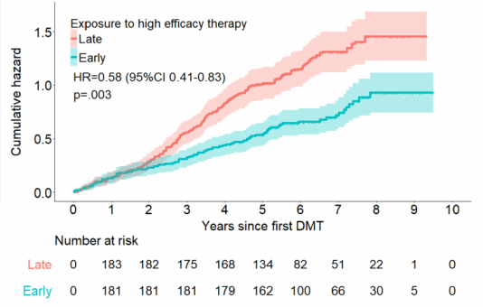
Early initiation of higher-efficacy therapy
MSBase analysis of RRMS patients who started a higher-efficacy therapy either Early (0-2 years after onset; n=170) or Late (>4 years after onset; n-578)
Higher-efficacy DMDs: Rituximab, ocrelizumab, mitoxantrone, alemtuzumab, natalizumab
The Early group had a higher risk of CDP in Years 0-2 due to a more aggressive course
From Years 2-10, the risk of CDP was significantly lower in the Early group
EDSS change from baseline to Year 6:*
  Early: EDSS 2.3 to 2.5
  Late: EDSS 2.3 to 3.4
*Propensity score match analysis, n=117 (Early) and n=181 (Late)
CDP, confirmed disability progression
He et al. ECTRIMS 2018; abstract P919.
Notes:
Abstract: P919 – He et al. Early start of high-efficacy therapies improves disability outcomes over 10 years
Introduction: The availability of numerous highly efficacious therapies for multiple sclerosis (MS) has ignited debate about whether early aggressive treatment is more favourable than the traditional approach of escalation after failure of first line therapies.
Aims: To compare patients' long-term disability outcomes following high efficacy therapy commenced either early or late in their disease course.
Methods: Data were extracted from MSBase, an international observational MS registry, as well as two local databases (Cambridge and Dublin). We identified patients with relapsing remitting MS who commenced high-efficacy disease modifying therapies (Rituximab, Ocrelizumab, Mitoxantrone, Alemtuzumab, Natalizumab) either 0-2 years (early) or >4 years (late) after clinical disease onset. Indication bias was minimised by propensity score matching on demographic and clinical variables in the first two years of disease. Outcomes were assessed at years 6 to 10 after disease onset. The primary outcome was difference in disability in each year of disease, as measured by the Expanded Disability Status Score (EDSS). Secondary outcomes were cumulative hazard of confirmed disability progression and hazard of treatment discontinuation.
Results: There were 170 patients who commenced high-efficacy therapy at 0-2 years (early) and 578 patients who commenced at >4 years (late). During years 0-2, the early group had a higher cumulative hazard of confirmed disability progression; the inverse was true after year 2. For the year 6 outcomes analysis, 117 patients in the early group were propensity score matched to 181 patients in the late group. At baseline, the mean(SD) EDSS was 2.3(1.3) vs 2.3(1.2) in the early vs late groups. At six years, the mean(SD) EDSS was 2.5(1.8) in the early group, compared to 3.4(1.7) in the late group (p< .001). This difference remained clinically (≥.5 EDSS steps) and statistically (p≤ .05) significant up to 10 years post disease onset.
Conclusions: Patients with MS commencing high-efficacy immunotherapy early after disease onset accumulate less long-term disability compared to those exposed later in their disease. Those treated earlier had a more aggressive disease course initially, which was then mitigated by their early active management strategy. In patients with highly active MS, early high efficacy therapy is recommended.

Slide 29
Switching studies
ANSWERS MS study: Natalizumab → Alemtuzumab (n=79)¹
Median duration of switchover was 115 days
ARR increased during the switch period from 0.8 during NTZ to 1.9 in months 6-9, then decreased to 0.4 during ALE
Mean EDSS increased from 3.4 pre-NTZ to 4.7 during switch and 4.4 during ALE
Number of new/worsening lesions was lowest during ALE (0.006/scan/year)
Fingolimod → Alemtuzumab (washout 42 days) or Rituximab (washout 34 days)²
Alemtuzumab: Median EDSS decreased from 2.8 to 2.0 at 1 year; 92.9% were relapse-free
Rituximab: Median EDSS decreased from 3.5 to 2.5 at 1 year; 81.5% were relapse-free
Danish MS Registry: Medium-efficacy DMD → Medium-efficacy or high-efficacy DMD (n=814)³
39% lower risk of relapse with high-efficacy switch; 13% lower risk of 1-point worsening of EDSS
ARR: 0.21 (HE) vs. 0.34 (ME) at 3.4-year follow-up
Natalizumab → Ocrelizumab (2 cases)⁴
Switched to ocrelizumab due to concerns about PML
Patient 1: 7-week washout; relapsed 11 weeks after starting ocrelizumab; PML-like lesion, PML ruled out
Patient 2: 4-week washout; 3 Gd+ juxtacortical lesions 12 weeks after starting ocrelizumab
1. Gallagher et al. ECTRIMS 2018; abstract 264. 2. Alcala et al. ECTRIMS 2018; abstract P572. 3. Chalmer et al. ECTRIMS 2018; abstract 263. 4. Richter et al. ECTRIMS 2018; abstract P1194.
Notes:
Abstract: 264 – Gallagher et al. Alemtuzumab after natalizumab SWitch in evolving rapidly severe multiple sclerosis (ANSWERS MS): long-term UK & Ireland experience
Background: The safety and efficacy of alemtuzumab (AZB) after natalizumab (NZB) in RRMS is unknown.
Methods: 13 UK and Irish centres provided long-term data on patients switched to AZB from NZB since pre-licensing use began in 1999.
Results: 79 patients were included. 51 patients had more than 2 years follow-up after their initial AZB infusion. Independent blinded MRI analysis was conducted in 20 patients.
Data were analysed in 5 phases: before NZB (PRE-NZB), NZB, switch period (SWITCH), AZB and POST-AZB (starting 2 years after first AZB infusion). Mean EDSS increased from PRE-NZB (3.4) to SWITCH (4.7), but fell in the AZB (4.4) and POST-AZB (4.3) phase. Mean annualised relapse rate (ARR) fell from PRE-NZB (2.3) to NZB (0.8), and further during AZB (0.4) and POST-AZB (0.5). The mean number of new or worsened MRI lesions was highest during SWITCH (4.32/MRI/year), lowest in AZB (0.006/MRI/year), and remained low in POST-AZB (0.017/MRI/year).
Median SWITCH lasted 115 days. ARR increased during SWITCH periods with increasing duration (< 3 months = 0.36, 3-6 months = 0.5, 6-9 months = 1.9), and EDSS increased during SWITCH for durations > 3 months. Fingolimod bridging was given to 6 patients, who had a median SWITCH of 233 days, a SWITCH ARR of 1.3, and an EDSS increase during SWITCH.
Three serious adverse events occurred (one urinary infection (UTI), one cytomegalovirus infection and one death from sepsis unrelated to alemtuzumab). Other significant infections occurred in 8 patients: zoster (n=3), UTI (n=2), fungal (n=1), tonsillitis (n=1) and norovirus (n=1). 12 patients developed thyroid disease. Thrombocytopaenia occurred in 2 patients. 1 patient developed proteinuria during POST-AZB.
Conclusions: Long-term data show no unexpected safety signals from the use of AZB after NZB. A shorter SWITCH without bridging was associated with the best outcomes, and no evident risk.
Abstract: P572 – Alcala et al. Treatment with alemtuzumab after fingolimod in relapsing-remitting multiple sclerosis is effective and safe
Background: It has been described that treating relapsing-remitting multiple sclerosis (RRMS) patients with alemtuzumab following fingolimod could be less effective due to the different dynamics of lymphocyte repopulation. Effectiveness and safety of alemtuzumab compared to a cohort of RRMS patients treated with rituximab after fingolimod withdrawal were analysed.
Patients and methods: A prospective follow-up of a cohort of RRMS patients of two MS Units in Valencia (Spain) treated with alemtuzumab or rituximab after fingolimod withdrawal was accomplished. Effectiveness, measured by the percentage of patients with no evidence of disease activity (NEDA), and the presence of side effects were registered.
Results: A total of 55 patients, 28 with alemtuzumab and 27 with rituximab were analysed. No differences in the washout period (median (interquantile range); alemtuzumab: 42 days (21.3-59.5); rituximab: 34 days (17.3-61.3); p=0,49) or in the number or lymphocytes before starting the new treatment (median (interquantile range); alemtuzumab: 1310 (815-1670); rituximab: 1100 (665-1580); p=0,44) were observed. After a mean follow-up period of 28.8 months (SD: 18), the annualized relapsing rate was significantly reduced in the alemtuzumab group from 1.29 to 0.004 (p< 0.001) and in the rituximab group from 1.24 to 0.02 (p< 0.001), without differences between groups. After one year of follow-up, a significant reduction of the median EDSS (interquartile range) from 2.8 (2-3) to 2.0 (1.5-2.5) (p=0.03) in the alemtuzumab group and from 3.5 (2-4) to 2.5 (2-4) (p< 0.01) in the rituximab group were observed; these reductions remained stable after the second year, without statistical differences between both groups. Eighty-two per cent (n=28) of patients in alemtuzumab group and 70% (n=27) in rituximab group achieved NEDA criteria, without differences (p=0.3). Symptoms related to the infusion were the most frequent side effect in both groups. No serious side effects were registered in any group.
Conclusion: Treating RRMS patients with alemtuzumab or rituximab after fingolimod withdrawal is effective and safe, without significantly differences between both groups. Previous treatment with fingolimod did not negatively influence response to alemtuzumab in our series.
Abstract: 263 – Chalmer et al. Treatment escalation leads to fewer relapses compared with switching to another moderately effective therapy
Introduction: Patients with relapsing-remitting multiple sclerosis (RRMS) who experience relapses often switch disease-modifying therapy (DMT). Treatment guidelines recommend switching to a highly effective DMT (HeDMT) when a patient experiences clinical disease breakthrough. Nevertheless, patients may switch between moderately effective DMTs (MeDMT) due to breakthrough disease or adverse effects.
Objective: To compare treatment effectiveness of HeDMT with MeDMT in patients with RRMS who switch therapy due to relapse activity.
Methods: In this registry-based cohort study we retrieved data from The Danish Multiple Sclerosis Registry (DMSR) on all adults with RRMS, with Expanded Disability Status Scale (EDSS) below level 6, who experienced a relapse while treated with an MeDMT, and, consequently, switched to either an HeDMT or an MeDMT. The groups were compared from treatment start and until outcome or censoring. Censoring was defined as post-baseline switch between HeDMT and MeDMT, cessation of therapy, relocation or death, whichever occurred first. Outcomes were annualized relapse rate (ARR), relapse rate ratio, time to first relapse and time to first 1-point confirmed EDSS worsening. We used propensity score matching approach to balance groups, Cox proportional hazards model to obtain hazard ratios (HR) when modeling time to first relapse and time to first worsening, and negative binomial regression to obtain ARR and relapse rate ratios.
Results: The matched cohort consisted of 814 patients (407 in each group). Median follow-up time was 3.2 years (Interquartile range (IR) 1.7-6.0). The group of patients who switched to an HeDMT had a 39% lower hazard rate of reaching first relapse (HR 0.61; 95% CI 0.50-0.74). ARRs were 0.21 (0.18-0.24) for patients who switched to an HeDMT and 0.34 (0.30-0.39) for patients who switched to an MeDMT. Relapse rate ratio for HeDMT compared with MeDMT was 0.62 (0.50-0.76). The group who switched to an HeDMT had 13% lower hazard rate of 1-point EDSS worsening (HR 0.87: 95% CI 0.66-1.16).
Conclusion: Based on virtually complete nationwide data from patients with MS in Denmark, relapse-induced escalation to an HeDMT was associated with reduced risk of relapses. We found a statistically non-significant trend towards reduced time to first 1-point EDSS worsening over the short-to-medium term. Escalation of therapy to an HeDMT when patients experience relapses on an MeDMT is recommended to improve control of relapse activity.
Abstract: P1194 – Richter et al. Switching stable RRMS patients from natalizumab to alemtuzumab - efficacy and safety in the real world
Objective: To assess evidence about efficacy and safety switching from natalizumab [NTZ] to alemtuzumab [ATZ] in stable MS patients due to risk of progressive multifocal leukoencephalopathy [PML] in a German MS center.
Background: For the treatment of RRMS patients who discontinue NTZ being positive for John Cunningham virus [JCV] it is important to evaluate data on the efficacy and safety outcomes. Data in real world clinical practice are still limited.
Design and methods: 20 patients discontinued NTZ treatment (19 due to risk of progressive multifocal leukoencephalopathy [PML]; 1 due to the experience of a massive rebound after NTZ cessation during a prior pregnancy); after a median of 55,1 months (range 7-102). No patients experienced clinical or radiologic disease activity in the 12 months prior to discontinuation. To rule out an asymptomatic PML, 19 patients received a recent contrast-enhanced brain MRI with DWI (median 15,5 days; range 2-65) and CSF-examination for JCV-PCR (median 14,6 days; range 7-27) prior to initiation of ATZ. Median washout period was 11,8 weeks (range 7-20) before receiving ATZ 12 mg/day (Course 1 [C1]: 5 days; Course 2 [C2, 12 months later]: 3 days). At least one brain MRI and Expanded Disability Status Scale [EDSS] was performed 12 months after ATZ initiation.
Results: All 20 patients have follow-up data for 12 months after ATZ-C1. All patients received C2. None of the patients experienced a relapse or progression of disability. EDSS was unchanged in all patients. Only 1 patient had active or new brain MRI lesions (2 gadolinium-enhancing lesions at 7 months [after C1] and 1 lesion 12 months [just before C2]), without clinical signs of MS activity. Only 1 patient had active or new brain MRI lesions (5 gadolinium-enhancing lesions) 2 days before C1 (washout 20 weeks). 4 patients had prolonged respiratory tract infections with high fever, thyroid AEs occurred in 2 patients (1 M. Basedow; 1 hypothyreosis); herpes zoster in 2 patients. No PML was diagnosed.
Conclusions: In this single center cohort of patients who discontinued natalizumab, alemtuzumab effectively maintained clinical stability over 12 months with no unexpected safety findings. Main AEs where respiratory tract infections with high fever within the first month. No carry over-PML occurred. The median washout for these patients was approximately 2,5 months.
Abstract: P933 – Repovic et al. Can ocrelizumab prevent MS reactivation after discontinuation of natalizumab?
Introduction: Natalizumab (NTZ) and ocrelizumab (OCR) are both highly effective therapies for relapsing multiple sclerosis (MS). Current evidence suggests that there is a small but appreciable risk of increased inflammatory activity (“rebound”) after NTZ discontinuation in some patients. It is unknown whether OCR is capable to preventing this phenomenon.
Objective: To describe 2 patients who experienced rebound MS activity after transitioning from NTZ to OCR.
Summary: Two female MS patients, aged 56 and 63, had been treated with NTZ for 105 and 29 months, respectively. While on NTZ, neither patient had MS relapses or additional MRI lesions; however, patient 1 had a history of severe relapses after self-discontinuing NTZ in 2009 and 2014. Due to increasing PML risk, patients transitioned from NTZ to OCR. The interval between last NTZ infusion and first OCR infusion was 7 weeks for patient 1, and 4 weeks for patient 2. Their MRI scans at the time of last NTZ infusion showed no new lesions. Patient 1 experienced a relapse 11 weeks after starting OCR (18 weeks after last NTZ infusion); her MRI showed 2 contrast-enhancing lesions, including a PML-like lesion in left temporal lobe. PML was ruled out, and she was treated with steroids and plasma exchange, with good functional recovery. Patient 2 reported ambulatory difficulty with MRI evidence of 3 contrast-enhancing juxtacortical lesions 12 weeks after starting OCR treatment (16 weeks after last NTZ infusion). Serum CD19 count was undetectable at the time of relapse for patient 1.
Conclusion: During transition from OCR to NTZ, even with a short (< 8 weeks) washout period and effective CD19 suppression, there remains a risk of MS reactivation that, in some cases, may mimic PML. We postulate that the factor(s) driving MS rebound are intrinsic to the central nervous system.

Slide 30
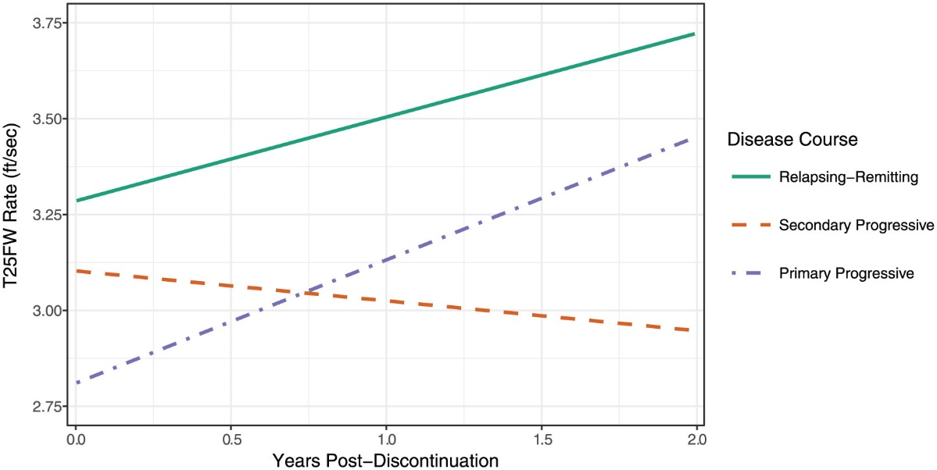
Stopping treatment
Retrospective chart review of MS patients aged >60 years on a DMD for >2 years who stopped vs. continued treatment
Mean duration on DMD was 21 years for Discontinuers vs. 18 years for Continuers
~65% of patients were on a front-line injectable at the time of the analysis
68% of discontinuations were initiated by the physician
62.2% of patients had progressive MS at discontinuation
No change in MRI after stopping: 95.1% had no new T2 lesions and 85.1% had no Gd+ lesions
T25FW improved in RRMS and PPMS patients but worsened in SPMS patients who stopped
T25FW, Timed 25-Foot Walk
DMD, disease-modifying drug
Hua et al. ECTRIMS 2018; abstract P1230.
Image from Hua et al. Mult Scler 2018; epublished March 1, 2018.
Notes:
Abstract: P1230 – Hua et al. Change in outcomes over time of discontinuing disease modifying therapy in patients with multiple sclerosis over age 60
Introduction: Current immunomodulatory disease modifying therapies (DMTs) may no longer benefit patients over age 60, due to little inflammatory activity presence or having already reached significant disability, leading clinicians and patients to consider stopping DMT. Our prior study demonstrated that discontinuing DMT can be successful in most patients over age 60.
Objective: This study focuses on changes in outcomes (EQ-5D, MSPS, T25FW, PHQ-9, new T2 or GdE lesions) over time between those who continued vs discontinued DMT.
Methods: Patients were previously identified from our MS clinics who were >60, on DMT for >2 years, with corresponding clinician and patient-reported outcomes (PRO). To compare how outcomes changed over time among treatment groups (continuers, discontinuers before discontinuation (DBD), and discontinuers after discontinuation (DAD)), we created separate mixed-effects linear regression models. We included an interaction term between the time and treatment group to study the trajectory of the outcome. Independent variables were time from age 60 and treatment group, with the following covariates: age at diagnosis, gender, MS course at baseline, time on DMT, baseline DMT and ambulation status at age 60. Among the final models, we made pairwise comparisons among the three treatment groups.
Results: 178 out of 600 patients discontinued DMT. Only the EQ-5D mixed-effects linear regression model with the interaction term was statistically significant (p-value = 0.043). The slope relating time to EQ-5D was significantly different when comparing continuers to DBD (0.009, 95% CI 0.002-0.016, P = 0.015). The slopes were not significantly different when comparing continuers to DAD, or when comparing the before and after discontinuation slopes among the discontinuers. With the interaction term removed, there were no significant differences between the three groups for any outcome. None of the pairwise comparisons were statistically significant. There was no significant association between treatment group and presence of GdE or new T2 lesions.
Conclusions: Most patients over age 60 who discontinued DMT remained off DMT. Among the outcomes, only ED-5D demonstrated significance over time, in continuers and discontinuers before stopping treatment. There were also no statistically significant differences in MSPS, T25FW and PHQ-9, new T2 or GdE lesions. Overall, stopping DMT appears to have minimal effect on outcomes over time.

Slide 31
Clinical Tips & Observations

Slide 32
Clinical tips
“Abdominal Lhermitte’s”
Thoracic flexion: bending forward at the lower chest/waist without flexing the neck
May be used to differentiate thoracic from cervical lesions in patients with thoracic symptoms (“MS hug” – sensory band usually at T6-T8)
Thoracic flexion was positive in 9/15 patients with recent-onset thoracic symptoms
  No cervical Lhermitte’s sign even with neck flexion
Pain was provoked or worsened, radiating around the chest or from the thoracic spine to the legs
  Most common when thoracic pain was present at rest
With induced thoracic pain, 6/8 subsequently found to have a thoracic T2 lesion
Manoeuvre is difficult to perform for obese or inflexible patients
Reder AT. ECTRIMS 2018; abstract P372.
Notes:
Abstract: P372 – Reder AT. Thoracic flexion provokes and localizes thoracic lesions in multiple sclerosis: a new clinical sign
Objective: Determine whether local spine flexion can discriminate thoracic from cervical MS lesions.
Background: Lhermitte's sign/symptom indicates there is a cervical cord lesion due to an MS plaque or other cause. New lesions may not be apparent on cervical MRI, the Clinical/MRI paradox, although there may be prior MRI activity. Some MS patients have thoracic symptoms such as a sensory band, usually at T6-8, the “MS hug.” Is it due to cervical or thoracic lesions?
Design and methods: 25 MS patients with potential thoracic cord lesions performed two maneuvers: 1) Rapid neck flexion, with flexion maintained briefly, and also rapid neck extension, and 2) Rapid thoracic flexion with the neck straight and immobile.
Results: Thoracic flexion was positive in 9 of 15 patients with recent onset thoracic cord symptoms such as a thoracic sensory band. Their pain or dysesthesia was provoked or worsened and radiated around the chest or from the thoracic spine then down to the legs. There was no cervical Lhermitte's sign elicited by this maneuver, even when it could be provoked with neck flexion. The thoracic flexion symptom was seldom positive when cord symptoms had appeared in the remote past, as in 10 additional patients. The maneuver is difficult when patients are corpulent, physically inactive, or have abdominal muscle weakness.
Conclusions: Thoracic flexion, a thoracic “crunch,” can elicit an electrical sensation. This is usually associated with recent thoracic cord lesions and is likely to be independent of cervical pathology. As with cervical cord symptoms on neck flexion, this sign may help localize MS plaques, even when MRI is negative.

Slide 33
Observations
MS patients resistant to a course of corticosteroids had lower serum 25(OH)D levels compared to steroid-responsive and stable MS patients¹
Frequent exposure to gadolinium contrast agent (5-11 injections/2 years) was not associated with greater clinical worsening in SPMS patients²
No loss of efficacy with extended-interval dosing (300 mg every 5-6 wks) of natalizumab;³ PML risk may be lower but cases can occur⁴
Fingolimod and dimethyl fumarate produced sustained increases in HDL-cholesterol levels (16% and 14%, respectively) within 3 months of starting treatment⁵
1. Bagnoud et al. ECTRIMS 2018; abstract 80. 2. Ackermans et al. ECTRIMS 2018; abstract P479. 3. Clerico et al. ECTRIMS 2018; abstract P587. 4. Scarpazza et al. ECTRIMS 2018; abstract P1247. 5. Staun-Ram et al. ECTRIMS 2018; abstract P944.
Notes:
80 – Bagnoud et al. Vitamin D augments glucocorticosteroid efficacy via inhibition of mTORc1
Background: Glucocorticoids (GCs) are the mainstay in the treatment of acute multiple sclerosis (MS) relapses. Still, increase of disability is observed in more than 40% of the patients. We investigated the potential of vitamin D (VD) to enhance steroid efficacy for MS relapse therapy and underlying mechanisms.
Methods: VD levels were analyzed using an immunoassay in stable (n=56), relapsing GC-responsive (n=30) or relapsing GC-resistant (n=24) MS patients. Gene expression of human T cells (microarrays, n=112) were correlated with 25(OH)D3 levels. Glucocorticoid receptor (GR) protein was measured using ELISA. T cell apoptosis was analyzed by FACS. MOG35-55 Experimental Autoimmune Encephalomyelitis (EAE) was performed in wild type and knockout mice with T cell specific deficiency for GR/mTORc1. Relevance of the JNK-pathway was analyzed in human T cells using a competitive JNK-inhibitor (SP600125).
Results: GC-resistant MS patients have a decreased VD serum level as compared to GC-responsive and stable MS patients. This was associated with reduced expression of the GR in T cells. In vitro, VD increases the concentration of GR protein in T cells in a dose-dependent manner. Focusing on T cells donated from MS patients during GC-resistant relapse, this GR upregulation by VD results in an increase of T cell apoptosis by approximately 10%, if treated with VD/GC compared to GC monotherapy. VD/GC combination therapy ameliorated EAE disease course more efficiently than respective monotherapies. This effect was dependent on the presence of the GR in T cells. On a molecular level, VD inhibits mTORc1 signal transduction in murine T cells in vitro. Furthermore, hypovitaminosis D was associated with reduced expression of the archetype mTORc1 inhibitor tuberous sclerosis complex 1 in human T cells. The upregulation of the GR by VD as well as the functional VD/GC synergism observed in vitro and in vivo were absent in mice with mTORc1 deficient T cells. Pharmacological inhibition of mTORc1 by everolimus augmented GC effects in wild type mice during EAE even more potently than VD co-administration.
No significant changes of proliferation/apoptosis by JNK-inhibition and MP co-incubation was observed in human T cells.
Interpretation: VD increases therapeutic effects of GCs via an mTORc1 dependent upregulation of the GR. These data suggest that efficacy of GC in treatment of MS relapses could be improved by mTORc1 inhibition.
Abstract: P479 – Ackermans et al. Effect of different doses of gadolinium contrast agent on clinical outcomes in multiple sclerosis
Introduction: Gadolinium-based contrast agents (GBCA) commonly used in routine neuroimaging can accumulate in the brain's deep gray matter structures despite chelation. A clinical trial of secondary progressive multiple sclerosis (SPMS) patients included an infrequent (IFR) and a frequent (FR) MRI cohort who received 1-4 or 5-11 GBCA injections over 104 weeks. By evaluating the clinical outcomes of these two cohorts, this retrospective study was performed to assess the potential dose-dependent effect of GBCA on MS progression.
Objective: To evaluate the potential dose-dependent effect of GBCA on MS progression
Materials and methods: Clinical outcomes from a cohort of 612 SPMS patients, enrolled in a 2-year placebo-controlled (negative) trial assessing the efficacy of MBP8298, were acquired. Patients received 1-4 (infrequent cohort; IFR) or 5-11 (frequent cohort; FR) GBCA injections between screening (week -4) and week 104. The primary clinical outcome was the change in Expanded Disability Status Scale (EDSS) and time to confirmed EDSS progression and secondary outcomes included the changes of Multiple Sclerosis Functional Composite (MSFC), Timed 25-Foot Walk (T25FW), the 9-Hole-Peg Test (9HPT), the Paced Auditory Serial Addition Test (PASAT) from baseline to week 104.
Results: The 512 IFR and 100 FR participants showed no differences in baseline demographics or disease history. The mean change from baseline to week 104 in EDSS was +0.21(IFR) and +0.13(FR); MSFC -0.38(IFR) and -0.14(FR); T25FW +1.28(IFR) and +0.55(FR); 9HPT -0.06(IFR) and -0.08(FR); PASAT +0.22(IFR) and +0.20(FR). The FR to IFR progression hazard ratio was at 0.68 (p=0.09) favouring the FR cohort. There were no significant differences in any of the outcomes between the FR and the IFR cohorts.
Conclusion: There were no differences in the clinical outcome measures of disability progression between the two groups for different GBCA exposure indicating that gadolinium does not result in greater clinical worsening in SPMS in the short term, after two years of follow up.
Abstract: P587 – Clerico et al. Extended interval dosing of natalizumab: is efficacy preserved?
Introduction: Some clinicians in Italy extended the dose of natalizumab infusions after 24 doses, with the hypothesis of reducing PML risk; this idea was supported by recent reports.
Objective: To make this strategy feasible, it is necessary to ascertain the therapeutic durability of the extended dosing strategy.
Aim: To evaluate the non-inferiority in controlling disease activity of an extended interval dosing (EID) of natalizumab.
Methods: Patients who received natalizumab for at least 24 weeks in 14 Italian centers were included in the analysis. Patients were grouped in 2 categories according to the mean number of weeks between doses (< =5.5 weeks, standard interval dosing (SID);>5.5 weeks, EID). Only the dose intervals before the first relapse was used to estimate the mean intervals between doses, to minimize the bias associated to a possible return to SID in patients under EID after they experienced a relapse. The non-inferiority of EID vs SID was a priori defined as satisfied if the upper limit of the 95%CI of the annualized relapse rate (ARR) in the EID group did not exceed the mean ARR of the SID group by 0.02 relapse/year. Baseline characteristics were compared between groups by a Mann Whitney U test. ARR during follow up was estimated and compared between groups by a multivariate Poisson regression model.
Results: 341 patients were included in this analysis. The median interval between doses was 4.9 weeks (range 3.7-8.4), with a clear bimodal distribution (modes at 4 and 6 weeks) associated with individual centers strategies (the median was 4.5 weeks in 220 patients from 12 centers and 6.2 in 121 patients from 2 centers). 221 patients were in the SID (median dose interval=4.5 weeks) and 120 in the EID group (median dose interval=6.3 weeks). The ARR during follow up adjusting for all the baseline variables (age, disease duration, relapses in 2 years pre-natalizumab start, EDSS, number of previous treatments) was 0.042 (95%CI=0.026-0.067) in the SID group, and it was 0.007 (95%CI=0.002-0.028) in the EID group. The non-inferiority of EID vs SID was satisfied.
Conclusions: In this cohort there is no evidence of a reduced efficacy of natalizumab by extending the intervals between doses from a median of 4.5 to a median of 6.3 weeks. This observation confirms previous results and together with the emerging evidence of a reduced risk of PML associated to an EID supports the need of a randomized study to change the standard of the natalizumab dosing schedule.
P1247 – Scarpazza et al. Progressive multifocal leukoencephalopathy in extended interval dosing of natalizumab: four cases from the Italian PML cohort
Background: Natalizumab (NTZ) is a highly effective therapy for multiple sclerosis, but it is associated with a high risk to develop Progressive Multifocal leukoencephalopathy (PML). Infusion of NTZ every 5-8 weeks (extended interval dosing, EID) is an approach that has been explored with the aim of reducing PML risk while maintaining efficacy.
Goals: To evaluate, in the Italian PML cohort, the presence of PML when reducing the NTZ frequency and to describe the cases of PML emerged during EID.
Methods: Clinical and imaging data of all the Italian patients who develop NTZ-PML from 2009 were retrospectively collected from 35 Italian sites. The clinical course was described and the longitudinal EDSS were recorded. The data were centrally reviewed and full-blown IRIS was identified in each patient. We defined EID when NTZ infusions were performed every 5 weeks or more.
Results: Up to April 2018, 56 cases of NTZ-PML occurred in Italy, five of which in EID (8.92%). Here, we present the data of four out of five of these patients. These patients developed PML after 74, 50, 47 and 38 infusions, of which the last 22, 9, 26 and 22 respectively were administered in EID regimen. All the four patients had a high JCv index prior to PML onset (3; 3,18; 2.3; 3.13). No one of them had a previous history of immune suppressant use. For all of them, PML was suspected on radiological findings (occipital; frontal; parietal; temporo-parietal lesion). Two patients were asymptomatic at PML onset, while two were symptomatic (respectively motor impairment of the right hand; anomia). All of them but one, who had 37 JCV copies/ml, had undetectable CSF viral load. Three patients showed enhancement suggestive of immune reconstitution. In two cases, this enhancement was coupled with clinical worsening, thus meeting the shared criteria for full blown IRIS. Three patients had a positive outcome: the increase of EDSS from NTZ beginning and the last follow up (one year after PML onset) is of 0.5 EDSS points. The fourth patients has been only recently diagnosed (mid April), and the follow up is ongoing.
Conclusions: Patients in EID regimen may develop PML. Despite this, PML in these patients seems to be milder with a favorable clinical outcome as the first three patients ended with reduced impairment at last follow up. Contrarily to PML patients receiving NTZ in standard dose described in literature, in EID-PML patients the IRIS did not severely impacted on patients disability.
Abstract: P944 – Staun-Ram et al. Increased blood levels of high density lipoprotein (HDL) in patients with multiple sclerosis treated with fingolimod or dimethyl fumarate - a beneficial side effect and /or a potential biomarker?
Background: Fingolimod and Dimethyl Fumarate (DMF) have been associated with immuno-modulation, promoting an anti-inflammatory state. The blood lipoprotein profile in patients with Multiple Sclerosis (MS) has previously been suggested to be associated with disease activity, with higher levels of high density lipoprotein (HDL) associated with lower inflammatory disease activity, while higher levels of low density lipoprotein (LDL), total cholesterol and triglycerides (TG) associated with worsening disability.
Aim: We aimed to assess whether Fingolimod or DMF therapy affects the lipoprotein profile of patients with MS.
Methods: We compared the blood lipid profiles before ,3 and 12 month (m) following treatment initiation in 27 patients treated with fingolimod and 34 patients treated with DMF therapy. All patients had no record of cholesterol-reducing medication before or during time of follow-up. Patients were asked about weight loss within 1 year of drug initiation.
Results: Fingolimod patients showed a mean 11.2% increase in HDL levels after 3m treatment, sustained and increased to 16% after 12m, a 8.1% increase in total cholesterol after 12m, while no change in LDL, TG and non-HDL cholesterol was observed. A 17.8% increase in HDL/LDL level was found after 3m, sustained throughout the follow-up. DMF patients showed a 13.6% increase in HDL levels after 3m, sustained throughout follow-up, with no change in other lipids, resulting in a 12.6% increase in the ratio of HDL/LDL after 3m. The majority (>81%) of patients did not experience any weight loss, thus weight reduction cannot explain the observed increase in HDL. We found no correlation between HDL increase and absolute lymphocytes count reduction in either group.
Conclusions: Fingolimod and DMF therapy are both associated with increased levels of HDL, while no change in other lipid levels was observed. This observation may be a beneficial side effect of the drugs and/or a biomarker of reduced inflammatory state. Whether increase in HDL correlates with clinical response to DMDs or cardiovascular risk remains to be determined in larger cohorts.

Slide 34
Income as a proxy for disease progression
Swedish MS Registry study examining the association between DMD start (< 2 years or >2 years after diagnosis) and income outcomes (n=3593)¹
  Endpoint was time from DMD initiation to 95% decrease in annual earnings
Significantly higher risk of lost income with later treatment start (HR 1.19)
36% lower risk of full-time disability pension if start DMD within 6 months after onset vs. after 18 months²
RRMS patients earn twice as much as patients with SPMS (ratio 2.56) and PPMS (ratio 1.78)³
Authors proposed that income can serve as proxy for disease progression
1. Kavaliunas et al. ECTRIMS 2018; abstract 145. 2. Landfeldt et al. J Neurol 2018;265:701-707. 3. Kavaliunas et al. PLoS One 2017;12:e0169460.
Notes:
Abstract: 145 – Kavaliunas et al. Impact of early treatment initiation on personal income of multiple sclerosis patients
Background: In the clinical course of multiple sclerosis (MS) early treatment initiation is associated with better physical outcomes, both in the short- and long-term. According to the guidelines, disease modifying drugs (DMDs) should be offered as early as possible in the pharmacological management of MS. However, little is known of how treatment decisions affect socio-economic outcomes in patients.
Objectives: The aim of this study was to investigate whether early treatment initiation affects the personal income of MS patients in long-term.
Methods: A prospective cohort study was conducted, of MS patients who started treatment with a DMD during 2001─2012, linking data from the Swedish nationwide registers, including the Multiple Sclerosis Register. A survival analysis was used to measure the association between the time from MS onset to treatment initiation and the outcome, defined as time from treatment initiation to a 95% decrease in annual earnings compared to the each patients' baseline level (at treatment initiation). Additionally, the association between time to treatment and increase of financial compensations from social security systems was investigated.
In total, 3593 MS patients were included in the analysis. Cox regression model was adjusted for gender, age at MS onset, education, family situation, country of birth, and baseline score of the Expanded Disability Status Scale (EDSS).
Results: Patients initiating treatment later had a greater risk of reaching the outcome, e.g., those who started treatment after 2 years from MS onset lost 95% of their earnings sooner with the adjusted hazard ratio of 1.20 (95% confidence interval 1.04─1.38).
Also, female gender, late MS onset, higher baseline EDSS, lower education, being single, and being born outside the European Union had the higher adjusted hazard ratios and were significantly associated with a worse outcome.
On the other hand, risk to receive a certain amount of income from the social benefits (e.g., sickness absence, disability pension) was not different between the early and delayed treatment groups (e.g., the adjusted hazard ratio to reach an annual compensation of SEK 100,000 (≈EUR 10,500) for those who started treatment later was 1.08 (95% confidence interval 0.92─1.26)).
Conclusion: Early treatment initiation was associated with a better outcome, i.e., a lower risk to lose earnings.

Slide 35
Physician/Patient perceptions
Swiss MS Registry survey (n=734)
Patients were more satisfied with their first visit if the clinician:
Talked with them for >20 minutes
Discussed many topics
The decision to start DMD was shared
Patients who were Satisfied/Very satisfied were more likely to start a DMD
Physician/Patient survey of risk tolerance (n=480)
Patients: most worried about PML (47%) and relapses (20%)
Physicians: most worried about progression (41%) and PML (29%)
To gain 4 years of disease stability with no relapses over the next 5 years:
  Patients would accept a risk of severe disability of 1.6% and risk of death of 1.0%
  Physicians would accept a risk of severe disability of 3.0% and risk of death of 1.0%
Physicians’ risk tolerance was higher compared to that of their patients
1. Barin et al. ECTRIMS 2018; abstract P335. 2. Minacapelli et al. ECTRIMS 2018; abstract P968.
Notes:
Abstract: P335 – Barin et al. Patient satisfaction with the first talk about diagnosis and its impact on treatment decisions: a Swiss multiple sclerosis Registry study
Introduction: Patient satisfaction with the first diagnostic consultation (FDC) might have an impact on treatment decision. Initiation of disease modifying treatment (DMT) in multiple sclerosis (MS) should be informed, shared with the patient, and consider all appropriate options.
Objectives: To investigate factors contributing to patient satisfaction with the FDC and to assess its association with DMT initiation.
Methods: Using retrospective patient-reported data of the Swiss MS Registry, we fitted ordered logistic regression models (outcomes: a. Satisfaction with FDC: 1(not at all, reference) to 5 (very satisfied); b. Start of DMT after FDC: no/yes), adjusted for period of diagnosis and other pre-specified confounders. Primary progressive MS was excluded.
Results: 421 persons with MS diagnosed after 1995 (clinically isolated syndrome (n=11), relapsing remitting (n=379) or secondary progressive MS (n=31) at diagnosis) were included. 54% of participants were satisfied with the FDC (levels 4-5), 24% were not satisfied (1-2), and 22% were neutral (3). For 18% the FDC lasted ≤10 min, for 42% 10-30 min, for 32% ≥30 min, others did not recall. 84% perceived the diagnosis as clear. The most covered topics were the nature of MS (67%) and DMT (72%). 59% were suggested ≥2 DMT options, 22% 1 option, and 19% no DMT option. Of all patients, 70% initiated DMT within 3 months, 7% after 3 months, and 23% did not start any.
In the multivariable regression on satisfaction with FDC, involvement in the DMT choice (odds ratio 16, [95% confidence interval 4-59] vs. no involvement), the number of topics covered (1.4 [1.2-1.7] per additional topic), clarity of the diagnosis (3.5 [1.5-8] vs. a perceived unclear diagnosis), and high socioeconomic status defined by highest work position (2.1 [1.1-4]), were associated with better satisfaction. Worse satisfaction was associated with an interval from contacting a doctor to the diagnosis exceeding 3 months (0.48 [0.27-0.85]). Satisfaction with the FDC (6 [2-19]), diagnosis after 2010 (8.6 [2.1-35.6]), and FDC longer than 30 min (4.9 [1.1-20.7]), were associated with DMT initiation. Males were less likely to start DMT (0.3 [0.1-0.7]).
Conclusions: Satisfaction with FDC could be crucial for increasing DMT initiation in the MS population. In order to achieve that, physicians should aim to minimize the diagnostic process length, dedicate ample time to the FDC, provide clear information about MS, and involve patients in treatment decision.
Abstract: P968 – Minacapelli et al. Patients' and physicians' risk tolerance for multiple sclerosis therapies: preliminary results of an Italian survey
Introduction: Risk tolerance, linked to socio-demographical and personality factors, could play a crucial role in the process of decision-making about disease-modifying therapy (DMT). This is true for people with multiple sclerosis (PwMS), and their physicians. Currently, little is known about this issue.
Objectives: To compare patients' and physicians’ risk tolerance using two hypothetical DMT scenarios.
Materials: Two comparable ad hoc questionnaires consisting of: a) socio-demographical and clinical/professional questions; b) the Zuckerman-Kuhlman Personality Questionnaire (ZKPQ); c) a section about hierarchy of MS- and DMT-related worries; d) visual analogue scales (VAS) and standard gamble decision trees about acceptable levels of severe disability and death risks in response to two different DMT scenarios.
Methods: Four hundred-twenty PwMS and 60 physicians working in MS Centres, previously contacted by mail, filled in the ad hoc questionnaire. The physicians completed the 'c-d' sections of the questionnaire, as if they were potential PwMS.
Results: The subjects were substantially comparable as for socio-demographical level, except for education, which was higher in physicians. PwMS stated that they were mainly and firstly worried about progressive multifocal leukoencephalopathy (PML) (47%), relapses (20%), as well as about disease progression and leukemia on equal percentage (14%), while physicians were worried about progression (41%), PML (29%) and leukemia (20%). To gain 2 years of disease stability with a risk of two relapses in the next 5 years, PwMS would accept a risk of severe disability and death of 1% and 0.5%, respectively; while they would accept up to 1.6% and 1.0%, to gain 4 years in absence of relapse in the next 5 years. Physicians would accept a risk of severe disability and death of 2% and 1% for the first scenario, rising their risk tolerance up to 3% and 1% for the second scenario. These results correlated only partially with ZKPQ scales in physicians, while they are significantly predicted by the Impulsive-Sensation Seeking Scale in PwMS.
Conclusions: Patients' and physicians' risk tolerance presents some differences and neurologists seem to accept almost double risks for hypothetical drug scenarios, compared to PwMS. This could be relevant information when approaching the moment of DMT change, the shared evaluation of the possible benefit/risk ratio and the drug final choice.

Slide 36
GROUP DISCUSSION
Copyright 2018 Lind Publishing Inc. All rights reserved.

