Slide 1
21ST Annual Conference of Rehabilitation IN MS
Selected highlights from ECTRIMS 2016
September 14 -17, 2016 London, UK
Copyright 2016 Lind Publishing Inc. All rights reserved.

Slide 2
Scientific Review
Dr. Daniel Selchen
Chief of Neurology
St. Michael’s Hospital
Assistant Professor
University of Toronto
Toronto ON

Slide 3
Highlights from ECTRIMS 2016
Environmental factors
Hormonal effects
MS variants
Immunology
Treatment trials – RRMS
Real-world/database studies
Progressive MS
Physician and patient perspectives

Slide 4
Environmental factors – Vitamin D
Finnish Maternity Cohort: Serum samples routinely collected during pregnancy: 1247 developed MS in the period 1983-2009
57% of MS subjects and 52% of controls were vitamin D deficient
50 nmol/L increase in 25(OH)D associated with a 37% reduced risk of MS
Ausimmune study of 279 subjects with first demyelinating event followed for 5 years
No association between baseline or longitudinal 25(OH)D levels and clinical outcomes (conversion to CDMS, relapse)
Historical sun exposure was inversely related to CDMS and relapses
Munger et al. Abstract 199. Simpson et al. Abstract P312.
Notes:
Notes
Serum levels of 25-hydroxyvitamin D and risk of multiple sclerosis among women in the Finnish Maternity Cohort
Munger et al. Abstract 199
Serum samples have been routinely collected in early pregnancy since 1983 in Finland.
1247 women identified as having developed MS in the period 1983-2009
Serum samples were collected on average 13 years before diagnosis
57% of women later diagnosed with MS and 52% of controls had low serum vitamin D levels
A 50 ng/L increase In 25(OH)D levels was associated with a 37% decreased risk of MS, p=0.003.
Women with 25(OH)D levels < 30 ng/L had a 23% increased risk of MS vs women with 30-50 ng/L, and a 48% higher risk compared to women with 25(OH)D levels >50 ng/L.
Historical but not current vitamin D and sun parameters are associated with a more favourable multiple sclerosis clinical course: data from the Ausimmune Longitudinal Study at 5 years
Simpson et al. Poster P312
Cohort of 279 patients from the Ausimmune study with a first clinical demyelinating event
At 5 years, 202/279 had developed CDMS
Neither baseline or longitudinal 25(OH)D levels were associated with CDMS or relapses.
However, historical sun exposure was inversely related to CDMS and relapse.

Slide 5
Vitamin D add-on therapy: SOLAR study
48-week prospective study of daily oral cholecalciferol (vitamin D3) vs. placebo in 229 patients receiving IFNβ-1a 44 µg tiw
6670 IU/wk x 4 wks, 14,007 IU/wk x 44 wks
No significant difference in NEDA rate at wk 48 with vitamin D vs. placebo (37.2% vs. 35.3%)
ARR was numerically lower (0.28 vs. 0.41, p=0.165)
Significant 32% reduction in the number of combined active lesions (1.09 vs. 1.49, p=0.005)
% free of new T1 hypointense lesions was significantly higher (85.7% vs. 46.8%) in the cohort aged 18-30 years; NS for whole cohort
Smolders et al. Abstract 166.
Notes:
Notes
High dose cholecalciferol (vitamin D3) oil as add-on therapy in subjects with relapsing-remitting multiple sclerosis receiving subcutaneous interferon-beta-1a
Smolders et al. Abstract 166
SOLAR study is the largest randomized, controlled trial of vitamin D3 add-on therapy in MS
Subjects on interferonβ-1a 44 µg (for 3-18 mnoths) received daily oral vitamin D oil 14,000 IU (350 µg) or placebo for 48 weeks. All subjects had serum 25(OH)D level <150 nmol/L at baseline. Mean age was 34 years.
The primary endpoint was no evidence of disease activity (NEDA) rate, defined as no relapses, no EDSS progression and no combined unique active lesions
No significant difference in NEDA rate at 48 weeks (37.2% vs. 35.3%)
No difference in mean ARR (0.28 vs. 0.41; 30% lower) or % of subjects free of any EDSS progression (71.7% vs. 75.0%)
Significant reduction in CUA lesions with vitamin D add-on therapy
Proportion of subjects free of new T1 hypointense lesions was significantly higher (85.7% vs. 46.8%, p=0.006) in the subgroup aged 18-30 years; results were not significant for the full cohort

Slide 6
Environmental factors – Smoking & alcohol
Danish studies on environmental risk factors
Exposure to second-hand smoke during adolescence associated with a 34% increased risk of developing MS
Higher alcohol consumption (>7 units/wk) during adolescence (ages 15 and 19) associated with a 24% lower risk of developing MS in women
A previous study found a dose-dependent inverse association between alcohol consumption and MS risk in women (OR 0.6) and men (OR 0.5) vs. non-drinkers (Hedstrom 2014)
Alcohol consumption also attenuated the effect of smoking on MS risk
Oturai et al. Abstract P850. Andersen et al. Abstract P852. Hedstrom et al. JAMA Neurol 2014;71:300-305.
Notes:
Notes
Adolescent exposure to passive smoking is associated with an increased risk of multiple sclerosis
Oturai et al. Poster P850
Survey data from 616 MS patients and 2587 controls in Denmark
Exposure to second-hand smoke during adolescence was associated with an increased risk of developing MS (OR 1.34)
MS risk was increased (OR 1.02) for every additional year of exposure to second-hand smoke.
Alcohol consumption in adolescence is associated with a lower risk of developing multiple sclerosis in women
Andersen et al. Poster P852
Case-control study of 1824 cases and 4685 controls in Denmark
Alcohol consumption recommendations in Denmark: < 7 units/week for women
Study investigated the risk of MS in subjects with alcohol consumption above and below recommendations at ages 15 and 19 years
Significant inverse relationship between higher alcohol consumption (>7 units/week) and MS risk (OR 0.76)

Slide 7
Latitude effect – MSBase
Higher latitude associated with:
Increasing F:M ratio (RRMS only)
Higher proportion OCB+
Earlier RRMS onset
Seasonal variation in relapses
Higher relapse rate in late winter
Associated with seasonal variation in 25(OH)D levels
Lag time between vitamin D trough and increasing relapse frequency is shorter at higher latitudes
Butzkueven H. Abstact 212.
Notes:
Notes
MSBase: studies to date and future prospects
H. Butzkueven
Published MSBase studies on the latitude effect:
Trojano et al. Geographical variations in sex ratio trends over time in multiple sclerosis. PLoS One 2012;7:e48078.
Lechner-Scott et al. The frequency of CSF oligoclonal banding in multiple sclerosis increases with latitude. Mult Scler 2012;18:974-82.
Spelman et al. Seasonal variation of relapse rate in multiple sclerosis is latitude dependent. Ann Neurol 2014;76:880-90.
Tao et al. Latitude significantly predicts an earlier age of disease onset in multiple sclerosis. ECTRIMS 2016; abstract P769.

Slide 8
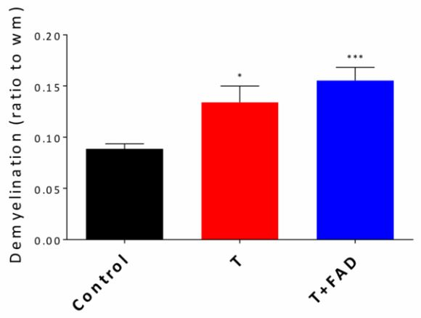
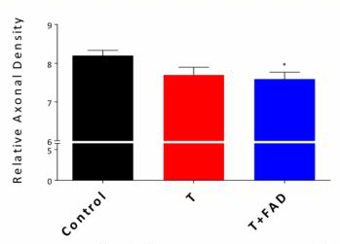
Hormonal effects Timing of administration of androgens alters effect in EAE
Demyelination
Relative axonal density
Testosterone and FAD improved the clinical course in MOG-induced EAE when administered on day 1
However, when administered therapeutically, T and T + FAD worsened demyelination and axonal loss
T, testosterone
FAD, fadrozole, an aromatase inhibitor
David et al. Abstract P858.
Notes:
Notes
Differential androgenic effects on inflammatory and neurodegenerative processes in neuroinflammation
David C et al. Poster P858
Timed hormonal treatments were administered to MOG-induced EAE mice. Different effects were seen depending on the timing of hormone administration.
Testosterone (T) + fadrozole (FAD), an aromatase inhibitor, ameliorated the disease course when administered on day 1 of immunization.
However, when administered later on, T + FAD exacerbated the chronic disease course.
Slide:
(Left) T and T + FAD administered later on significantly increased demyelination in spinal cord white matter and (right) decreased relative axonal density.

Slide 9
Hormonal effects Effect of estrogens in MS
OC use: Lower ARR in past OC users vs. never-users (0.27 vs. 0.46, p=0.02) in CLIMB cohort; trend to lower ARR with current OC use (Bove et al. Abs. P320)
Ovarian age: Lower anti-Müllerian hormone levels associated with decreased cortical GM volume and increased EDSS score over a 10-year period (Graves et al. Abs. 201)
Menstrual symptoms: 16.7% of survey respondents reported worse MS symptoms during menstruation; this subgroup was more likely to use a cane (47.2% vs. 36.0%, OR 1.40) and started using a cane at a younger age (40 yrs vs. 45.4 yrs) (Kavak et al. Abs. P323)
OC, oral contraceptive; ARR, annualized relapse rate
CLIMB, Comprehensive Longitudinal Investigation of MS at Brigham and Women’s Hospital
Bove et al. Abstract P320. Graves et al. Abstract 201. Kavak et al. Abstract P323.
Notes:
Notes
Oral contraceptive use
Analysis of 179 patients in the CLIMB cohort receiving an injectable DMT. OC use was classified as past, current or never.
Mean age was 40.3 years (past), 31.6 years (current) and 38.1 years (never). Mean disease duration was 1.3 years for all groups. Median baseline EDSS was 1.0 for all groups.
Annualized relapse rate (ARR) was lower among past OC users compared to never OC users (0.27 vs. 0.46, p=0.020). ARR was lower in current vs. never OC users (0.43 vs 0.46, p=0.75), differences were not significant.
Current or past OC use was associated with a trend to a lower risk of reaching a higher EDSS score.
Ovarian age
10-year follow-up of women with MS and healthy controls
Levels of anti-Mullerian hormone (AMH) were measured at baseline, and years 3, 5, and 8-10; results were adjusted for age, disease duration, smoking, race/ethnicity, vitamin D level, DMT use, pregnancy, birth control, and hormone replacement therapy.
AMH levels were similar in women with MS and healthy controls. This indicates that there is no reduction in follicular reserve in women with MS.
However, lower AMH levels were associated with decreases in total and cortical gray matter volumes, and an increase in EDSS score in multivariate analysis.
Menstrual symptoms
Survey of 443 women registered with the New York State MS Consortium
16.7% reported that their MS symptoms worsened during their menstrual period
This subgroup were significantly younger at MS onset (25.4 vs. 30.5 years) and younger at diagnosis (32.1 vs. 35.4 years) vs. those not reporting worse MS symptoms during menstruation; no significant differences between the two groups with respect to disease duration, OC use or pregnancy
Worse MS during menstruation was associated with an increased risk of using an assistive device (47.2% vs. 36.0%, OR 1.4, p=0.029), and earlier use of an assistive device (40.0 vs. 45.4 years), suggesting a worse disease course.

Slide 10
Emerging concepts – MOG Ab disorders
MOG antibodies may be found across a range of demyelinating diseases: NMOSD, ADEM, ON, MS, etc.
MOG almost exclusively expressed in CNS; located on outermost layer of myelin → easy access for potential pathogenic autoantibody binding
Differential diagnosis may be challenging
MOG Ab disease
Male:female ratio ~1:1; younger age of onset; ON predominant; generally more favourable outcome vs. AQP4-Ab disease
Common phenotypes at presentation: myelitis (espec. adult), encephalopathy (espec. pediatric), unilateral ON
Common brain MRI findings: large, fluffy, bilateral lesions, often in brainstem, cerebellar peduncles, basal ganglia and thalamus
MOG, myelin oligodendrocyte glycoprotein; NMOSD, neuromyelitis optica spectrum disorder; ADEM, acute disseminated encephalomyelitis; ON, optic neuritis
Palace et al. Abstract 105. Cobo-Calvo et al. Abstract P809.
Notes:
Notes
Patients with demyelinating diseases, including neuromyelitis optica spectrum disorder (NMOSD), acute disseminated encephalomyelitis (ADEM), unilateral or bilateral optic neuritis (ON), and MS have been found to have antibodies against myelin oligodendrocyte glycoprotein (MOG). MOG is a glycoprotein localized to the outermost layer of myelin, which enables easy access for potential pathogenic autoantibody binding.
MOG antibody-related disorders cohort description: common features and uncommon presentations
Cobo-Calvo et al. Abstract P809
Analysis of 27 consecutive adult and pediatric patients with MOG Abs. All were negative for AQP4 Abs.
Median age was 16.8 years. Female:male ratio was 1:0.9.
The most common findings at presentation were myelitis, encephalopathy and ON. Encephalopathy was more common in pediatric patients, myelitis was more common in adults.
59% had abnormal brain MRI. 89.5% had lesions either in the thalamus or basal ganglia.
Bilateral thalamic lesions more common in pediatric patients, and in MOG Ab+ vs. MOG Ab- ADEM patients.

Slide 11
Immunology – Effect on lymphocyte subsets
Emerging importance of the effect of DMTs on T and B cell subsets
Teriflunomide: reduces T cells (CD4+, CD8+) and B cells (CD19+)
Fingolimod: reduces CD19+ B cells and memory B cells
DMF:
Reduces CD8+ T cells >> CD4+ T cells; 1.4-fold increase in CD4+/CD8+ ratio
Integrated safety analysis: mean ALC reduced 30% in year 1
Lymphopenia ≥6 months: severe 2.5%, moderate 10.9%
Retrospective study (n=155) reported that 21% of DMF-treated patients had grade 3-4 CD8+ lymphopenia (≤100 mm³), including 9% with grade 1 lymphopenia (ALC ≥800 µL) but severe CD8+ lymphopenia
Wiendl et al. Abstract P1044. Blumenfeld et al. Abstact 47. Fox et al. Abstract P716. Ghadiri et al. Abstract P652.
Notes:
Notes
Characterizing the impact of teriflunomide on adaptive immune cell subsets, repertoire, and function in patients with relapsing-remitting MS: TERI-DYNAMIC
Wiendl et al. Abstract P1044
TERI-DYNAMIC is a phase IIIb study in RRMS patients treated with teriflunomide for 24 weeks
N=50; median baseline EDSS score 1.5; most previously treated with an injectable DMT
Teriflunomide reduced the absolute number of lymphocytes, the % of CD19+ B cells, and reduced the number of CD4+ and CD8+ T cells
The relative of effect on T cell subsets was CD8+>CD4+, resulting in an increase in the CD4+/CD8+ ratio
There was an increase in the number if inducible Tregs; a decrease in Th17 cell number; and an increase in the Treg/Th17 ratio.
Immunomodulatory effects of fingolimod on B cell phenotype and functional profile during treatment of patients with multiple sclerosis
Blumenfeld et al. Abstract 47
Analysis of PBMCs in MS patients after 3 months of fingolimod.
Absolute reduction in the number and proportion of CD19+ B cells, and CD4+ T cells, a reduction in the proportion of CD27+ memory B cells, and an increase in the proportion of naïve and transitional B cells.
Decrease in the proportion of B cells expressing antigen presentation markers (ICAM).
Reduction in B cell inflammatory cytokines, such as IFN-gamma, TGF-beta and IL-6.
DMF induces differential apoptosis of T cell subsets and leads to a shift in the regulatory to effector T cell balance in MS patients
Ghadiri et al. Abstract P652
Blood samples obtained every 3 months from MS patients treated with DMF
Reduction in total lymphocyte count especially in the first 6 months
Preferential reduction in CD8+ vs. CD4+ T cells, resulting in a 1.4-fold increase in CD4+/CD8+ ratio
Greater decrease in memory vs. naïve T cells; and effector vs. regulatory T cells
DMF-induced apoptosis: CD8+ vs. CD4+ (79% vs. 39%); memory vs. naïve T cells (CD4+ 73% vs. 18%, CD8+ 92% vs. 8%); and effector vs. regulatory T cells (42% vs. 6%)
Supporting data presented by Mao-Draayer, abstract P430.
Absolute lymphocyte count and lymphocyte subset profiles during long-term treatment with delayed-release dimethyl fumarate in patients with relapsing-remitting multiple sclerosis
Fox et al. Abstract P716
Integrated analysis of data from phase 2, phase III (DEFINE, CONFIRM) and extension (ENDORSE) studies, n=2470. ALC assessed at weks 4, 8, 12 and at least every 12 weeks thereafter
Mean ALC decreased 30% then plateaued, remaining above the lower limit of normal (0.91 x 10⁹/L).
Among those treated for at least 6 months, 2.5% had severe lymphopenia (< 0.5 x 10⁹/L) persisting for >6 months; 10.9% had persistent moderate lymphopenia (< 0.8 x 10⁹/L).
T cells (CD8+ > CD4+) were preferentially reduced relative to B cells and NK cells
9% of multiple sclerosis patients taking dimethyl fumarate have a severe reduction in CD8+ T lymphocytes but have only grade 1 lymphopenia when measured as absolute lymphocyte count
Spinelli et al. Abstract P703
Retrospective single-centre study of 174 patients receiving DMF in the period 2013-2016; mean age 46.9 years. Average duration of DMF exposure as 25 months.
Mean ALC decreased 27%; 29% had prolonged lymphopenia after DMF discontinuation
CD8+ counts obtained in 155 patients
21% developed severe CD8+ lymphopenia (< 100 mm³), including 12% with CD8+ counts < 50 mm³
9% of patients had grade 1 lymphopenia based on ALC, but grade 3-4 CD8+ lymphopenia
The authors suggested that CD8+ counts may be a better predictor of PML risk than ALC.

Slide 12
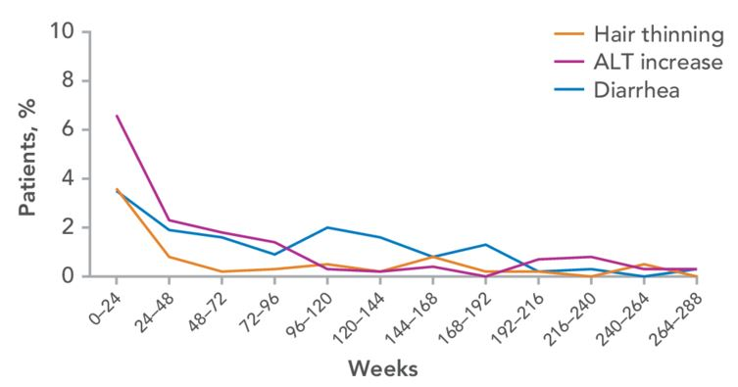
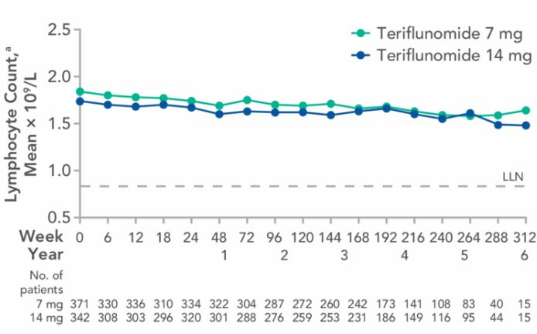
Treatment trials – Relapsing MS TEMSO extension
Hair thinning, liver enzymes and diarrhea
Lymphocyte count
10.8% on continuous teriflunomide 14 mg discontinued due to AEs
Hair thinning, ALT increases and diarrhea were generally mild and rarely led to discontinuation
Lymphocyte counts remained stable over time
Freedman et al. Abstract P692.
Notes:
Notes
Outcomes of the TEMSO extension study of teriflunomide: 10.5 years of clinical results
Freedman et al. Abstract P692
1,086 patients entered the core study, 742 patients (68.3%) entered long-term the extension
68% of patients on teriflunomide 14 mg/14 mg were relapse-free during the extension
EDSS scores remained stable (data not reported)
The overall rate of discontinuations due to AEs was 12.6%; and 10.8% for the teriflunomide 14 mg/14 mg group
Hair thinning, ALT increases and diarrhea were generally mild, resolved with continued treatment, and were rarely associated with treatment discontinuation
Mean lymphocyte counts remained stable over time; mean counts remained within normal limits

Slide 13
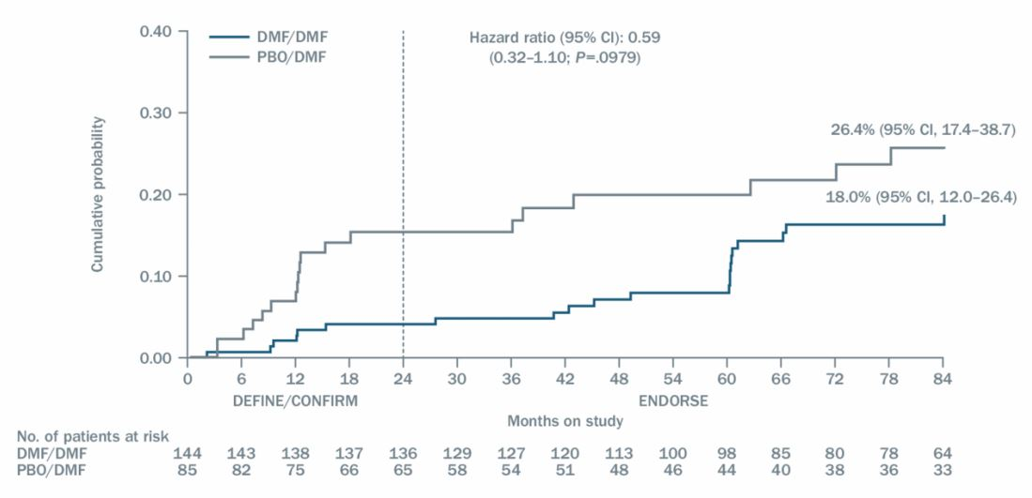
Treatment trials – Relapsing MS ENDORSE extension
Proportion of newly-diagnosed subgroup with 6-month confirmed disability progression
7-year data for the subgroup of newly-diagnosed patients
ARR 0.13 for pts on DMF 240 mg BID
% with 6-month confirmed disability progression was 18% for DMF/DMF group
Majority of DMF/DMF group were free of relapses (61.8%) and disability progression (85.4%)
Gold et al. Abstract P631.
Notes:
Notes
Seven-year follow-up of the efficacy of delayed-release dimethyl fumarate in newly-diagnosed patients with relapsing-remitting multiple sclerosis: integrated analysis of DEFINE, CONFIRM and ENDORSE
Gold et al. Abstract P631
Integrated analysis of the subgroup of newly-diagnosed RRMS patients from phase III studies (DEFINE, CONFIRM) who entered the ENDORSE extension
There were 678 newly-diagnosed patients in DEFINE/CONFIRM; total ITT population was 2,301.
The present analysis includes 229 patients remaining on study (34% of newly-diagnosed subgroup): DMF/DMF, n=144; and Placebo/DMF, n=85. Patients randomized to glatiramer acetate in CONFIRM were excluded from the analysis.
ARR at year 7 was 0.13 for the DMF/DMF group and 0.16 for the placebo/DMF group.
The estimated proportion with 6-month confirmed disability progression was 18.0% for DMF/DMF, and 26.4% for Placebo/DMF.
The proportion with no relapses was 61.8% for DMF/DMF, and 55.3% for Placebo/DMF.
The proportion with no 6-month confirmed disability progression was 85.4% for DMF/DMF, and 77.6% for Placebo/DMF.
The proportion with no relapses and no 6-month confirmed disability progression was 54.9% for DMF/DMF, and 48.2% for Placebo/DMF.

Slide 14
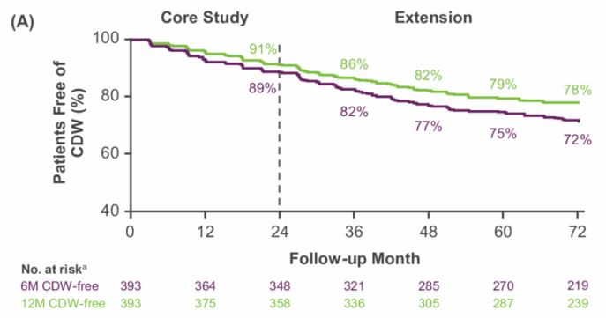
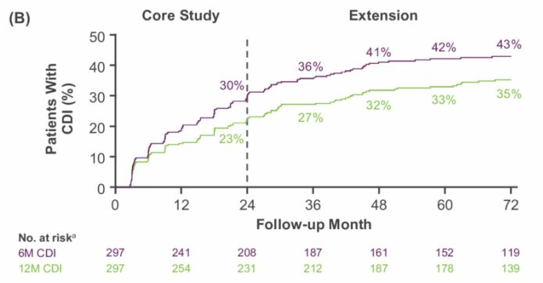
Treatment trials – RRMS CARE-MS II extension
% free of 6-month confirmed disability progression
% with 6-month confirmed disability improvement
50% received only 2 courses of treatment
ARR in year 6 was 0.15
72% free of 6-month disability progression; 43% with 6-month confirmed improvement
77% had stable or improved EDSS score
Fox et al. Abstract P1150.
Notes:
Notes
Efficacy of alemtuzumab is durable over 6 years in patients with active relapsing-remitting multiple sclerosis and an inadequate response to prior therapy in the absence of continuous treatment
Fox et al. Abstract P1150
6-year extension of the CARE-MS II trial in RRMS patients previously treated with a DMT
81% of patients completing the core study have remained in the extension
50% received no additional therapy after the initial 2 courses of alemtuzumab
ARR in year 6 was 0.15
72% were free of 6-month confirmed disability progression
43% achieved 6-month confirmed disability improvement
Mean EDSS increased 0.1 points from baseline to year 6
The proportion with stable or improved EDSS was 77% in year 6
NEDA (cross-sectional): 53% in year 3, 54% in year 4, 58% in year 5, 60% in year 6
NEDA data presented in LaGanke et al. Abstract P681.

Slide 15
Treatment trials – RRMS Alemtuzumab: Safety results – Autoimmunity
6-year analysis of autoimmunity in CARE-MS I & II + extensions¹
Most autoimmune AEs were mild or moderate
Serious autoimmune AEs were uncommon (<2/100 PY)
Thyroid AEs: peaked in Year 3
Cumulative: 42.3% at 6 years
ITP: peaked in year 4
Cumulative 2.6% at 6 years
ITP rate of 2.6% also reported in a real-world study in the UK (n=235)²
Nephropathy: cumulative rate 0.2% at 6 years
No patients withdrew from the extension studies due to autoimmune AEs
1. Vermersch et al. Abstract 168. 2. Pace et al. Abstract P1260.
Notes:
Notes
Autoimmunity in patients treated with alemtuzumab for relapsing-remitting multiple sclerosis: 5-Year follow-up of the CARE-MS studies
Vermersch P. Abstract 168.
Analysis of autoimmunity in patients receiving 2 courses of alemtuzumab 12 mg in the CARE-MS I and CARE-MS II core studies + extensions.
Thyroid function was tested q3months; CBC with platelets monthly with symptom monitoring for immune thrombocytopenia (ITP); and serum creatinine and urinalysis monthly.
Most autoimmune AEs were mild or moderate in intensity.
Serious autoimmune AEs were uncommon (67 events; 1.8/100 patient-years over 5 years).
The most common autoimmune AEs were thyroid Aes. Peak incidence was in Year 3 (227 events; 31.3/100 patient-years).
The cumulative rate of thyroid AEs at 6 years was 42.3%.
Serious thyroid AE rates were low.
Low rate of ITP; peak in year 4. The cumulative rate was 2.6% at 6 years.
Nephropathies: cumulative rate of 0.2% at 6 years.
No patients withdrew from the extension studies due to autoimmune AEs.
A separate study of ITP at three MS centres in the UK reported an ITP rate of 2.6% (Pace et al. ECTRIMS 2016; abstract P1260).

Slide 16
Treatment trials – RRMS OPERA I/II
% NEDA over different time periods
↑ 70%
↑ 47%
↑ 75%
↑ 36%
↑ 57%
p<0.0001 for all comparisons
Giovannoni et al. Abstract P1593.
Notes:
Notes
NEDA epoch analysis of patients with relapsing multiple sclerosis treated with ocrelizumab: Results from OPERA I and OPERA II, phase III studies
Giovannoni et al. Abstract P1593
Analysis of no evidence of disease activity (NEDA), defined as no protocol-defined relapses, 12-week confirmed disability progression, Gd+ lesions or new/enlarging T2 lesions, in the phase III OPERA I and II trials of ocrelizumab 600 mg q24 wk vs. IFNβ‐1a 44 µg tiw.
NEDA results during different time periods are shown on the slide.
In the subgroup with disease activity in weeks 0-48, 79.8% in the ocrelizumab group and 44.4% in the IFN group achieved NEDA during weeks 48-96 (i.e. NEDA was rebaselined to week 48).

Slide 17
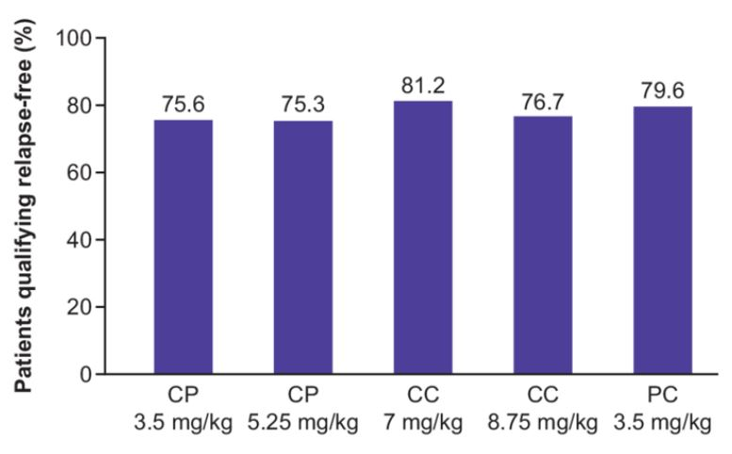
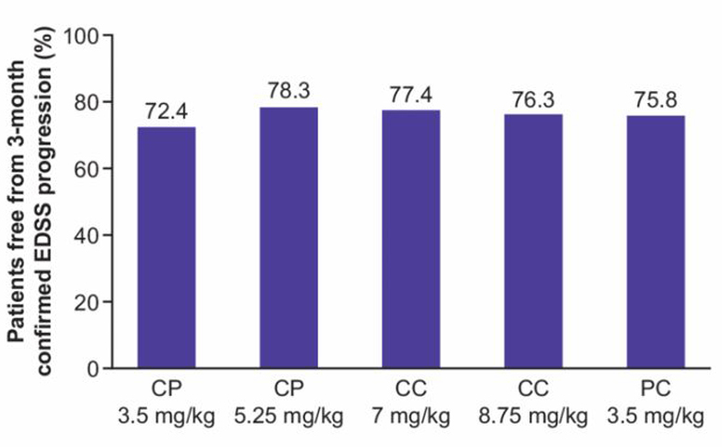
Treatment trials – Relapsing MS CLARITY extension
% relapse-free
% free of 12-wk disability progression
A high proportion of patients had no clinical disease activity for up to 6.5 years after study entry with oral cladribine
Giovannoni et al. Abstract P636.
Notes:
Notes
Benefits of cladribine tablets on the proportion of patients with multiple sclerosis free from clinical and radiological indicators of disease activity in the clarity extension study
Giovannoni et al. Abstract P636
In the CLARITY trial, relapsing MS patients were randomized to placebo or one of two courses of cladribine: 3.5 mg/kg or 5.25 mg/kg cumulative dose over two years. Cladribine was administered in weeks 1 and 5; the second course was administered a year later.
There was a mean 41-week treatment gap prior to the extension. For the extension, there were 5 treatment groups. Patients in the cladribine 3.5 mg group were randomized to continue on cladribine 3.5 mg (CC 7 mg/kg group) or to placebo (CP 3.5 mg/kg). Patients in the cladribine 5.25 mg group were randomized to cladribine 3.5 mg (CC 8.75 mg/kg) or to placebo (CP 5.25 mg/kg). Patients in the placebo group received cladribine 3.5 mg/kg (PC 3.5 mg/kg).
The proportion of patients free of relapses and disability progression was comparable across treatment groups.
There were significant differences between groups for MRI results (data not shown). The % with no new Gd+ lesions was 73.0% for CP3.5, 80.2% for CP5.25, 88.9 for CC7, 89.9% for CC8.75, and 85.1 for PC3.5.
The effect of the duration of the treatment gap prior to the extension was also analysed. The proportion of patients with no new Gd+ lesions was 87.5% with a treatment gap < 4 weeks (n=9); 77.3% with a treatment gap of 4-43 weeks (n=47); and 64.9% with a treatment gap >43 weeks.

Slide 18
Treatment trials – Relapsing MS Oral cladribine safety analysis
Adverse Event | Adjusted AE/100 patient-years
 | Cladribine 3.5 mg/kg (n=923) | Placebo (n=641)
AE leading to discontinuation | 2.07 | 1.05
Number with serious AEs | 4.00 | 3.57
Number with AEs leading to death | 0.25 | 0.25
Lymphopenia Serious Leading to discontinuation | 8.88 0.11 0.89 | 1.16 0 0.04
Infections/infestations Severe infection Herpes zoster | 24.93 0.09 0.83* | 27.05 0.05 0.20
Neoplasms (benign, malignant, unspecified) | 1.14** | 1.01
*reported more often in patients with grades 3-4 lymphopenia
**no clustering of malignancies with a common etiology; no hematological malignancies observed
Cook et al. Abstract P644.
Notes:
Notes
Cladribine tablets in the treatment of patients with multiple sclerosis: an integrated analysis of safety from the multiple sclerosis clinical development program
Cook et al. Abstract P644
Integrated safety analysis of safety data from trials of cladribine 3.5 mg/kg (n=923) or placebo (n=641). Data derived from CLARITY, CLARITY Extension, ORACLE-MS and the PREMIERE registry
Total exposure was 3432.65 patient-years. Mean duration on therapy was 194 weeks for cladribine, and 165 weeks for placebo. Mean patient age was 36.5 years.
Lymphopenia was expected from the mode of action of cladribine.
There was no evidence of an increased risk of infections or neoplasms.

Slide 19
Real-world & observational studies Retrospective analysis of Canadian claims data
Discontinuation rates at 12 months
(n=1,131) (n=516) (n=1,773) (n=482) (n=5,073)
Analysis of private claims data in Canada (n=8975), Jan 2012 - Oct 2015
BRACE=Betaseron, Rebif, Avonex, Copaxone and Extavia.
Duquette et al. Abstract P374.
Notes:
Notes
A retrospective claims analysis: compliance and discontinuation rates among canadian MS patients treated with disease-modifying therapies - Canadian real world experience
Duquette et al. Abstract P374
Analysis of Canadian private claims data for the period 2012-2015.
All subjects filled at least one prescription for fingolimod, teriflunomide, DMF, natalizumab or an injectable. BRACE=Betaseron, Rebif, Avonex, Copaxone and Extavia.
Compliance data were collected for 11,348 patients: fingolimod (1476), DMT (2800), teriflunomide (1113), natalizumab (589), and BRACE (5370).
Compliance rates over a 6-month period were 77% for fingolimod and teriflunomide, 62% for DMF, 69% for natalizumab, and 55% for BRACE. Compliance was defined as medication possession ratio (MPR) >80%.
The 6-month discontinuation rates were 24% for fingolimod and teriflunomide, 27% for DMF, 34% for natalizumab, and 48% for BRACE.
The 12-month discontinuation rates are shown on the slide.
The 24-month discontinuation rates were 26% for fingolimod (n=518), 36% for DMF (n=376), 53% for natalizumab (n=276), and 58% for BRACE (n=2904). Data for teriflunomide not presented.

Slide 20
Real-world & observational studies Comparative studies – 1 of 2
Comparators | Data source | Results
DMF vs. injectables | Swedish Drug Registry, n=2149 | 1-yr adherence DMF 76% vs. GA 66% vs. IFN 52% (PDC) DMF 94% vs. GA 93% vs. IFN 70% (MPR)
DMF vs. fingolimod | Single centre, n=775 Treatment 1 year
 | 1st-line use (n=55) | Relapses: DMF 12.5% vs. Fingo 11.8% New T2 lesions: DMF 12.5% vs. Fingo 6.7% Gd+ lesions: DMF 6.3% vs. Fingo 0% Discontinuation: DMF 32% vs. Fingo 23%
 | 2nd-line use (n=720) | Relapses: DMF 14.1% vs. Fingo 11.3% New T2 lesions: DMF 18.2% vs. Fingo 13.1% Gd+ lesions: DMF 10.1% vs. Fingo 6.9% Discontinuation: DMF 33% vs. Fingo 25%
Fingolimod vs. DMF | Single centre, n=809 | 1-yr discontinuation: Fingo 19.6% vs. DMF 25.2%
PDC, Proportion of Days Covered; MPR, medication possession ratio
Berglund et al. Abstract P649. Hersh et al. Abstract P657. Vollmer et al. Abstract P1049.
Notes:
Notes
Comparative analysis of adherence and persistence for delayed-release dimethyl fumarate versus interferons and glatiramer acetate - a population based study in Sweden
Berglund et al. Abstract P649
Analysis of patients in the Swedish Drug Prescribed Registry for the period January 2013 to February 2016. Data obtained for patients prescribed dimethyl fumarate (DMF), interferons (IFN β-1a or β-1b) or glatiramer acetate (GA). N=2149: DMF, n=1076, GA, n=268 and IFN, n=805.
Adherence evaluated by the Proportion of Days Covered (PDC), defined as total number of days with pill coverage divided by the number of days.
The medication possession ratio (MPR) was also used to evaluate adherence.
PDC results are shown on the slide. Mean MPR: 94% for DMF, 93% for GA and 70% for IFNs.
Comparative efficacy and discontinuation of dimethyl fumarate and fingolimod as first line and second line therapy in clinical practice
Hersh et al. Abstract P657
Single-centre analysis of discontinuation rates for patients prescribed DMF or fingolimod at 1 year. Most DMF and fingolimod prescriptions were for patients who had received prior therapy.
DMF, 1st line n= 38; 2nd line n= 420. Fingolimod, 1st line n= 17; 2nd line n= 300. Results on slide.
Comparison of fingolimod and dimethyl fumarate in the treatment of multiple sclerosis: one year experience
Vollmer et al. Abstract P1049
Single-centre retrospective study of patients prescribed fingolimod (n=317) or DMF (n=492) prior to 2014. Mean disease duration was 11 years for both groups. Proportion relapsing: fingolimod 6.3%; DMF 6.6%. 1-year discontinuation rate: fingolimod 19.6%, DMF 25.2%; adjusted odds ratio 1.548. Discontinuation due to adverse events: fingolimod 12.3%, DMF 16.3%. Discontinuation due to new disease activity: fingolimod 3.8%, DMF 6.5%. Median time to discontinuation: fingolimods 5 months, DMF 4 months.

Slide 21
Real-world & observational studies Comparative studies – 2 of 2
Comparators | Data source | Results
Fingolimod vs. DMF | MSBase registry | Risk of 1st relapse: HR 1.15 favouring Fingo Risk of 6-month discontinuation: HR 2.39 favouring Fingo
DMF vs. IFN |  | Risk of 1st relapse: HR 0.74 favouring DMF Risk of 6-month discontinuation: HR 1.40 favouring IFN
DMF vs. glatiramer acetate |  | Risk of 1st relapse: HR 0.72 favouring DMF Risk of 6-month discontinuation: HR 1.18 (no difference)
DMF vs. teriflunomide |  | Risk of 1st relapse: HR 0.66 favouring DMF Risk of 6-month discontinuation: HR 0.95 (no difference)
Alemtuzumab vs. IFN, fingolimod and alemtuzumab | MSBase registry 5-year outcomes | ARR 0.2 with ALE vs. 0.5 with IFN; lower risk of CDP vs. IFN ARR 0.15 with ALE vs. 0.3 with fingolimod ARR 0.2 – no difference between alemtuzumab and natalizumab No difference in CDP, alemtuzumab vs. natalizumab Likelihood of EDSS improvement: HR 2.9 favouring natalizumab
CDP, confirmed disability progression
Spelman et al. Abstract P1157. Kalincik et al. Abstract 251.
Notes:
Notes
Comparative analysis of MS outcomes in dimethyl fumarate-treated patients relative to propensity matched fingolimod, interferon, glatiramer acetate, or teriflunomide
Spelman et al. Abstract P1157
MSBase registry, propensity score matching of patients on index DMT for ≥6 months
Primary analyses: time to first relapse; and time to discontinuation. Results on slide.
Comparison of 5-year treatment outcomes between alemtuzumab versus natalizumab, fingolimod and interferon-beta-1a
Kalincik et al. Abstract: 251
MSBase analysis of RRMS patients (n=3936) on treatment for ≥6 months. 3 pairwise comparisons, alemtuzumab (n=189) vs natalizumab (n=1160), fingolimod (n=828) or IFN (n=2155).
Propensity score matching on demographic and clinical characteristics.
alemtuzumab was associated with lower ARR (0.5 vs 0.2, p=10-16) and lower risk of EDSS progression and more likely EDSS reduction in patients with previously highly active MS (hazard ratio(HR)=4, p=0.02). Compared to fingolimod, ARR was lower on alemtuzumab (0.3 vs 0.15, p=10-11). Importantly, no differences in ARR (0.2 both groups, p=0.8) and EDSS progression were found between alemtuzumab and natalizumab. The likelihood of EDSS reduction was higher on natalizumab (HR=2.9, p=10-4).

Slide 22
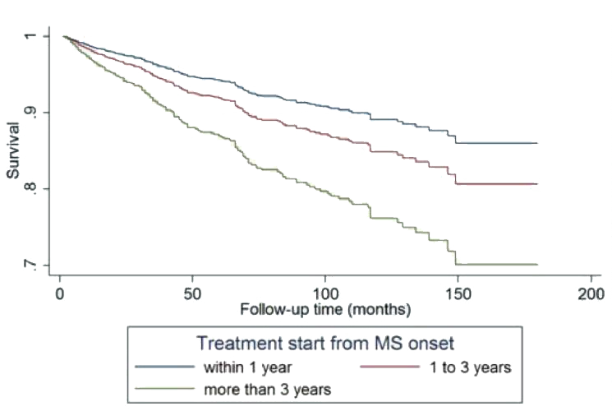
Importance of early treatment
Retrospective analysis of patients treated, 2001-2007 (n=639)
Median follow-up 8.25 years
Risk of EDSS 4 increased 6.7% for every year that treatment was delayed after MS onset
HR 2.43 of reaching EDSS 4 if treatment started 3 years after MS onset vs. within 1 year of diagnosis
Kavaliunas et al. Abstract P1222
Notes:
Notes
Importance of early treatment initiation in the clinical course of multiple sclerosis
Kavaliunas et al. Abstract P1222
Retrospective analysis of 639 patients diagnosed with MS in the period 2001-2007 at two hospitals in Sweden
Median follow-up was 8.25 years
Primary outcome was time from treatment start to EDSS 4
Results: Patients initiated on treatment later had a greater risk of reaching EDSS 4 (hazard ratio of 1.067 (95% CI 1.044−1.091)), increased by 6.7% for every year of delay in treatment start after MS onset. Patients that started treatment after 3 years from MS onset reached the outcome sooner with hazard ratio of 2.43 (95% CI 1.60−3.69) compared with the patients that started treatment within 1 year from MS onset. Similar results were obtained by analyzing time to EDSS 6. Baseline EDSS and age at onset were found to be predictive factors of disability progression. Gender (male) was associated with a greater risk to reach EDSS 6 only.

Slide 23
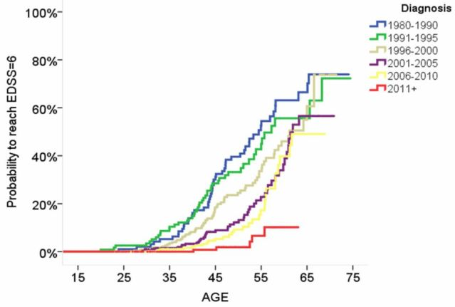
DMTs slow progression to EDSS 6
Retrospective analysis of 1324 RRMS patients treated at a single Italian centre, 1985-2011
Patients diagnosed in more recent periods reached EDSS 6 at an older age
Risk of EDSS 6 was reduced:
15% for the period 1996-2000 vs. 1990
37% for 2001-2005 vs. 1990
46% for 2006-2010 vs. 1990
Proportion of patients reaching EDSS 6 by age 50 years:
27% if diagnosed prior to 2000
15% if diagnosed after 2000
DMTs available in Italy as of 1996
2nd-line agents introduced in 2010
Cordioli et al. Abstract P299.
Notes:
Notes
Estimating the long-term effect of drugs in multiple sclerosis
Cordioli et al. Abstract P299
Retrospective analysis of age at which patients reached EDSS 6 according to year of diagnosis; data for the period 1985-2011. n=1324.
Average age at diagnosis was 35.6 years. Age at diagnosis increased from 32 to 37 years.
Patients diagnosed in more recent periods reached EDSS 6 at an older age. Using the year 1990 as a reference, the probability of reaching EDSS 6 was unchanged for the period 1991-1995, but was reduced by 15% for patients diagnosed in 1996-2000, by 37% for 2001-2005, and by 46% for 2006-2010.
The proportion of patients who reached EDSS 6 by age 50 years was 27% for those diagnosed prior to 2000 vs. 15% after 2000..

Slide 24
Long-term effect of DMTs – Calgary results
 | DMT (n=954) | Non DMT (n=589) | p value | OR
Mean age at 1st visit | 37.7 | 40.1 | <0.00001
Baseline EDSS | 2.21 | 2.28 | 0.32
Years on DMT | 11.2 | 1.2 | <0.00001
EDSS at final visit | 3.17 | 3.62 | 0.0003
EDSS change/year | 0.073 | 0.116 | 0.0001
% EDSS >3* | 46.0% | 52.5% | <0.00001 | 0.41
% EDSS >6* | 21.4% | 29.3% | <0.00001 | 0.37
% deceased* | 3.14% | 5.6% | <0.04 | 0.57
*multivariate analysis
DMT: >5 years/ exposure; Non DMT: <5 years’ exposure
Poliakov et al. Abstract P214.
Notes:
Notes
Effect of disease modifying therapies on long-term multiple sclerosis disability and mortality
Poliakov et al. Abstract 214
Retrospective/prospective study of CIS/RRMS outcomes for patients in the Calgary MS database.
Inclusion criteria included a diagnosis of CIS or RRMS; at least 5 years of follow up, and baseline EDSS < 7.
DMT group defined as cumulative DMT exposure >5 years. Non DMT had < 5 years of DMT exposure. Mean follow-up was 12 years (range: 5.0 to 19.7 years).

Slide 25
Is there a “treatment lag” in progressive MS?
Hypothesized that it may take several years for DMTs to stabilize the disease process and demonstrate a therapeutic effect in progressive MS
Data from the SPECTRIMS trial of IFNβ-1a sc in SPMS and PROMISE trial of glatiramer acetate in PPMS were reanalysed
SPECTRIMS:
2.5-year lag in treatment effect
Significant improvement thereafter, HR 0.65, p=0.041
PROMISE
2-year lag in treatment effect
Significant improvement thereafter, HR 0.42, p=0.044
Additional analyses of failed progressive trials (OLYMPUS, ASCEND) needed
Sormani et al. Abstract 215.
Notes:
Notes
Therapeutic lag: is treatment effect delayed in progressive MS?
Sormani et al. Abstract 215
Hypothesis that in MS patients with substantial disability, it may take several years for DMTs to stabilize disease progression
Post-hoc analysis of the 6-year extension of the SPECTRIMS trial (n=618) of IFNβ-1a SC in SPMS, and the 3-year follow-up of the PROMISE trial (n=943) of glatiramer acetate in PPMS.
IFNβ-1a in SPMS, HR 0.88, p=0.18; GA in PPMS, HR 0.87, p=0.18.
A stepwise selection run independently on the 2 trials indicated 2.5 years as the best cut-off to identify the start of the treatment effect in the SPECTRIMS trial and 2 years in the PROMISE trial.
With a treatment lag (treatment starting its effect after 2.5 years), the HR was 0.65, p=0.041 in the SPECTRIMS trial.
With a treatment lag of 2 years, the HR was 0.65, p=0.044 in the PROMISE trial.

Slide 26
“No evidence of progression” (NEP)
NEP defined as having no 12-week CDP on EDSS; and no 12-week confirmed progression ≥20% on the T25FW and 9HPT
Exploratory analysis of patients receiving ocrelizumab (n=461) or placebo (n=230) in ORATORIO trial of PPMS
Significant increase in the proportion of patients with NEP at week 120 with ocrelizumab vs. placebo (42.7% vs. 29.1%), RR 1.47, p=0.0006
NEP, 12-week CDP – 68.5% vs. 63.0%
NEP, T25FW – 51.0% vs. 38.7%
NEP, 9HPT – 82.2% vs. 71.3%
CDP, confirmed disability progression; T25FW, Timed 25-foot Walk; 9HPT, 9-Hole Peg Test
Montalban et al. Abstract 167.
Notes:
Notes
Evaluation of no evidence of progression using composite disability outcome measures, in patients with primary progressive multiple sclerosis in the ORATORIO trial
Montalban et al. Abstract 167
Post-hoc exploratory analysis of ORATORIO trial of ocrelizumab in PPMS using the composite disability measure of NEP.

Slide 27
ORATORIO – post-hoc analysis of composite disability outcomes
Reduction in disability outcomes with ocrelizumab vs. placebo
N=732
Analysis of cCDP, defined as time to first onset either of CDP on EDSS, ≥20% worsening on T25FW, or ≥20% worsening on 9HPT
CDP, confirmed disability progression; T25FW, Timed 25-Foot Walk; 9HPT, 9-Hole Peg Test
Giovannoni et al. Abstract P746.
Notes:
Notes
An exploratory analysis of 12- and 24-week composite confirmed disability progression in patients with primary progressive multiple sclerosis in the ORATORIO trial
Giovannoni et al. Abstract P746
Analysis of “clinical confirmed disability progression” (cCDP), comprising 12-week confirmed disability progression (CDP), upper extremity function (9-Hole Peg Test) and ambulation speed (Timed 25-foot walk).
cCDP was defined as time to first onset of either CDP, ≥20% worsening on T25FW, or ≥20% worsening on 9HPT sustained for ≥12 or ≥24 weeks.
N=488 on ocrelizumab, n=244 on placebo.

Slide 28
EXPAND trial of siponimod in SPMS
Siponimod is a second-generation sphingosine-1-phosphate (S1P) receptor modulator selective for S1P1/S1P5. Dose is titrated: 0.25 mg/day increased to 2 mg/day
EXPAND trial (n=1651)
Mean age 48 years, mean EDSS 5.4, mean time from SPMS onset 3.8 years (placebo 3.5 years)
Results
Completion rate 83%; median follow-up 21 months
21% reduction in 3-month CDP with siponimod (p=0.013)
26% reduction in 6-month CDP (p=0.006)
% brain volume change from baseline was 23.4% lower over 12 and 24 months vs. placebo (p=0.0002)
Kappos et al. Abstract 250.
Notes:
Notes
Efficacy and safety of siponimod in secondary progressive multiple sclerosis - Results of the placebo controlled, double-blind, Phase III EXPAND study
Kappos et al. Abstract 250
EXPAND is a phase 3, multicentre, randomized, double-blind, parallel-group, placebo-controlled study of siponimod, a second-generation sphingosine receptor modulator, in SPMS..
Additional results for secondary endpoints:
Time to 3-month confirmed worsening >20% in T25FW: risk was reduced by 6.2% (NS)
Change from baseline in T2 lesion volume: mean 79.1% lower change at 12 and 24 months vs. placebo (p<0.0001)
ARR reduced by 55% vs. placebo (p<0.0001).
Background
Siponimod (BAF312) for the treatment of secondary progressive multiple sclerosis (SPMS): baseline characteristics of the EXPAND study population
Kappos et al. ECTRIMS 2015; abstract P649
Inclusion: Patients with initial RRMS followed by progressive increase in disability over at least 6 months with or without occasional relapses, minor remissions, and plateaus; aged 18-60 years; EDSS score 3.0 to 6.5 at screening
Subjects randomized 2:1 to siponimod (6-day dose titration, 0.25 mg increased to 2 mg/day) or placebo
Primary outcome: time to 3-month confirmed disability progression on EDSS
Secondary outcomes: MRI, T25FW, safety.
Enrolled: n=1510 as of March 2015 (full enrollment n=1651)
Mean age at baseline: 47.9 years, 60% female. Median duration since MS diagnosis was 11.6 years. Mean time from conversion to SPMS was 2.6 years,
Mean baseline EDSS: 5.4; 53% with EDSS score of 6.0-6.5.
34.5% had relapses in the 2 years prior to study start.

Slide 29
“Therapeutic inertia”
Therapeutic inertia: the absence of treatment escalation when there is clinical-radiological evidence of disease activity
Clinical-radiological evidence defined as relapse + ≥1 Gd+ lesion
Survey of 96 neurologists: mean age 39.5 years, 53% female, 67% specialized in MS, mean 14 years in practice, mean 20 MS patients seen/week
Therapeutic inertia:
MS specialists – 62.5%
General neurologists – 81.3%
Predictors of therapeutic inertia:
Aversion to ambiguity (preference for known vs. unknown risks)
Lower tolerance to uncertainty
Saposnik et al. Abstract P749.
Notes:
Notes
Therapeutic inertia in multiple sclerosis care: lessons learned from behavioral economics
Saposnik et al. Abstract P749
Therapeutic inertia (TI) is defined as lack of treatment escalation when there is clinical-radiological evidence of disease progression.
A web-based survey of 96 neurologists with expertise in MS in Spain.
Respondents were presented with 20 case scenarios, and were asked to complete three surveys. Standardized tests were used to measure aversion to risk and ambiguity. Ambiguity aversion is a preference for known risks over unknown risks.
TI was present in at least one case scenario in 68.8% of participants.
TI was less common (29.2%) if other criteria for clinical worsening were used.
TI was less common among MS experts (OR 0.29).
Low tolerance to uncertainty was associated with higher prevalence of TI (85.4% vs. 56.4%; adjusted OR 4.48). Aversion to ambiguity was associated with TI (82% vs 52%; adjusted OR 4.2).

Slide 30
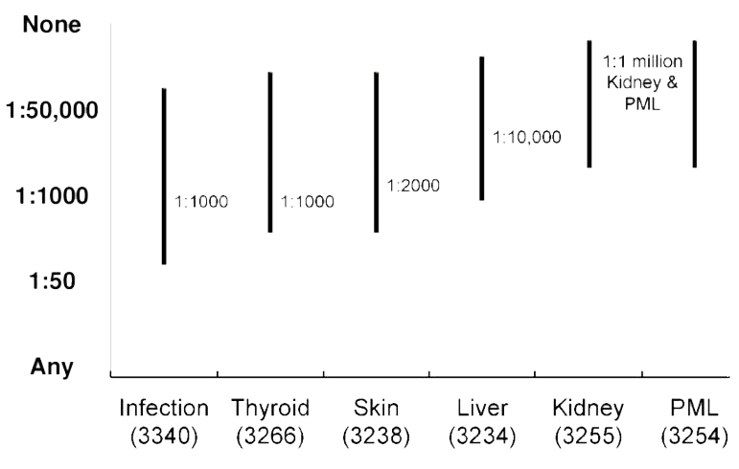
Risk tolerance – the patient perspective
Risk tolerance for different complications
US survey (n=3719) of MS patients about their risk tolerance
Mean age 55.4 years; 78% female; mean duration of MS 16.8 years
89% had been on DMT; 51% currently on DMT
Patients were most willing to accept the risk of infection (possibly requiring hospitalization) and thyroid injury (possibly requiring life-long treatment)
Patients were least willing to accept kidney injury (requiring blood monitoring) and PML
Fox et al. Abstract P1304. .
Notes:
Notes
A survey of risk tolerance to multiple sclerosis therapies
Fox et al. Abstract P1304
Survey of people with MS registered in the NARCOMS database and recruited through the National MS Society website.
Standard Gamble method to identify the highest tolerated risk level for a hypothetical therapy that would reduce rate of clinical relapses by 50% and disability by 30%. Starting point was a risk of 1:1000.
The risk was changed to identify the highest risk tolerated, ranging from “would take regardless of the risk of death” to “no acceptable risk.”
Risks included skin rash or infection (possibly requiring hospitalization), kidney injury (possibly requiring life-long dialysis), thyroid injury (possibly requiring life-long thyroid medication), liver injury (requiring blood monitoring), and progressive multifocal leukoencephalopathy.
N=3719; mean age 55.4 years; 78% female; disease duration 16.8 years, 89% had been on a DMT (51% currently on DMT).
Median risk tolerance for each complication was infection 1:1000; thyroid injury 1:1000; skin rash 1:2000; liver injury 1:10 000; kidney injury 1:1 000 000; and PML 1:1 000 000.

Slide 31
Group Discussion
Copyright 2016 Lind Publishing Inc. All rights reserved.

